Slide 1
Installation and Inspection of Concrete Pipe
Connecting to
Structures
American Concrete Pipe Association
Notes:
Introduction: Who you are, who you work for, title, etc.
We are here to talk about Connecting to structures and all that entails. Most of the discussion that we have today will apply to storm drain applications and are relevant to either the use of a rigid pipe material such as concrete or flexible products such as plastic or metal. I will make a few observations that discuss the differences between rigid and flexible pipe products as it pertains to installation.
My intent is for this to be an interactive discussion where I can share my knowledge of the subject with you and I can learn from the vast knowledge and experience gathered in this room. Hopefully, when we are done we have all gained from the experience. Please remember it is only interactive if you participate.

Slide 2
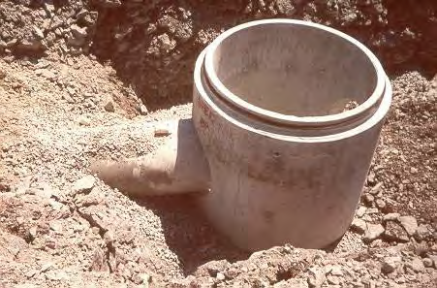
Agenda
Structures
Goal
Challenges
Other
Notes:
The agenda items are on the screen. You will notice that the first item is “GOAL”. We will start by talking about what we hope to accomplish with this presentation and why we are here talking about Connections to fittings.
From there we will discuss how the concrete pipe industry can help provide a quality, long-term product that minimizes risk, liability, and maintenance costs by helping to accomplish our goal.
So, unless there are any questions, lets get into it.

Slide 3
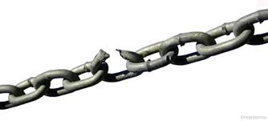
Notes:
We are all familiar with the saying “A chain is only as strong as its weakest link”. If one step or phase in a system fails the whole system is at risk of failure. A pipe line system is no different. It is important to review the system from beginning to end. Find the weak link or links and work to strengthen them.

Slide 4
Scope Connecting a Pipe to a Structure
Notes:
Ask the group to define and provide a scope of what encompasses connecting a pipe to a structure.
What is the function of the connection?
What affects accomplishing this function?
Looking for
Physical connections
Support of pipe and structure – Differential settlement
Adequate Structure size
Other ideas that you haven’t thought of
After you get some answers move on to the next slide

Slide 5
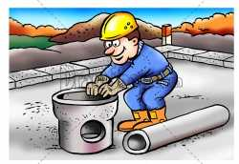
Notes:
A lot of focus is put on the design of a pipe line system. Design includes the hydraulic, structural, environmental, and there could be other design facets that are required for a specific project. Design also includes the writing of specifications and development of details specific to a project, so the design assumptions made by the engineer are relayed to the contractor in a clear format so that he can deliver a quality product. A proper inspection program is also a necessary element to help minimize issues in the field and to again deliver a quality, long-lasting product. Post-installation inspection of installed pipe is a good example of a necessary inspection protocol.

Slide 6
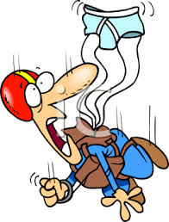
Notes:
However, sometimes the designers vision is not always created in the field. Sometimes overlooking the minor details can result in a big problem.
Structure connections are often one of the details of a system that don’t get adequate review. Most agencies specifications contain some information about structure connections, but often it is limited. Even with specifications that clearly define an acceptable process, is the process always carried out?
I was discussing pipe to structure connections with a City Engineer when he shared with me a personal story with me.
He received a call at home on a Saturday morning informing him that a roadway in his community had been fallen in. He immediately headed to the location and found that one lane of a two lane street had disappeared for a about 50 feet. This resulted in closing the entire street. Upon investigation, it was discovered that the pipe and a structure were still in place with no apparent joint separation or damaged sections. What was found were clear openings around the pipe stubbed into the inlet structure. A 2 inch void that should have been grouted in was left open.

Slide 7
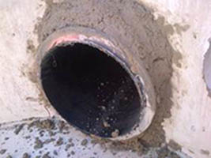
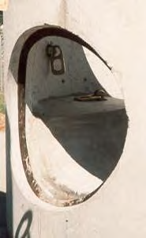
Physical Connection
Notes:
Grouted and booted/gasketed connections are two common methods. To my knowledge, grouted connections are used exclusively in storm applications while rubber connections are used in both sanitary and storm sewer applications.

Slide 8
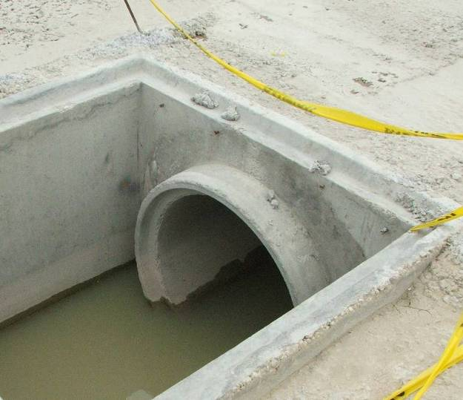
Mortar/Grouted Connection

Slide 9
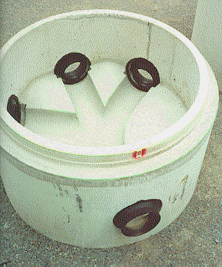
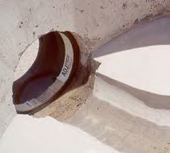
Booted Connectors
Notes:
Flexible Connectors
(also known as Boots)
These are available as a both cast-in and as mechanical fastener
designs as shown in the picture on your right.
• Discussions should be had with your local precaster/manufacturer and connector supplier
for exact design requirements.

Slide 10
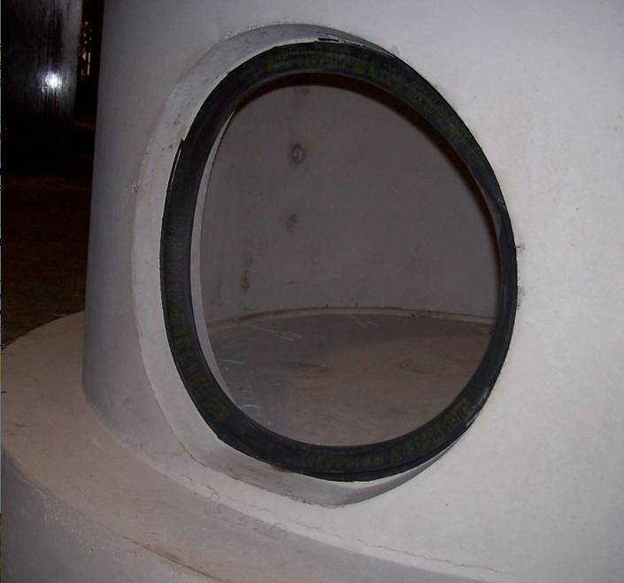
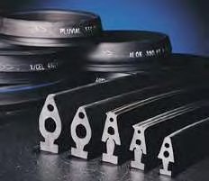
Compression Connectors
Notes:
Compression Type Connectors
Works similar to rubber gasket on concrete pipe. Gasket cast into the structure and provides a seal between structure and pipe. There are several producers of these types of gaskets. Many precasters and/or contractors have a preference for a specific brand or type.
Again, please consult with your local precaster on exact design requirements.

Slide 11
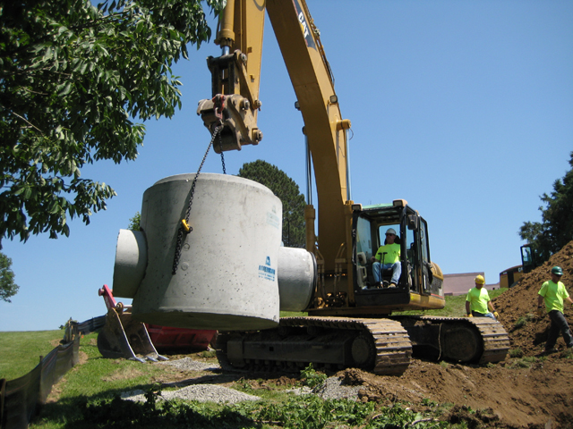
Prefabricated stubs
Notes:
Another option for connecting to a structure is a fabricated stub. How many people are familiar with these?
Many precasters have the motto, if you can draw it, they can build it. Prefabricated pipe stubs are certainly available in many markets.

Slide 12
Challenges
Mortar Connection
Booted/Compression
Pipe Stub
Notes:
As with most things, none of the methods of connecting pipe to structures is perfect. Each has pro’s and con’s and can be dependent on the application and pipe type.

Slide 13
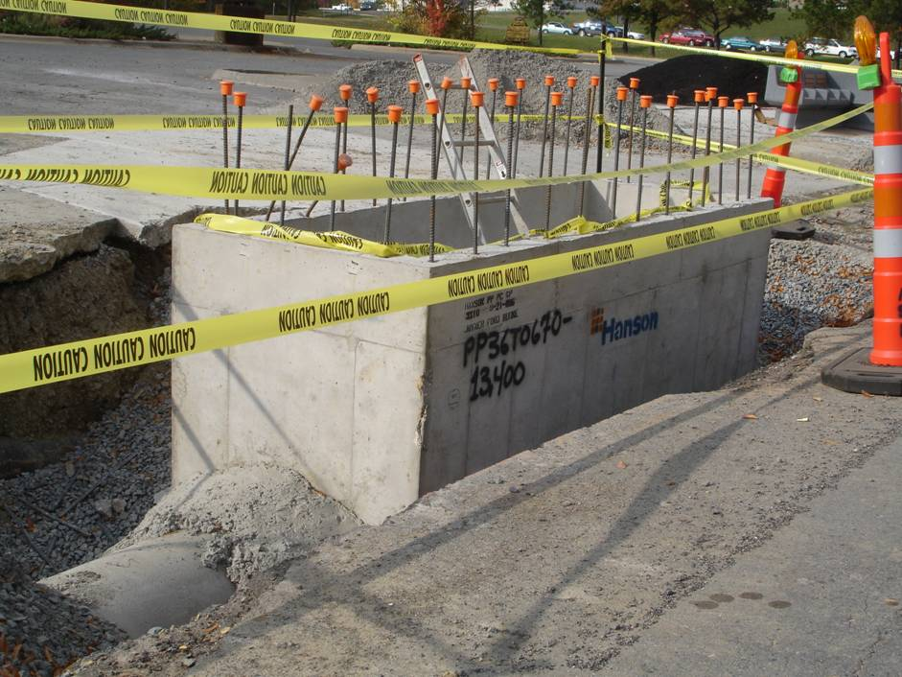
Mortar
Connection
Notes:
What do you think of these pictures?
Cons
Poor quality workmanship
Once it is grouted it is a chore to adjust
Pros
Flexibility to adjust in the field
Cost
Structure size

Slide 14
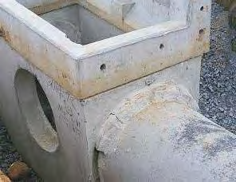
Notes:
There can certainly be no question about the quality of the workmanship on this connection.

Slide 15
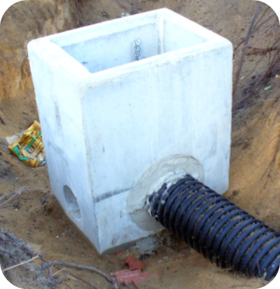
Mortar Connections
Notes:
Another consideration is what type of pipe material can be used with a grouted connection.
A grouted connection is rigid by nature of the material used, typically a non-shrink grout, a cementitious material. If the grout is rigid what happens when a flexible pipe deflects as is inherent in the structural design of a flexible pipe product.
ASTM D 2321 is the installation standard for thermoplastic pipe materials.
Section 7.10 Use flexible water stops, resilient connectors or other flexible connections as approved by engineer…

Slide 16
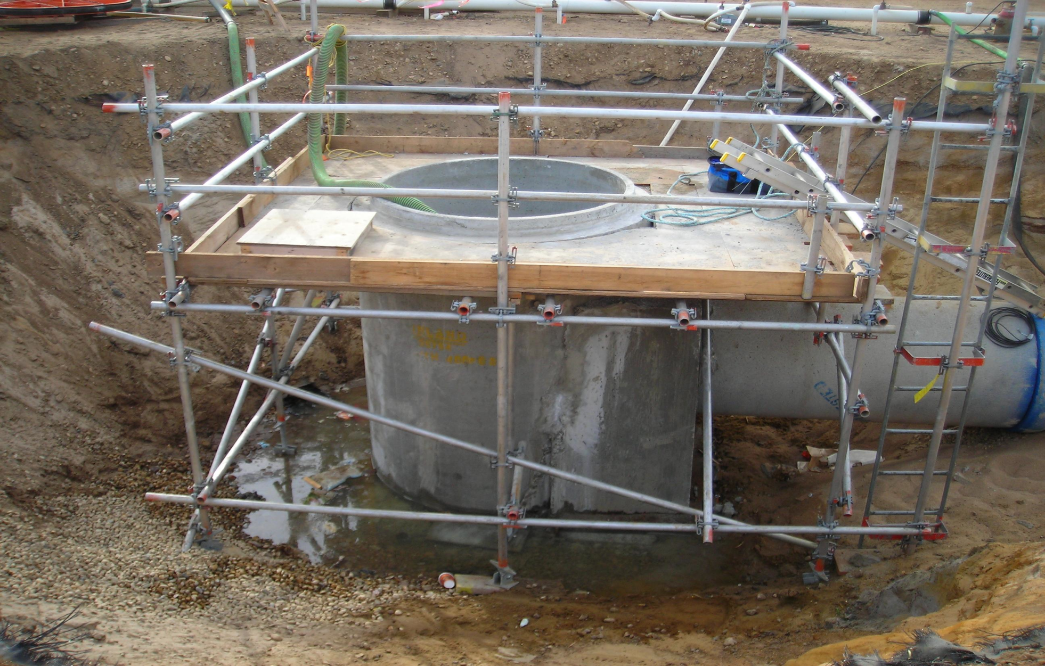
Booted/Compression
Notes:
What are some potential problems or difficulties with booted/compression style gaskets?
Cons
Increased size of structure
Installed incorrectly
Wrong size
Tearing of rubber
COST
Pros
Ability to adjust angle of pipe
Water/soil tight

Slide 17
Prefabricated Pipe Stubs
Notes:
What are the comments on Prefabricated pipe stubs?
Cons
Little flexibility in the field
Cost?
Pros
Time
Plant level Quality Control
Normal pipe joint connection

Slide 18
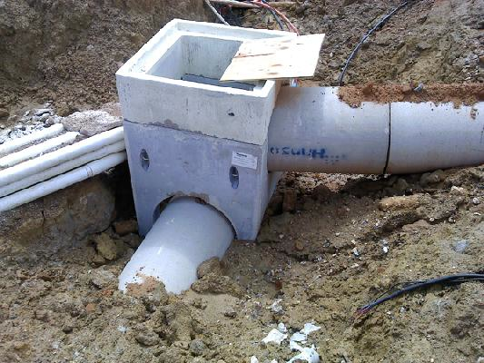
Notes:
What potential problems do you see in this picture?
Looking for
No grout or rubber connector
Potential for differential settlement between pipe and structure
Others?

Slide 19
Sizing Considerations
Notes:
Why is the size of the structure an important aspect of connecting pipe to it?
The structure must be large enough to accommodate the number of pipes, at the given angles, of the give pipe material, with the desired type of connection (Mortar, booted, compression, stub) and still maintain its structural integrity during production, handling, and installation.

Slide 20
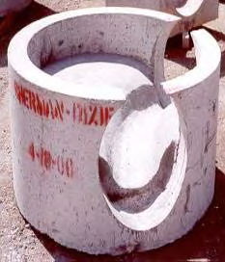
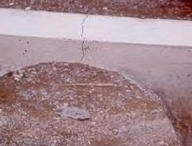
SIZING CONSIDERATIONS
Authorities having jurisdiction may require a minimum amount of concrete above openings.
Notes:
A structure intended for a gasketed connection must have enough concrete above the opening to resist cracking. Also, the pipe cannot be sticking up into the grate or roadway.

Slide 21
SIZING CONSIDERATIONS
O.D. = 30”
W.T. = 3”
Annular Space = 2”
I.D. = 24”
H.S. = 34”
Notes:
A rule of thumb in estimating the required hole size in a precast inlet/manhole is 2” around the outside of the pipe wall. Some booted or gasketed connections may require additional space.

Slide 22
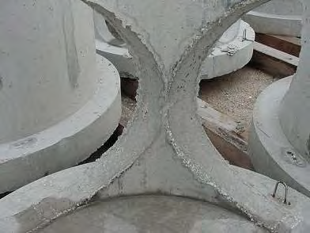
SIZING CONSIDERATIONS
Required minimum structural leg
has not been achieved.
Notes:
Describe and discuss. The amount of wall between holes is the only structural member on that side of the manhole. The structural integrity must be maintained by providing a
minimum structural leg of concrete between pipe holes.
A general rule of thumb is to provide a minimum of 6 inches as measured from the interior of the structure.The manhole is likely to break apart during handling if there is not a structural element. Even if the structure holds together during handling and shipping, it is unlikely to work for a gasketed connection. The pressure from the boot would most likely crack the thin concrete wall. The solution is to provide a larger manhole.

Slide 23
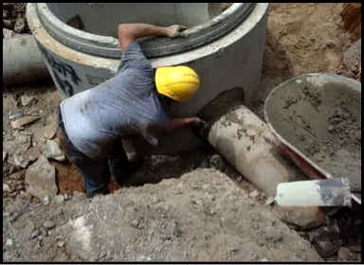
Notes:
• Round structures allow more flexibility in the system design and layout. Various sizes of pipes entering at different angles can more easily be accommodated by a round structure.

Slide 24
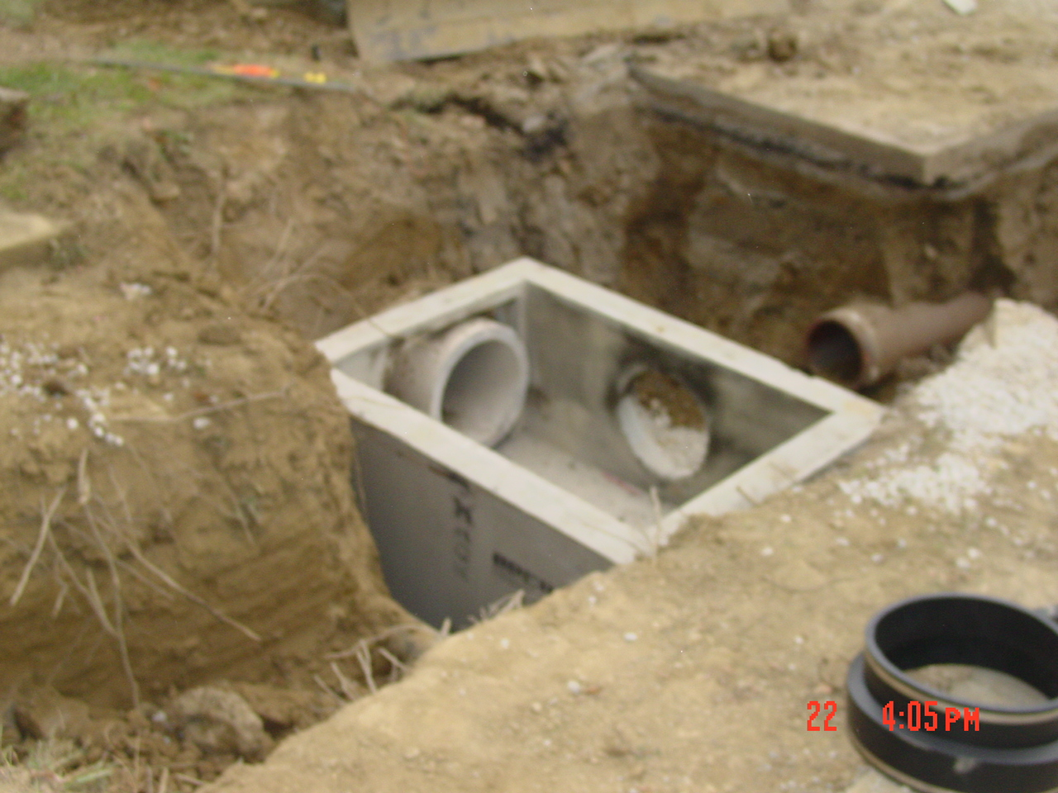
Notes:
Square and/or rectangular structures are typically used where pipes can intercept at 90 degrees or 180 degrees. Most roadways and some stormwater site drainage systems employ these types of structures.
Does anyone see anything interesting in this photo?
A boot is lying on the side of the ditch. It doesn’t appear that the pipe in the top (on your left side) has a boot. Assuming the boot is for the pipe coming in on the right side, why a boot for one pipe and no boot for the other.

Slide 25
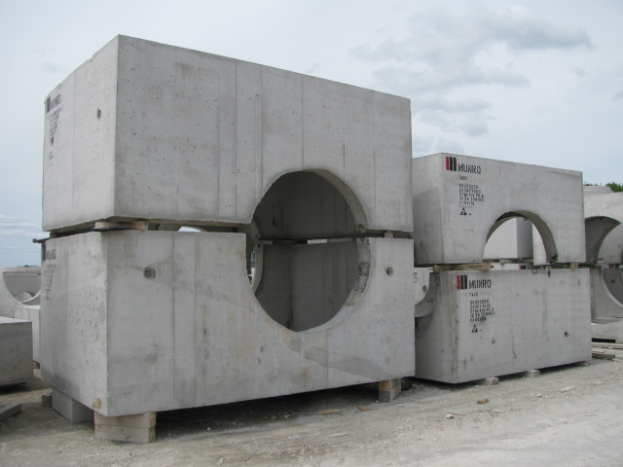
Notes:
When possible, avoid pipes entering into structure joints and corners, as this may compromise the structural integrity of the structure. However, this practice may be necessary for certain installations.
While a minimum thickness of concrete is required around the pipe for a gasketed connection, a grouted connection on pipe utilizing precast structures comprised of two-pieces is possible.
Ask the audience why a structure might be provided in two-pieces?
Size and weight restrictions. Often difficult to produce a structure large enough in one piece and equally difficult to handle at the plant and at the jobsite.
Deep structure with multiple pipe entries
Other
Utilizing a two-piece structure should always be discussed with your local precaster.

Slide 26
Notes:
Do you see potential problems with these field connections? What are they? The picture in the bottom right has numerous problems including the compromised structural integrity of the main line pipe.

Slide 27
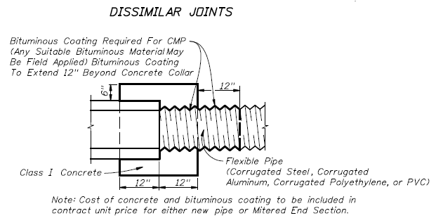
Concrete Pipe
Notes:
Typical detail for field joining concrete pipe with dissimilar pipe materials. A precast fitting can also be provided from a precaster.

Slide 28
Questions????

Slide 29
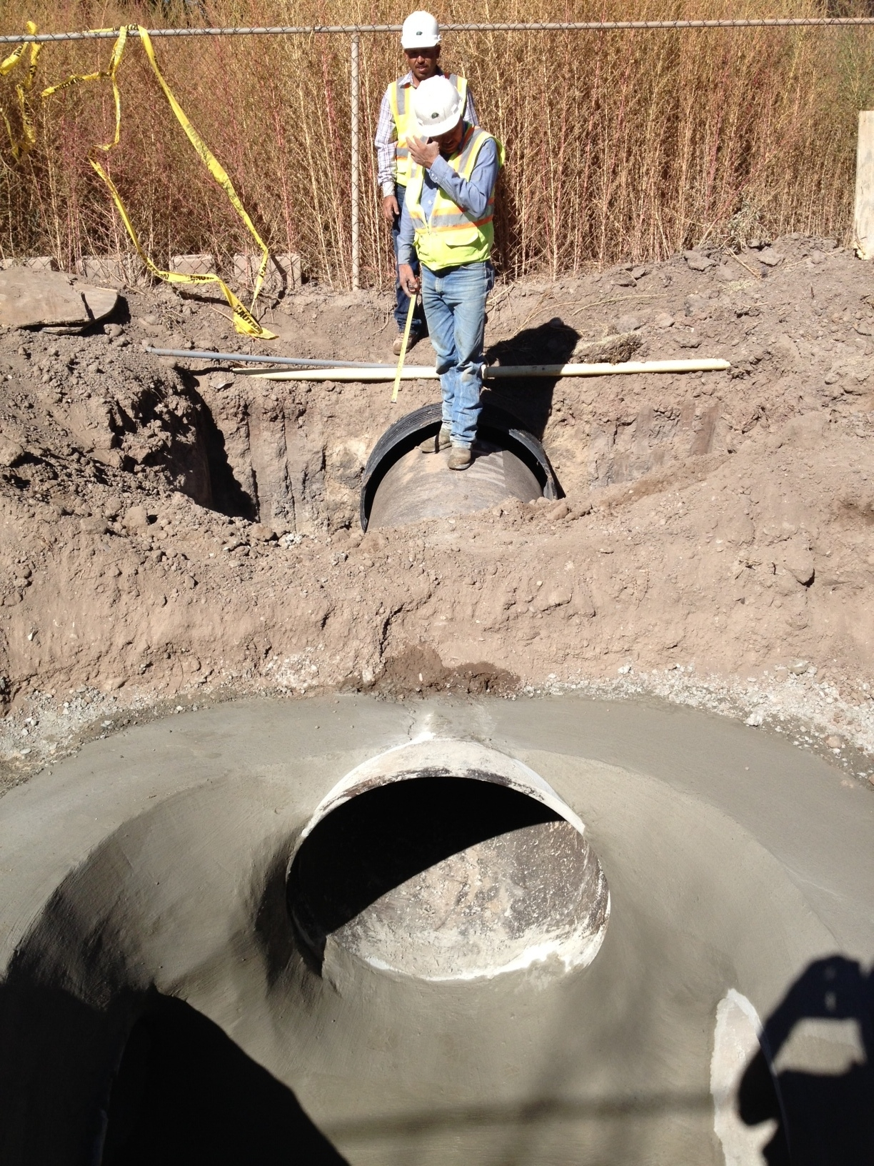

Slide 30
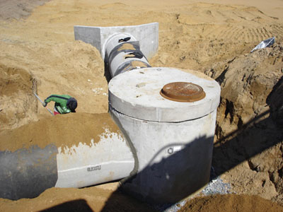
Notes:
Appears to be a great job of filling the void between the pipe and the structure. Is there adequate support under the pipe?

Slide 31
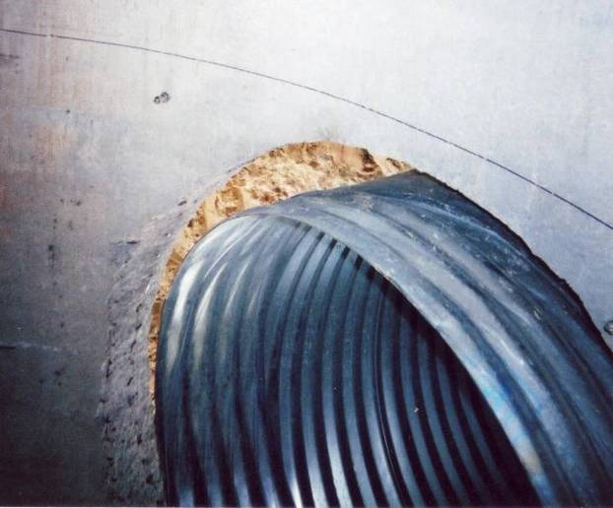
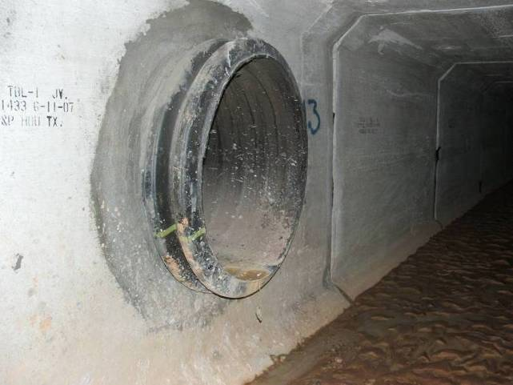
Connections to Structures

Slide 32
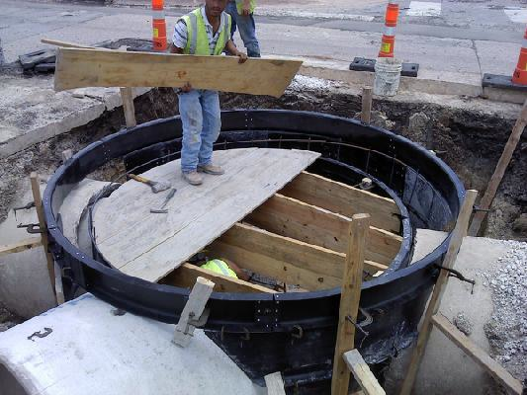
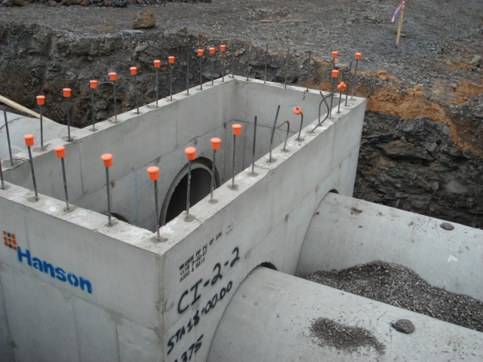
Type and Shape of Structure
Cast-in-Place
Precast

Slide 33
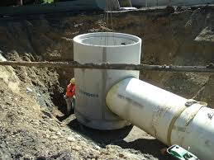

Slide 34
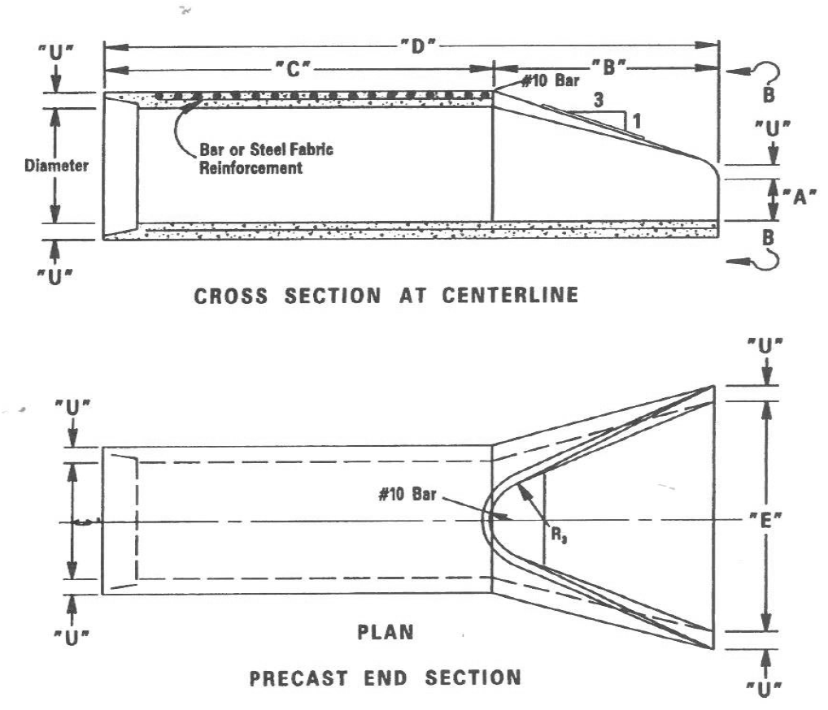
End Sections
34
Precast concrete end sections should be placed with their tongue (or groove) fully entered in the groove (or tongue) of the pipe.
Notes:
The use of concrete flared end sections is common for concrete pipe as well as for other pipe materials. The concrete flared end sections help prevent fire from roadside burning from getting into a combustible pipe as well as suffer less damage from roadside mowing and other maintenance operations. Fully homing the pipe and the flared end section prevents soil migration through the joint. Proper soil support under the flared end section helps prevent “fall off”. Check with your local concrete pipe producer regarding fabricated flared end sections to connect dissimilar pipe types.

Slide 35
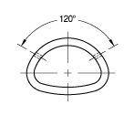
Tie Bars
Notes:
Some agencies require end sections to be connected to the adjoining pipe by the use of tie bars. Tie bars help to prevent the end sections from falling away as the surrounding soil sloughs off. The last few sections of pipe in a run may also be connected by tie bars.

Slide 36
Fittings

Slide 37
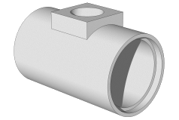
Fittings
Notes:
Your local pipe producer may be able to provide fabricated fittings: wyes, tees, bends, reducers, etc. Proper support of the barrel of both the main line and the stub are necessary. When the pipe or stub have a bell it is necessary to dig out a bell hole.

Slide 38
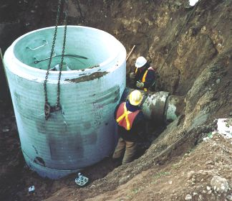

Slide 39
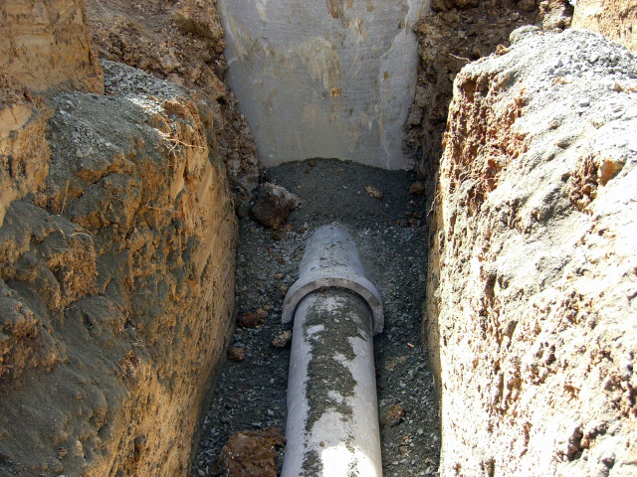

Slide 40
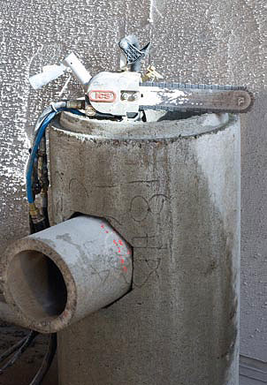

Slide 41
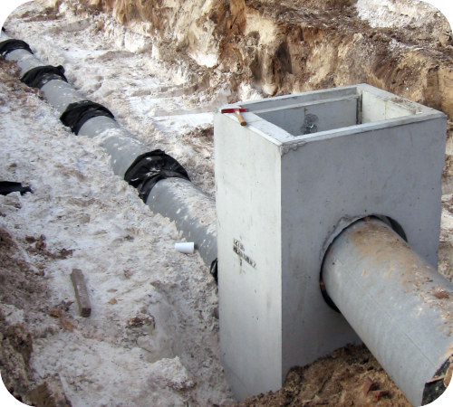

Slide 42
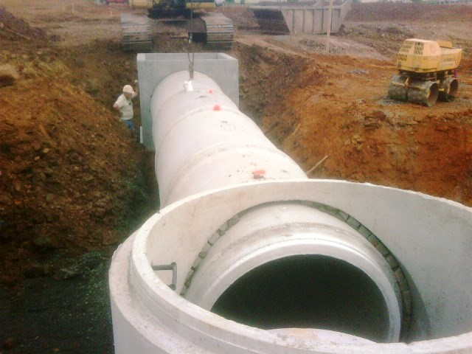

Slide 43
Connections to Structures
Manhole Connections ASTM D 2321, 7.10 Use flexible water stops, resilient connectors or other flexible connections approved by engineer….
Notes:
D 2321 says use booted connection
Note– critical to get good haunch material under this pipe– eliminates “shear” failure

Slide 44
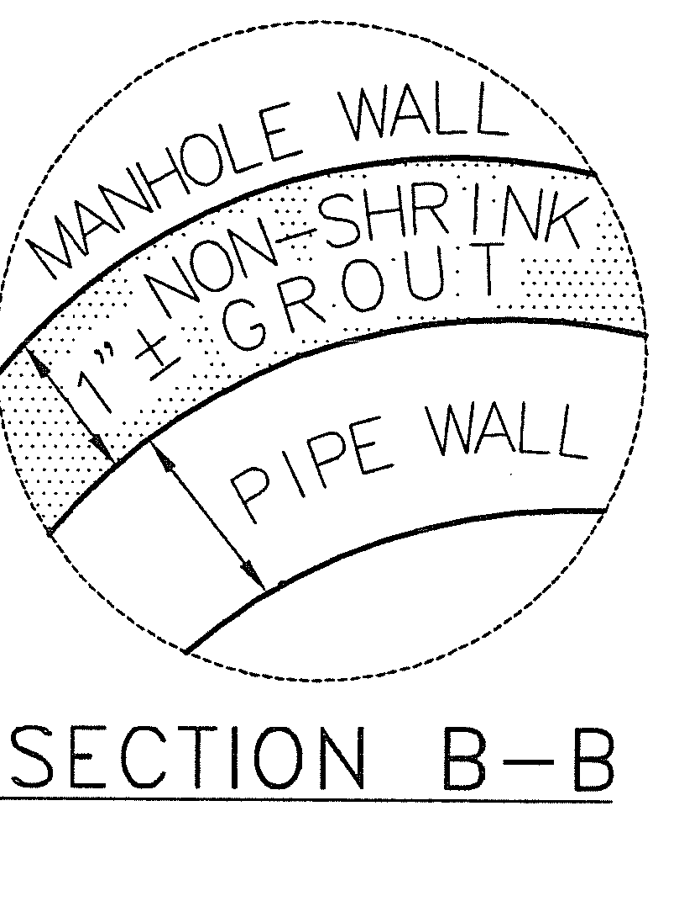
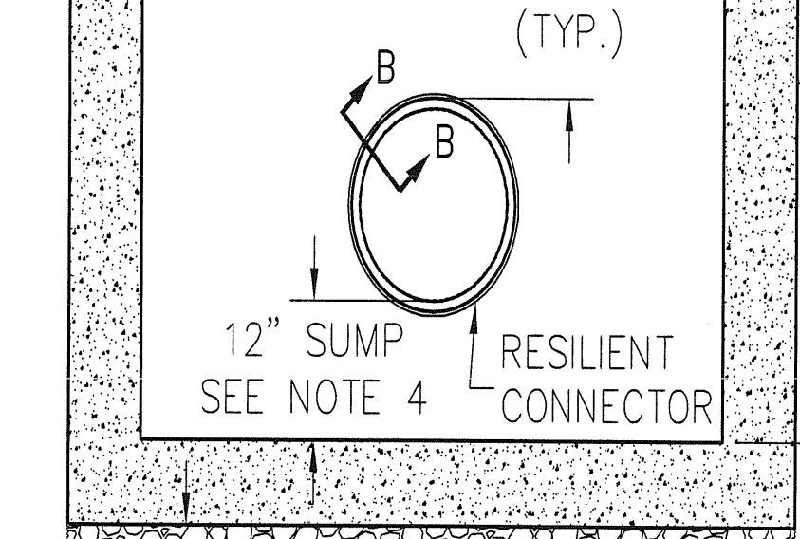
Connectors
Mortar/Grouted Connections
Using a non-shrink grout, mix per manufacturers recommendations.
Fill void between pipe wall and structure
Notes:
Typical detail and section drawing of mortar joint in bottom right. Good connection in bottom left.

Slide 45
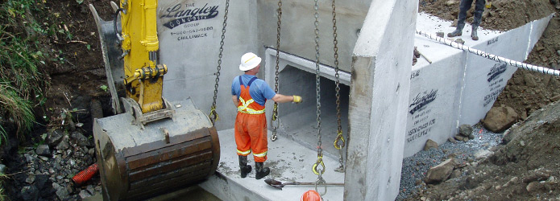
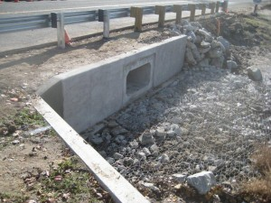
Headwalls
45
When headwalls are constructed or installed, the ends of pipes should be placed flush or cut off flush with the headwall face, unless otherwise permitted by the Engineer.

Slide 46
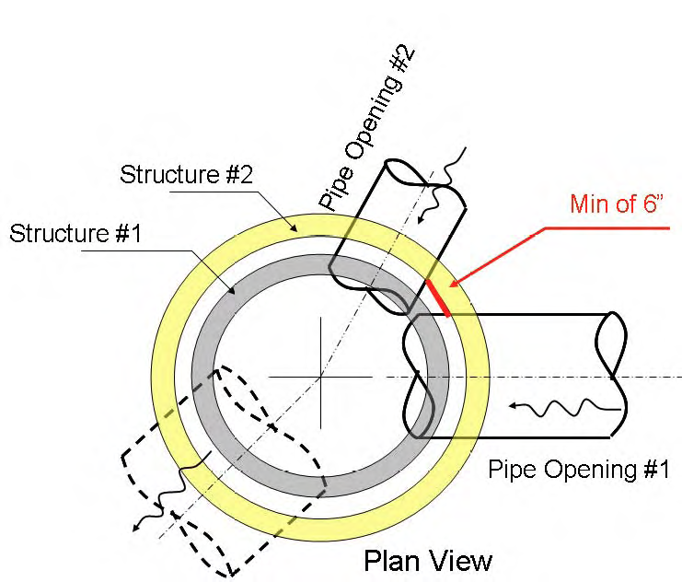
SIZING CONSIDERATIONS
• Pipe opening (H.S.) is assumed
to be:
• H.S. = I.D. + W.T. + (2” to 4”)
• Recommended minimum
structural leg is 6 inches as
measured from the interior of the
structure.
• Structure #1 would not provide
the minimum structural leg.
• Increasing the manhole diameter
to the next size (Structure #2)
provides the required structural
leg.
Notes:
Structure #1 does not provide enough structure between holes. Manhole needs to be larger. See structure #2.

Slide 47
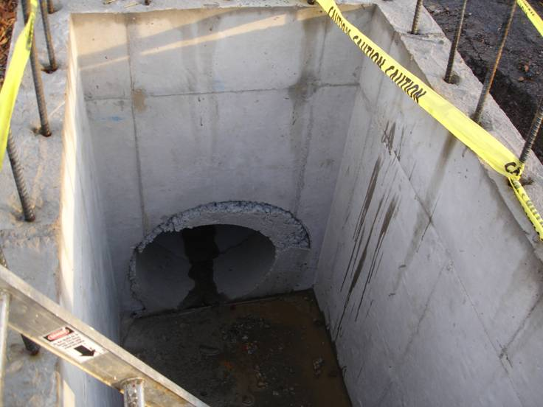
Connectors
Mortar/Grouted Connections
Concerns?
Notes:
What potential problems do you see in these pictures? Ask for input from the audience.

