Slide 1
Installation and Inspection of Concrete Pipe
Overview of Fundamentals
1. Basic Pipe & Soil Concepts
2. Soil Fundamentals
3. Pipe Fundamentals and Standards
4. Standard Installation Direct Design (SIDD)
Notes:
Suggested Reading:
Concrete Pipe Design Manual, Chapter 4
Concrete Pipe Handbook, Chapter 4
Pipeline Installation, Amster Howard, Chapter 1
Pipeline Installation, Amster Howard, Chapter 10
Design Data 9, ACPA Publication

Slide 2
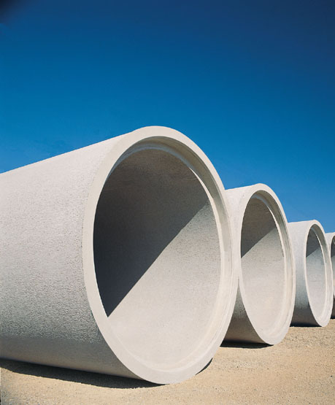
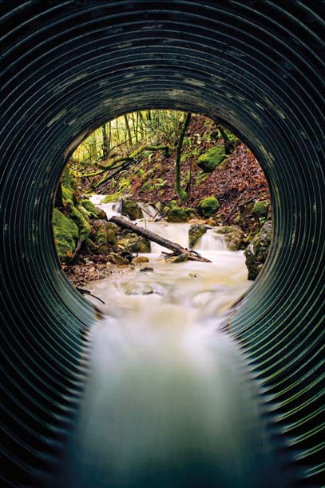
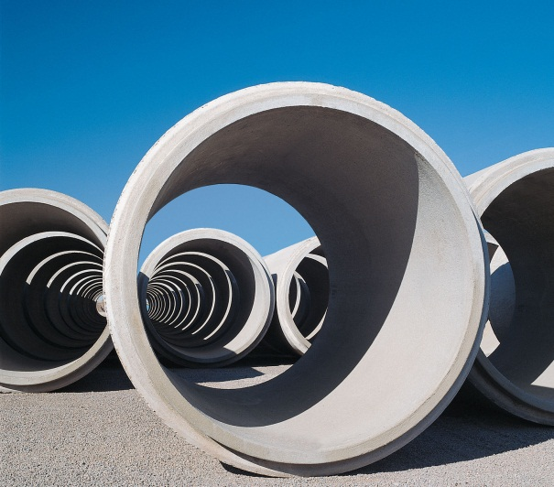
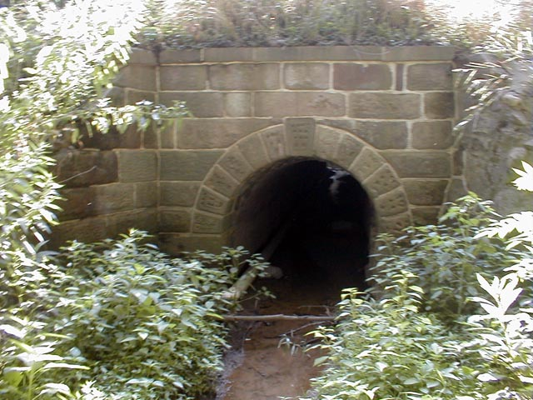
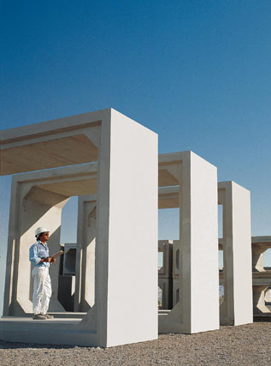
Pipeline Functions
What 2 functions must an underground pipe provide?
Conduit
Structure
2
www.concrete-pipe.org
Notes:
When planning a pipeline installation, there are 2 key functions that we must design the pipeline to provide.
What are those two functions?
Clearly the pipe needs to function as a conduit, as the whole idea of a pipe is to move liquid in a controlled manner and direction.
And the pipe must provide structure, because if the ground above the pipe collapses then the pipe can no longer perform as a conduit. Having one of these functions without the other, is worthless.

Slide 3
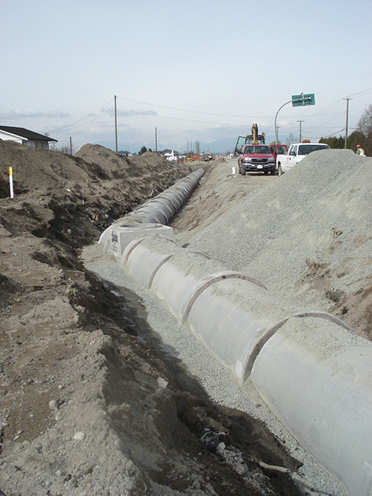
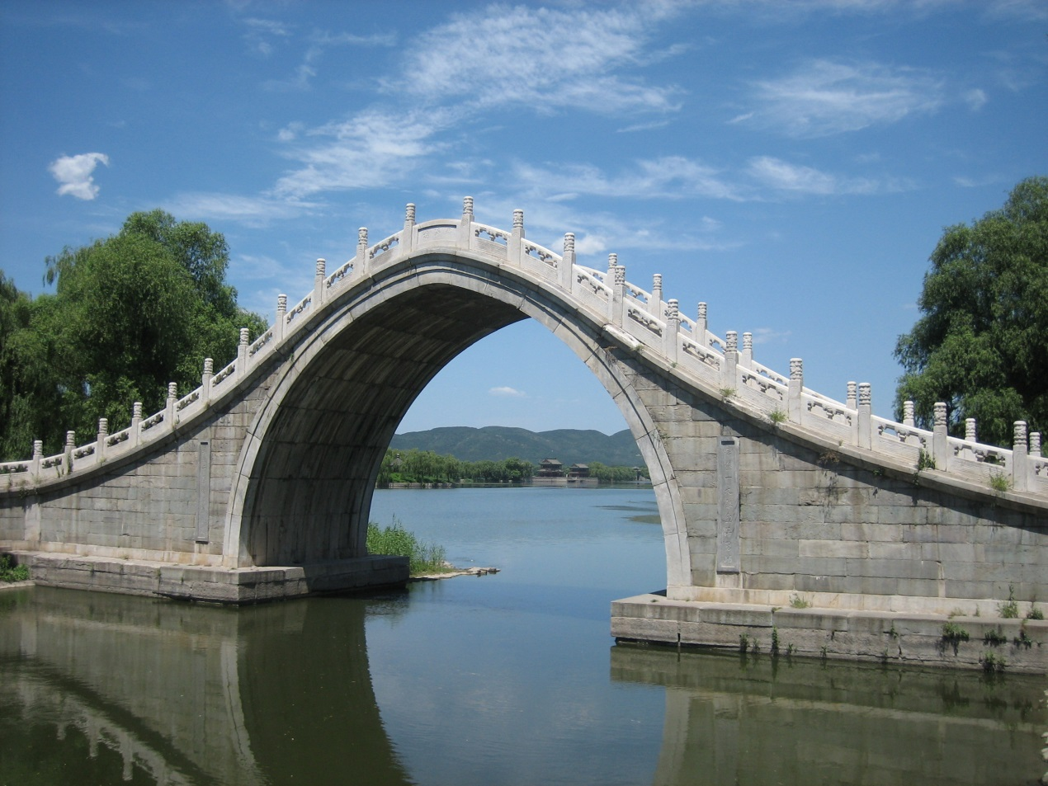
Pipeline Functions
The Soil/Pipe System works as an underground bridge, supporting the loads from above while conducting water below.
3
www.concrete-pipe.org
Notes:
The key to a good Soil/Pipe System is a properly installed pipeline. From the correct width of trench, to a firm and consistent foundation, a soft cushioned bedding and properly compacted haunches; each section of the installation is vital to a long lasting soil/pipe system.
Just as an arched bridge relies on solid abutments to provide horizontal support and a solid keystone to withstand vertical forces, a proper pipe installation provides horizontal support through proper bedding and backfill to the springline, while the crown of the pipe withstands the vertical forces.

Slide 4
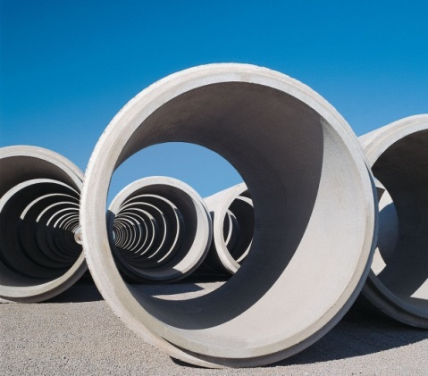
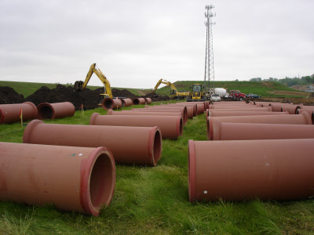
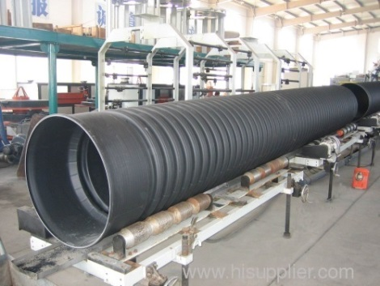
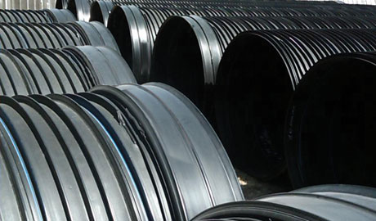
Pipe Types
Pipe Types:
Rigid examples
  Clay Pipe/Vitrified Clay Pipe
  Concrete Pipe
  Reinforced Concrete Cylinder Pipe
  Pre-stressed Concrete Cylinder Pipe
Flexible examples
  Steel Pipe
  Ductile Iron Pipe
  Corrugated Metal Pipe (CMP)
  Fiberglass Pipe
  Polyvinyl Chloride Pipe (PVC)
  Polyethylene Pipe (HDPE)
  Polypropylene Pipe (PP)
  Steel Reinforced Polyethylene (SRPE)
Notes:
This presentation is intended to focus on rigid pipe; however, one must understand the differences between the two types in order to better understand rigid pipe.
Rigid Pipe: Designed to transmit the load on the pipe through the pipe walls to the foundation soil beneath. A rigid pipe installation basically is selecting a pipe-soil system that will support the anticipated dead and live loads on the pipe. Storm sewers and culverts are typically clay or reinforced concrete pipe, although some non-reinforced concrete pipe is still being produced.
Flexible Pipe: Designed to transmit the load on the pipe to the soil at the sides of the pipe. As the load on the pipe increases, the vertical diameter of the pipe decreases and the horizontal diameter increases. The increase in horizontal diameter is resisted by the stiffness of the soil at the sides of the pipe.

Slide 5
Discussion
Rigid vs Flexible
What application would be most appropriate for each?
Flexible
Rigid
5
www.concrete-pipe.org
Notes:
Again, it is not our intent to badmouth the competition. We feel that there are appropriate applications for both rigid and flexible pipe materials. If the strengths of our product aren’t good enough to impress our clients, then us saying bad things about competitive products isn’t going to help.
With that in mind, lets open a discussion on the situations where each of these types of products would excel. Where would you suggest using a flexible pipeline? Where would you suggest just a rigid pipeline? Each of you has a copy of this slide in front of you. I’m going to take a second and let you fill out two or three answers for each of these pipe types. If you’re still thinking about it, feel free to jot down your ideas and we’ll discuss at the end of this subsection.

Slide 6
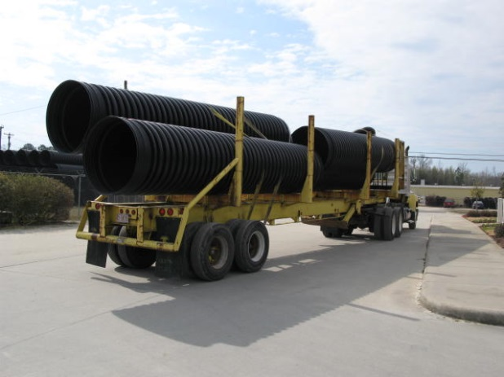
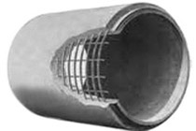
Rigid vs Flexible
What function(s) does a flexible pipe provide?
Conduit.
A flexible pipe serves as a liner within the surrounding soil structure. A majority of the structure is provided by that soil envelope.
What function(s) does a rigid pipe provide?
Conduit
&
Structure
A rigid pipe serves as a conduit while it also provides a majority of the structure capable of withstanding the loads from above.
6
www.concrete-pipe.org
Notes:
From a plumbing perspective, a flexible pipe would be similar to a garden hose, while a rigid pipe would be similar to a copper plumbing that you’d find in your house. So when you see a truckload of plastic pipe on the highway, what function or functions does that pipe perform?
Flexible pipe actually only serves as a liner within the soil structure. A majority of the structure function is provided by the soil envelope, which is built in the field through proper materials and compaction levels. Using the garden hose analogy, if you park your tire on top of that hose it will collapse and there won’t be much if any flow through the hose.
What about a rigid pipe? When you see a concrete pipe on a semi heading down the highway, what function is provided by that pipe?
The rigid pipe serves as both a conduit and a structure. The strength of the pipe along with a small amount of support from the surrounding soil is capable of supporting the loads from above. Again back to our analogy, if you drive your car over a thick walled copper pipe the strength of the pipe will allow it to continue flowing.

Slide 7
Rigid vs Flexible
Specifying Rigid Pipe:
Manufacturer builds and tests the conduit at the plant.
  Both the conduit and the structure are delivered on the truck
Specifying Flexible Pipe:
Manufacturer builds the conduit (liner) at the plant, while a majority of the structure is built on site.
  The conduit is delivered on the truck, but the structure is built on site.
7
www.concrete-pipe.org
Notes:
Through the use of in-plant, proof-of-design tests like the 3 edge bearing test, rigid pipes are tested for their capacity to meet specification requirements for their ability to provide both the conduit and the structure.
Flexible pipe, on the other hand, mostly provides just a liner which acts as a conduit and the structure is built around that liner in the ground. If the soil envelope is built correctly and as designed by the engineer, this is a perfectly acceptable pipeline system. But the low bid process can promote shortcuts and inferior materials that can undermine the structure of the soil envelope, and eventually lead to the loss of conduit capacity as well. Which is why Post Installation Inspection is so important.

Slide 8
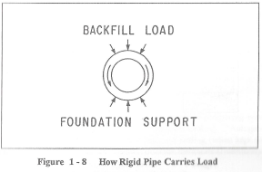
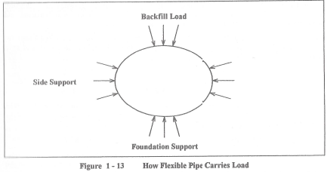
Strength vs. Stiffness
Rigid Pipe (i.e. Reinforced Concrete)
  Strength: Designed to resist stress and transmit the loads on the pipe through the pipe walls to the foundation soil beneath.
Flexible Pipe (i.e. HDPE)
  Stiffness: Designed to transmit
  part of the load to the
  soil at the sides of the
  pipe and resist
  deflection.
www.concretepipe.org
Notes:
So we’ve discussed some of the situations when a flexible line may be better than a rigid, and vice versa. How do these pipe types differ from a structural standpoint?
A rigid pipe must exhibit strength. Strength is the ability of a rigid pipe to resist stress that is created in the pipe wall due to internal pressure, backfill load, live load and longitudinal bending.
A flexible pipe must exhibit stiffness. Stiffness is the ability of a flexible pipe to resist deflection.

Slide 9

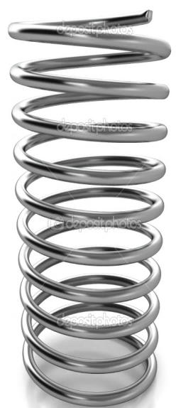
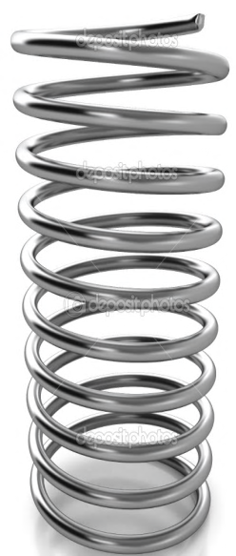


Soil / Pipe System
Dead load
Dead load
Live load
Live load
Stiff
Flexible
Stiff
Flexible
Stiff
Flexible
Flexible pipe – embedment soil must carry most of the load.
Rigid pipe – the pipe carries the majority of the load.
9
Notes:
The flexible soil/pipe system is designed to deflect the load from above and transfer it to the side walls of the trench. The deflection of the pipe is not bad, that’s what it’s design to do.
However, AASHTO, ASTM and individual manufacturers have limitations on the extent of this deformation to avoid damage to the pipe walls. Because flexible pipe is so flexible, the surrounding soil is actually stiffer than the pipe itself. Causing more settling above the pipe.
The rigid soil/pipe system is designed for the pipe to carry the load with minimal deflection and load transfer to the sides. With this system the surrounding soil is less stiff than the pipe, and the trench backfill will settle more at the sides of the pipe.

Slide 10
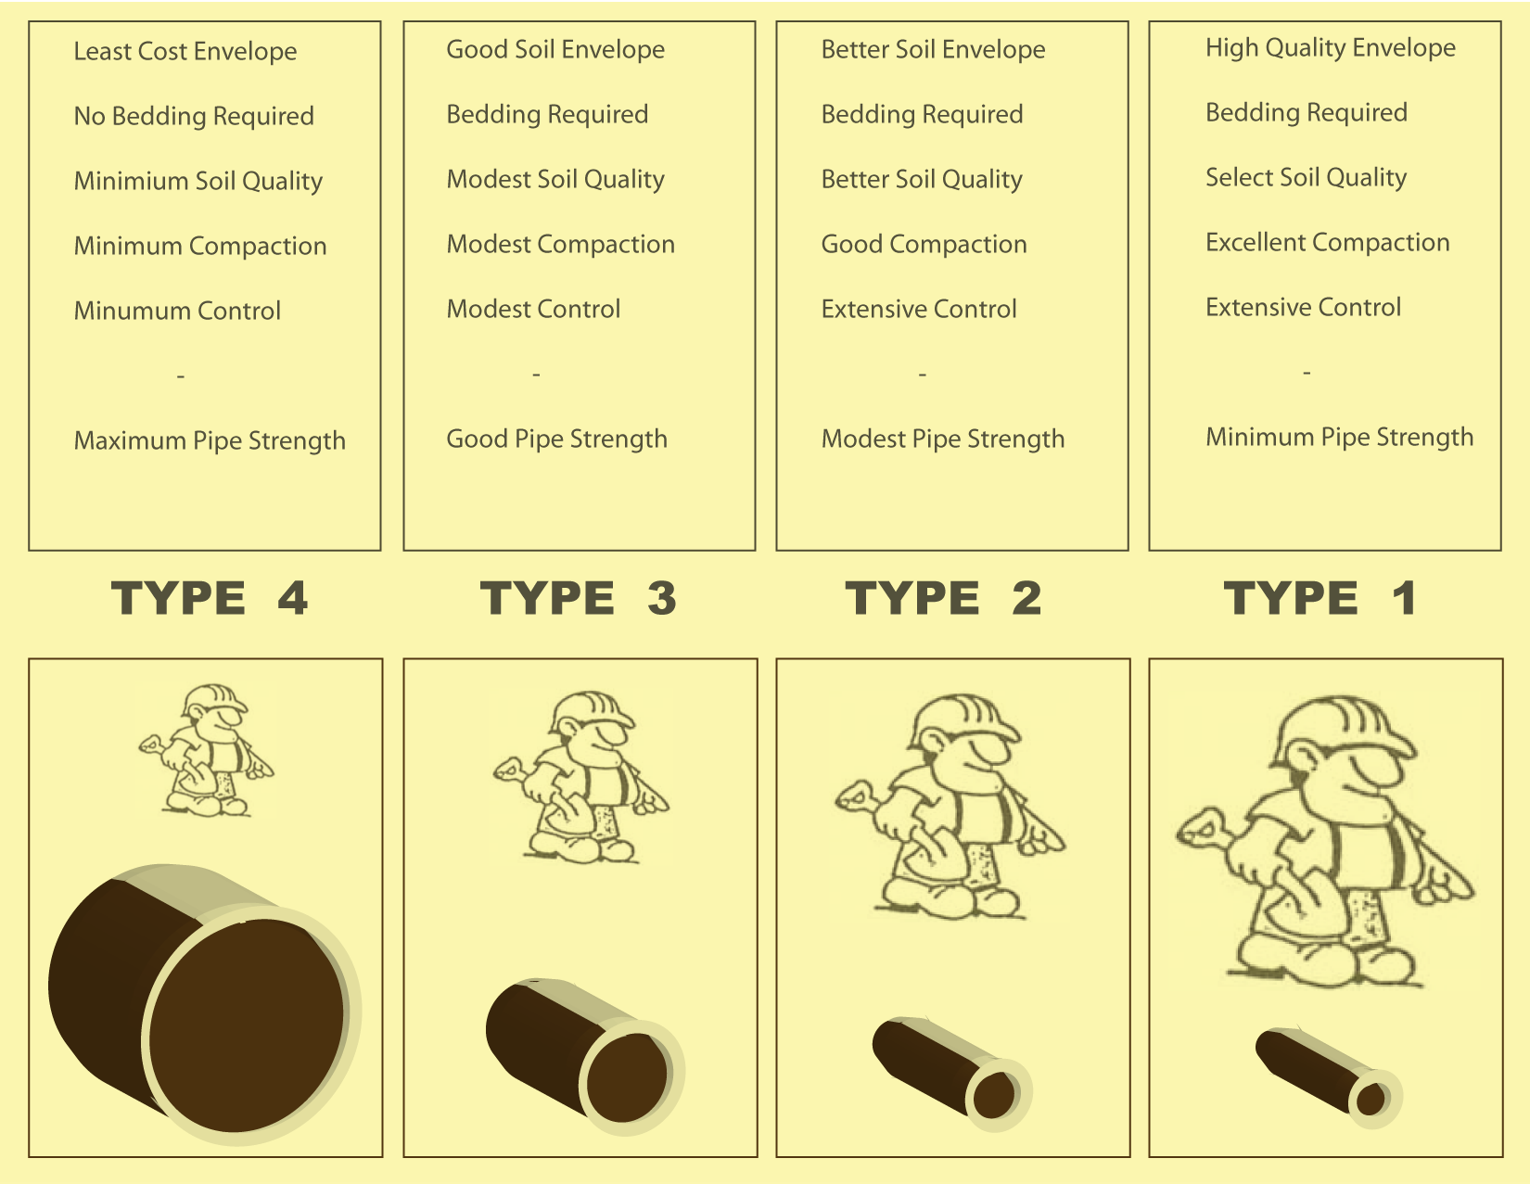
Soil / Pipe System
Weak Pipe + Strong Soil or Strong Pipe + Weak Soil
Notes:
This graphic illustrates the relationship between pipe strength (illustrated by the size of pipe) and installation trench strength (illustrated by the size of the worker).
The supporting strength of a Soil Pipe System is a combination of the pipe strength and the soil strength.
When the pipe is very strong, very little soil strength is required and the embedment soil may only need to be dumped beside the pipe.
A lower strength pipe could be used if the embedment soil has a high strength.

Slide 11
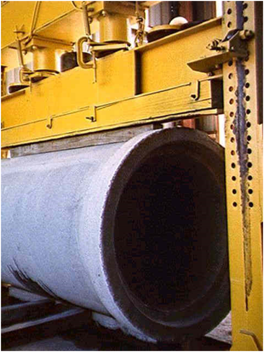
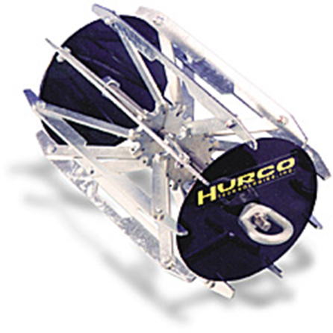
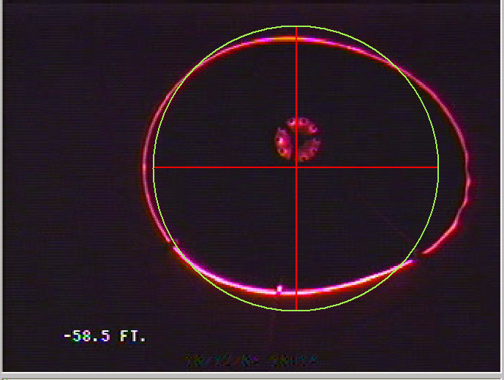
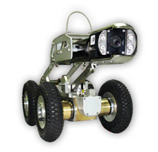
Rigid vs Flexible
Verification
11
www.concrete-pipe.org
Notes:
As we mentioned, rigid pipe comes on the truck with the conduit and the structure built in. The structure is verified at the plant before the truck is even loaded, using a three edge bearing test. Because of the nature of flexible pipe, a similar plant test is not available. As we’ll discuss, the flexible pipe gets it’s structure from the surrounding soils and therefore cannot be tested in the plant.
Both flexible and rigid pipe can be tested in the field for proper installation. This type of testing is called Post Installation Inspection and typically checks for excessive deflection in flexible pipes and excessive cracking or offset joints in rigid pipes.
Lasers now play a key role the technology employed by PII. Laser diodes are used to measure the width of cracks, while projected laser rings give camera operators a clear view of how much deflection the pipe is exhibiting.

Slide 12
Discussion
Rigid vs Flexible
What application would be most appropriate for each?
Flexible
Rigid
12
www.concrete-pipe.org
Notes:
Ok, we’ve taken some time to brainstorm on when it’s most appropriate to install flexible pipe, and when you would think its more applicable to install rigid pipe. So what all did you guys come up with?
Flexible?
Rigid?

Slide 13
Installation and Inspection of Concrete Pipe
Soils Fundamentals
1. Trenches
2. Soil Properties
Notes:
We’ve been talking a lot about soils and compaction while discussing pipelines, so in this next session we’ll cover the basics of soils and trenches.

Slide 14


Trench Terms & Definitions
Final Backfill
H_{cover}
D_{o}
D_{i}
In-situ Soil
Springline
Haunch Embedment
Middle Third
D_{o}/3
Bedding
Foundation
14
Notes:
Before we discuss the properties of soils and compaction requirements, lets go over basic trench terms and definitions.
Trench Terminology:
Do/Di: The Do/Di terms reference the outer and inner diameters of the pipe.
In Situ: The in situ soils describes the existing or in-place soil or rock, through which the trench is excavated. This is either naturally formed and deposited, or manmade such as an embankment.
Foundation: Just like with a building, the soil/pipe structure is built upon it’s foundation. The foundation should be uniform and consistent the full length and width of the trench or embankment project. Soft spots (or exceedingly wet areas) or rock outcroppings within 6” of the surface of the foundation should be removed and replaced with well compacted bedding material to provide a uniform foundation.
Bedding: The bedding provides a cushion for the pipe line to not only help support the lower half of the pipe, but also to avoid a point load on the bottom of the pipe. Per AASHTO recommendations, the Inner Bedding (or middle third of the pipe) should be loosely placed for the middle third of the pipe. This loose material allows the weight of the pipe to form a cradle impression which provides consistent distributed loading along the bottom of the pipe. The Outer Bedding should be compacted to the same percentages as the Haunching.
Haunch: The haunch area (aka Embedment) provides support for the lower half of the pipe (for rigid pipe only, flexible pipe has a different embedment requirement), both vertically and laterally. This area includes all material between the springline of the pipe and the bedding. If the haunch is properly installed and compacted, it should support the pipe in such a way that the upper half of the pipe behaves as a arch or bridge span. This is the most difficult location to achieve optimum compaction due to the shape of the pipe and the close proximity of trench walls.
Springline: The springline of the pipe is the imaginary horizontal line located at the maximum width of the pipe (centered for round and elliptical pipe, but lower for arch pipe). This line illustrates the limit of required structural embedment for rigid pipes.
Final Backfill: The Final Backfill, or Overfill, is the material placed over the embedment (Haunch) up to the ground surface. Materials above the springline of the pipe do not provide any structural advantage for the soil/pipe system, however, the material and compaction should be evaluated based on the improvements planned above (building, pavement, etc).
Cover: The cover is the depth of backfill over the pipe and is measured from the top of the pipe to the ground surface.

Slide 15
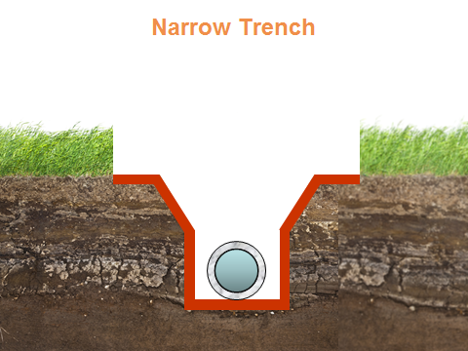
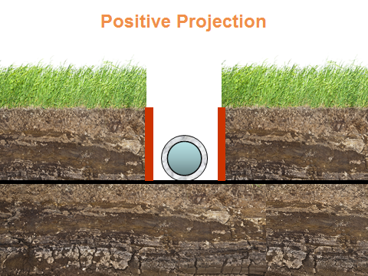
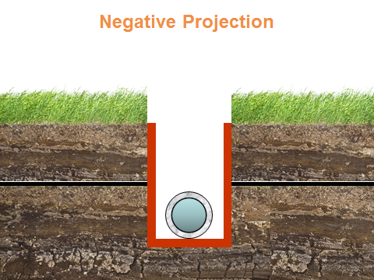
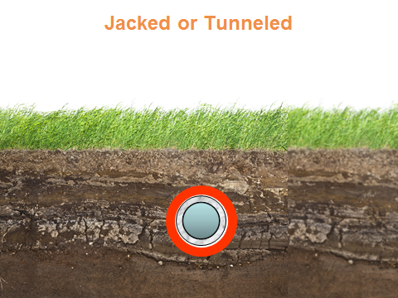
Trench Types
15
Notes:
There are four basic trench installations (other variations exist, but those are beyond the scope of this fundamentals section).
Narrow Trench Installation
Negative Projection
Positive Projection
Jacked or Tunneled Installation

Slide 16
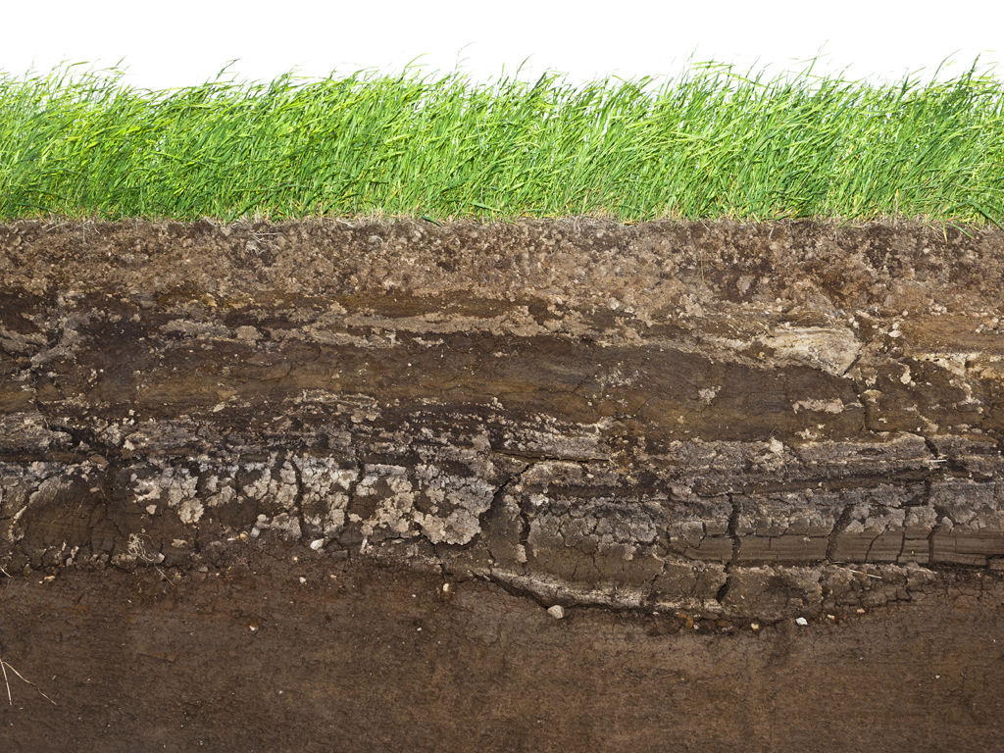
Narrow Trench
Notes:
When we are installing pipe in a narrow trench that has been open cut through existing, or In Situ, soils, this is called a Trench condition. I mention “narrow” because as the width of the trench expands, we lose some of the supporting friction forces from the wall of the trench which help to support the loads from above.
Trench Walls: The trench walls are in situ, or native soils, through which the trench is excavated. Trench walls must be firm enough to support haunching materials or the embedment should be installed wide enough to provide the full support for the pipe.

Slide 17
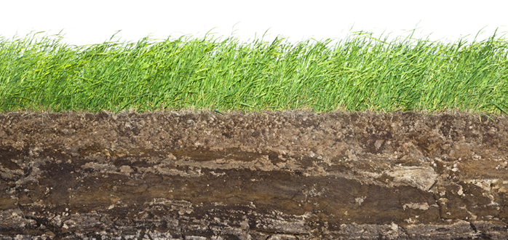
Negative Projection
Notes:
A Negative Projection Trench Installation involves digging a shallow trench where the top of the pipe is below the existing grade, and building up earth fill or embankment which extends above the original soil level. The in situ soils of this type installation do offer some structural support, but not as much as the full trench condition.
Embankment: A construction term describing the earth-fill material placed during construction.

Slide 18
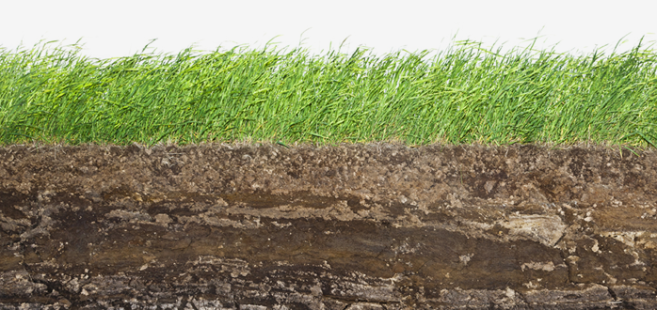
Positive Projection
Notes:
A Positive Projection Trench Installation involves placing the pipe on top of the existing, In Situ, soils and installing lifts around the pipe to raise the “Embankment” up around and above it. This type of installation does not provide any loading support from the surrounding soils as the soil above and beside the pipe are of the same compaction percentage. Typically this situation is assumed in design because it provides the most conservative soil structure.

Slide 19
Jacked or Tunneled
Notes:
The final “trench” situation we’ll discuss is the tunnel or jacked installation. In this installation an auger or tunneling crew bore an opening in the existing soils and push or jack the pipeline through the tunneled opening. This installation offers the advantage of not requiring an open cut and therefore not shutting down busy highways.

Slide 20
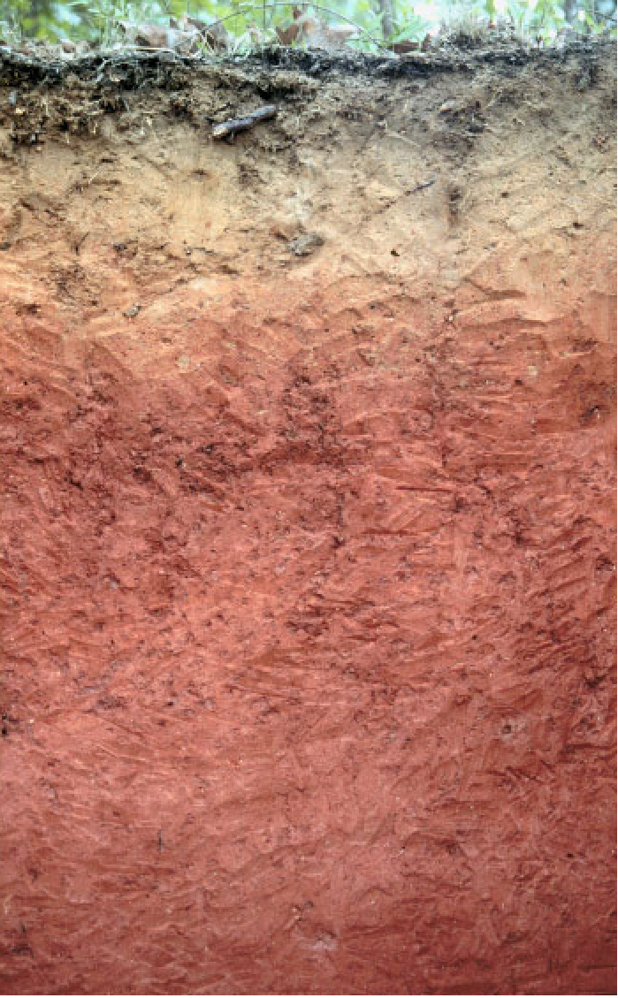
Soil Properties
What three major soil properties come into play when installing a pipeline?
Composition
Gradation
Compaction
Notes:
Now lets look at the soil properties necessary for a good installation. First we’ll consider the composition of the existing soils. Then the gradation and finally the amount of compaction.

Slide 21
Soil Properties: Composition
Soil is an aggregate of loose mineral and organic particles.
Rock exhibits strong and permanent cohesive forces between mineral particles.
Soil’s primary components are:
  Gravel
  Sand
  Silt
  Clay
Notes:
As you can see on this slide, soil is an aggregate of loose minerals and organic particles. Soil is typically classified based on particle size and the nature of those particles, which we’ll get into later. The four primary components of soil are, in order of size, Gravel, Sand, Silt and Clay.

Slide 22
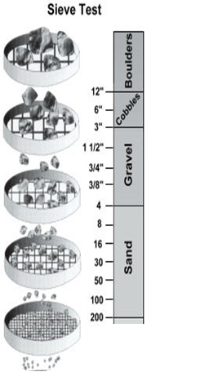
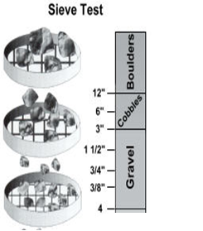
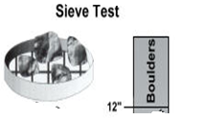
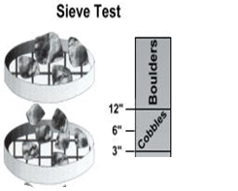
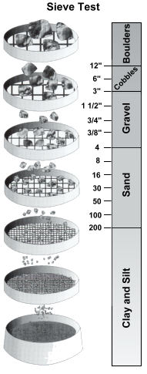
Unified Soil Classification System
Boulders - 12”+
Cobblers - 3” to 12”
Gravel
Course Gravel - grapes to tennis balls
Fine Gravel - peas to marbles
Sand
Course Sand - ice cream salt
Medium Sand - kosher salt
Fine Sand - table salt
Silt - talcum powder
(very little plasticity when moist)
(little resistance to crushing when air dry)
Clay - talcum powder
(plasticity over a range of moisture contents)
(resistance to crushing when air dry)
Notes:
Using the Unified Soil Classification System, we can more accurately describe the soils terminology that are most frequently encountered. First, Boulders are the largest particles commonly found in soil classification systems.
Boulders are particles that are larger than 12” across.
Next, Cobbles fill the range between 3” and 12”.
Gravel is broken down into two categories, course and fine. Course gravel would be grapes to tennis ball size. Fine gravel is in the pea to marble range.
Sand is also broken down into smaller categories. Course sand is about the size of ice cream salt. Medium Sand is like kosher salt, and Fine sand is about the size of sugar or table salt.
Fines are particles that pass a No. 200 sieve, which has 200 openings per inch. This size range at the bottom of the scale includes silts and clays. Silt is about the size of talcum powder, and is distinguished from clay by it’s physical properties. For instance, silt has very low plasticity when moist, and is not strong when air dry. Clay on the other hand has a high plasticity when moist and resists crushing when air dried.

Slide 23
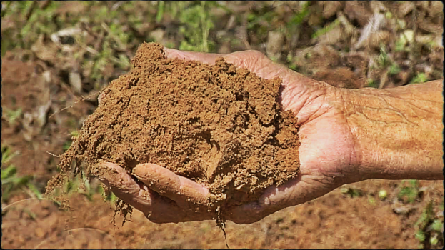
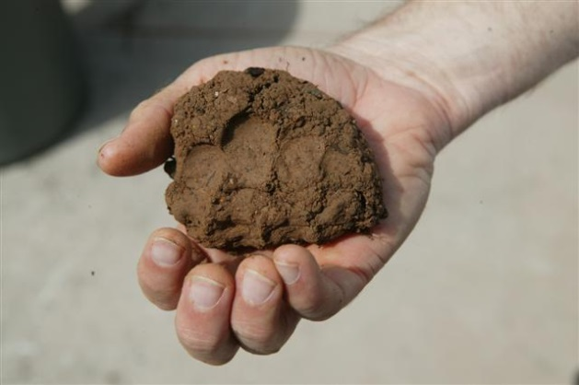
Soil Composition
Fine Soil Distinctions:
Classifications of a soil depend mostly on the % of gravel, sand, silt & clay.
Characteristics of the soil depend on the silt and clay fractions.
Clays display the characteristic of plasticity, while silts do not.
Organic matter causes a darker soil color. Typically has a significant negative effect on mechanical properties of the soil.
Notes:
Soil classifications are based on the percentage of gravel, sand and fines. The fraction of fines (silt & clay) are used to classify smaller particle sized soils. The plasticity of the soil can illustrate to the user whether the fines are silty or clayey. Organic matter (which is definitely not good from a structural stand point) is often identified by a dark soil color.

Slide 24
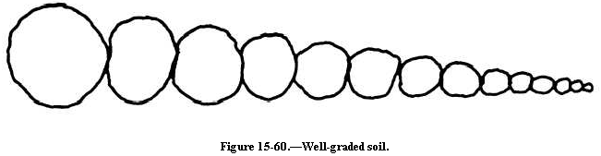
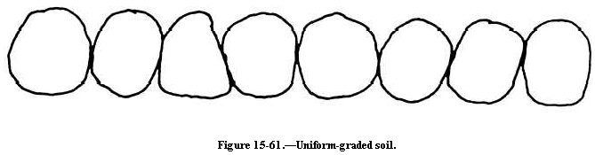
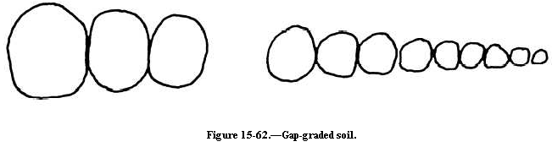
Soil Properties: Gradation
Well-graded soil has all sizes of material present from the No. 4 sieve to the No. 200 sieve.
Well graded
Poorly graded soil may be uniformed-graded or gap-graded.
Uniformly graded
Gap graded
Notes:
Well-graded soil for example, means that the material has particle sizes representative of everything between a No. 4 sieve and a No. 200 sieve.
Poorly-graded means that there are sections missing of that spectrum of particles missing.
Only a few sizes could be missing which would be considered gap-graded, or all of the sizes except a few are missing which would be considered uniformly-graded (uniform because the entire sample is basically one size).

Slide 25
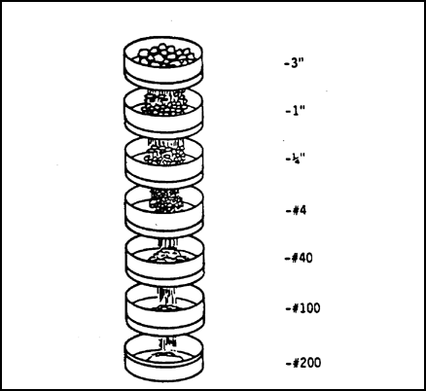
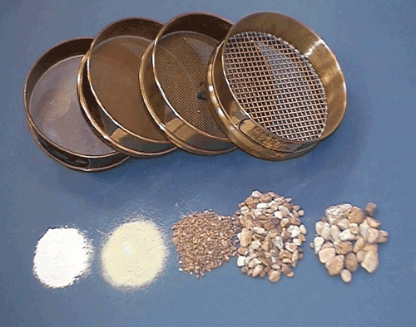
Gradation
Particle size distribution (gradation) is measured with a sieve test.
Notes:
We measure the particle size distribution using sieve tests. The results of a sieve test is reported by the percent passing. Meaning the percentage of the sample that has passed each sieve screen.

Slide 26


Gradation
Why is gradation important?
Notes:
Intuitively you can see that a well graded sample in which all or most of the voids have been filled, has less air voids, less volume for water to seep in and is likely to be more stable. While the illustration below of a uniformly graded soil or aggregate offers lots of space for migration and movement.

Slide 27
AASHTO Classification
AASHTO Soil Classification Particle Size Definitions:
Gravel: 3” to No. 10 Sieve
Sand: No. 10 to No. 200 Sieve
Silt: No. 200 Sieve to 0.002 mm
Clay: 0.002 mm to 0.001 mm
AASHTO Table Subgrade Classification:
A-1 Soil is best subgrade material
A-8 Soil is unsatisfactory (peats, highly organic soils)
Notes:
The two main soil classification systems used by transportation officials and engineers are the AASHTO and USCS classifications.
The AASHTO classification system is based on particle sizes and plasticity index scores. The soils are broken down into 8 categories, A-1 through A-8 with A-1 being the best structural subgrade material, and A-8 being highly unsatisfactory (soils that have a high organic content fall under this classification).

Slide 28
USCS Classification
Unified Soil Classification System (USCS) – ASTM D2487
Particle Size Definitions:
Gravel: 3” to No. 4 Sieve
Sand: No. 4 to No. 200 Sieve
Silt & Clay: Less than No. 200 Sieve
Soil Classifications (1st Letter): Gradations (2nd Letter):
G – Gravel W – Well Graded
S – Sand P – Poorly Graded
M – Silt M – Silty
C – Clay C – Clayey
O – Organic L – Low Plasticity
PT – Peat H – High Plasticity
Atterberg Limits:
Low Plasticity (LL < 50%)
High Plasticity (LL > 50%)
Plasticity is a property of the soil which allows the soil to be deformed or molded without cracking or appreciable volume changes.
Notes:
The Unified Soil Classification System is found in ASTM D2487.
This system also uses the sieve passing percentages and the Plasticity Index to help classify soils.
The USCS system gives letter classifications for the particle size and a letter classification for the gradation type which can include a silty or clayey designation.
Finally, the letters L and H are used to distinguish the level of plasticity.

Slide 29
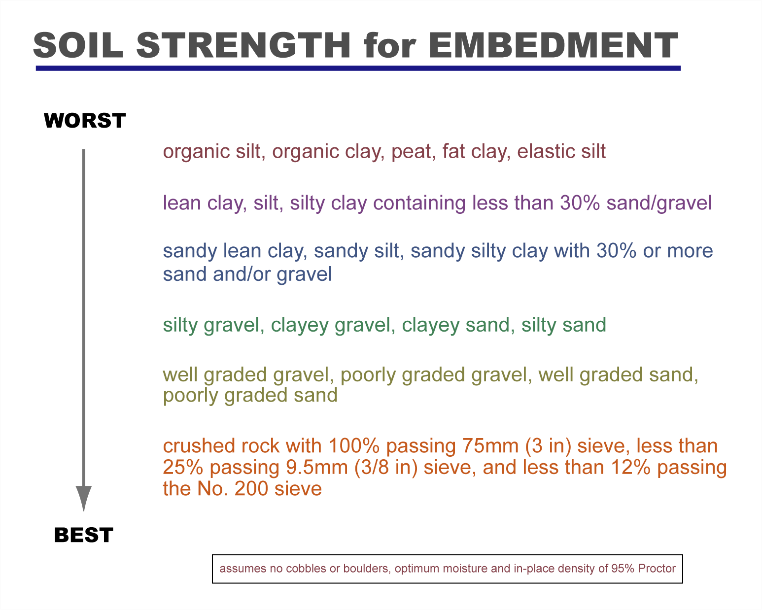

Slide 30
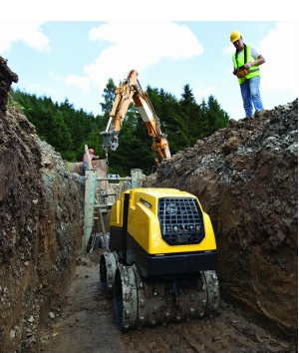
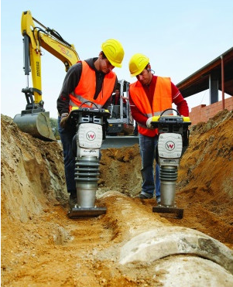
Soil Properties: Compaction
Compaction is the densification of soil by the reduction of air in the soil voids.
The degree of compaction is measured in dry unit weight (dry density).
Notes:
What is compaction? In general terms, compaction is nothing more than the densification of soil by removing air using mechanical energy. Compacting a soil improves the performance of soil and it’s engineering properties such as bearing capacity, settlement, shear strength and permeability.
How is compaction measured? The quality of compaction is measured basically using two (2) parameters. Dry density and moisture content. The in-place density of a compacted soil must be as close as possible to maximum dry density measured using a Proctor test (Standard or Modified). Similarly, the in-place moisture content of a compacted soil must be as close as possible to the optimum moisture content measured using Proctor test (Standard or Modified).

Slide 31
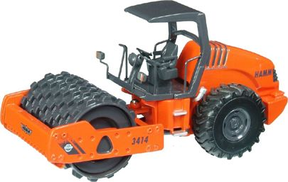
Compaction
Purposes of Compaction:
  To reduce the subsequent settling under loading.
  To increase the shear strength of the soil.
  To reduce the voids ratio, and make it more difficult for water to migrate.
Notes:
So we’ve established that compaction increases the densification of the soil or aggregates, but what does that mean? By reducing the voids in the soil, we reduce subsequent settling later, and we increase the shear strength of the soil.

Slide 32
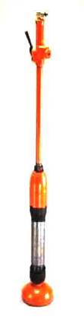
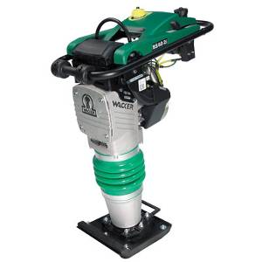
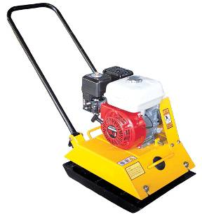
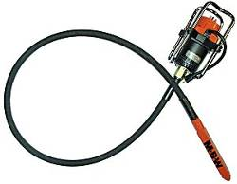

Compaction Methods
Impact
Clays, silts, plastic soils, etc.
Vibration
Granular soils, crushed stone, sands.
Kneading
Natural soils, mixed soil materials but not for gravels and sandy soils.
Notes:
Impact compactors work well with clays, silts and other soils exhibiting plasticity. The higher the cohesive nature of the material, the more it’s particles stick together. Therefore a machine with a high impact force is required to ram the soil and force the air out to rearrange the particles. A rammer works best for this type of soil, and works well in trench conditions due to the size of the compactor.
Vibration compactors work better for granular soils, sands and crushed stones. Because granular soils are not cohesive, the particles require shaking or vibratory action to move them, therefore vibratory plates work better.

Slide 33
Compaction
Factors That Affect Compaction:
  Water content of the soil
  Type of Soil
  Compactive effort
    lift thickness, number of roller passes, weight of the roller
    The type of compaction equipment
    smooth drum, sheepsfoot, pneumatic tire, vibrating plate, vibratory or static, etc
    The speed of application
    Compactive energy
Notes:
We also need to keep in mind that there are certain factors that affect the compaction achieved. The type of soil or aggregate is important, and the amount of water content in that soil can determine the quality of compaction. The amount of energy used (not only the weight of the compaction equipment, but also the amount of passes and the thickness of the lifts) affects the compaction. It should also be noted that some types of compaction equipment work better with certain soil types.

Slide 34

Proctor Tests & Pipe Installation
Standard Proctor – ASTM D698
Modified Proctor –ASTM D1557
Maximum dry density and optimum moisture content.
Trench soils are tested for in-place dry bulk density and is divided by the maximum dry density. This gives us the relative percent compaction for the trench soils.
Notes:
The relationship between the maximum density and the optimum moisture content determined through the proctor tests is often shown on a graph of the dry density versus moisture content. The Zero Air Voids Curve shown in this graph gives the user a useful tool for evaluating whether or not an empirical density is reasonable, because none of the density points should land above this line. If the soil could be compacted so that all of the air was expelled, and all that remained was soil particles and water filling the voids between those particles, the value of density and moisture would plot exactly on this zero air voids curve. Typically an in field compacted soil should have about 10-20% air content.
There are three (3) ways you can measure the density in the field. One is the sand cone method (ASTM D1556), one is the rubber balloon method (ASTM D2167) and the other is nuclear gauge method (ASTM D6938). All three are fairly simple and quick. Each test takes no more than 15 to 20 minutes. However, not everyone can do nuclear gauge tests in the field. For that you need to be certified for its use. Check with your manager and get certified if you think you’ll be using nuclear gauge.
And as we will discuss later, certain types of installations require very close observation to ensure that the appropriate compaction level has been achieved. So these density measurement tests in the field are important as well. The information taken from one of these tests is then related back to the lab results from the Proctor test.

Slide 35
Installation and Inspection of Concrete Pipe
The Pipe System
1. Pipe Terminology
2. Manufactured Pipe Standards
Notes:
Now that we’ve covered the basics of the soil/pipe system and soils and trenches, lets discuss the pipe going into the trench.

Slide 36

Pipe Terminology
Notes:
Many of you have heard or seen much of the material in this section. And several of you have probably forgotten more about pipe installation than we will ever know, but just like with sports, it’s good to go back to the basics and freshen up those fundamentals. So first we’re going to discuss pipe terminology that you’ve probably seen or heard on the job site.
Pipe Terminology:
Crown: The crown is the inside top of the pipe.
Invert: The invert is the inside bottom of the pipe.
Springline: The springline is the horizontal centerline of the pipe, an imaginary line located at the maximum width of the pipe along a horizontal plane.
Barrel: The portion of the pipe between the joining structures on each end.
Bell: (Socket, Female End) The end of the pipe (regardless of shape or dimensions) that overlaps a portion of the end of an adjacent pipe in order to join the pipe together. On this diagram we are seeing a flared bell, but as we’ll discuss there are also straight walled pipe options as well.
Spigot: (Tongue, Male End) The end of the pipe, regardless of shape or dimensions, which is inserted into the bell end of an adjacent pipe in order to join the pipe together.

Slide 37

Pipe Terminology

Slide 38

Pipe Terminology

Slide 39



Pipe Terminology
Notes:
RCP joint configurations include Bell and Spigot, Tongue & Groove (some call this straight wall pipe), or they may be supplied with a modified Tongue and Groove (aka baby bell, which is somewhere in the middle between a flared bell and straight wall pipe). These are, of course, just the basic joint options. Different regions, states, producers and even plants have variations on these and other joint configurations.
Each of these configurations can have various features to allow the placement of gaskets or sealants of some sort.
Joint Terminology:
Bell Shoulder: The interior surface of the bell end of a pipe that would butt against the end of the adjoining pipe if the joint were totally closed.
Bell Face: The vertical surface on the end of the bell.
Sealing Surface: the surface of a bell, spigot or plain end of a pipe that the compressed gasket bears against to make a watertight seal.
Spigot Groove: A groove in the sealing surface of the pipe spigot to hold the sealing gasket. This style spigot is also called a Confined O-Ring Spigot.
Spigot Shoulder: Exterior surface of the spigot end of a pipe that would butt against the bell shoulder of the adjoining pipe if the joint were totally closed.
Spigot Face: The vertical surface on the end of a spigot.
Single Offset: The end of a spigot that tapers off to a narrower diameter. This joint is easier to manufacture than a grooved spigot (casting headers can simply slide off of the end), and still provides a good sealing joint. This style spigot usually has a profile gasket.

Slide 40

Joint Terminology
Notes:
Joints requiring a sealing option are typically designed as either a Confined O-Ring joint or Single Offset joint. You’ll likely see these joints discussed later in the Joining Section of the seminar in more detail.
Joint Terminology:
Tongue & Groove: A bell & spigot type joint with straight walls (flush bell). The joint consists of a tongue (male end) and groove (female end) with no defining areas for gasket material placement. Rubber gaskets may be used when the joint slope is five degrees or less, however it is usually limited to mastic or butyl sealants.
Flared Bell: A pipe with a flared bell has the outside diameter of the bell larger than the outside diameter of the pipe. Another option with the flared bell is the Modified Tongue & Groove, or Baby Bell which is kind of a cross between a straight walled T&G and a Flared Bell – it does not stick out from the barrel as far as a flared bell.
Confined O-ring: The first “rubber gasket” joint design established by the industry. The spigot end of the pipe contains a confined groove for the gasket to seat. This style of flared bell joint is the hardest to manufacture and can be difficult to properly seat the gasket in the field.
Single Offset: This joint first appeared in the early 1990’s. This style of spigot is much easier to manufacture as the form can easily slip off the end, and is usually easier to install due to less stringent lubrication requirements for the gasket.

Slide 41
Installation and Inspection of Concrete Pipe
Product Standards
ASTM-American Society for Testing and Materials
AASHTO-American Association of State Highway Transportation Officials
Notes:
Next we’ll cover the ASTM and AASHTO standards that you will likely see around the pipe installation business.

Slide 42
Product Standards
Standard vs Specification
A Standard is a guideline as supplied by a industry or government group
  ASCE, ASTM, AASHTO
A Specification is language describing the practice or procedure, that will become a legal contract
  Engineer’s plans
Notes:
As you all know, a Standard is a recommended guideline for a product or practice, such as the Standards supplied by ASCE, AASHTO and ASTM.
A Specification is written language describing a practice or procedure that will become a legal contract (for example, an engineer’s project plans and proposal).

Slide 43
DISCUSSION
Standards
You’ll be seeing several references to Standards during this Installation Training program today. For example, RCP Product Standard is ASTM C76 or AASHTO M170. What is the difference between ASTM and AASHTO?
ASTM
ASTM is a standards development organization made up of volunteers from industry and transportation officials.
AASHTO
AASHTO also develops standards but the decision making process is limited to transportation officials.
43
www.concrete-pipe.org
Notes:
ASTM International (originally known as the American Society for Testing and Materials) is a voluntary, but highly recognized, standards development organization. Their work guides design, manufacturing and trade in the global economy. Their consensus standards make products and services safer, better and more cost effective.
AASHTO is a standards setting body which publishes specifications, test protocols and guidelines which are used in highway design and construction throughout the US. Despite its name, the association represents not only highways but air, rail, water, and public transportation as well.
The difference between the two is that the ASTM group includes both industry and transportation officials, while the AASHTO voting rights are limited to just transportation officials. Often these standards are identical with editorial differences; however, they can be quite different.

Slide 44
Product Standards
How do Standards affect you?
A Manufacturer must produce pipe to production standard requirements
  (i.e. ASTM C76 or AASHTO M170)

Slide 45


ASTM/AASHTO Production Standards
Circular Pipe
  ASTM C 76
    (AASHTO M 170)
  ASTM C 655
    (AASHTO M 242)
  ASTM C 1765
    (Steel Fiber Reinforced Concrete Pipe)
Arch Pipe
  ASTM C 506
    (AASHTO M 206)

Slide 46


ASTM/AASHTO Production Standards
Elliptical Pipe
  ASTM C 507
    (AASHTO M 207)
Box Culverts
  ASTM C 1577
    (AASHTO M259)
    (AASHTO M273)
  ASTM C 1433
Notes:
ASTM C1577 is for the design of boxes using AASHTO LRFD design.

Slide 47
Product Standards
How do Standards affect you?
A Manufacturer must produce pipe to production standard requirements
  (i.e. ASTM C76 or AASHTO M170)
A Contractor must install pipe to installation standard requirements
  (i.e. ASTM C1479 or AASHTO Section 27)

Slide 48


ASTM/AASHTO Installation Standards
ASTM/AASHTO Standards
Installation Standards:
ASTM C 1479 – Pipe
ASTM C 1675 – Box Culverts
AASHTO LRFD Bridge Construction Specifications
  Section 26 – Metal Pipes
  Section 27 – Concrete Pipes & Box culverts
  Section 30 – Plastic Pipes

Slide 49
Product Standards
How do Standards affect you?
A Manufacturer must produce pipe to production standard requirements
  (i.e. ASTM C76 or AASHTO M170)
A Contractor must install pipe to installation standard requirements
  (i.e. ASTM C1479 or AASHTO Section 27)
The Manufacturer and Contractor must test the pipe and installation to testing standard requirements
  (i.e. ASTM C443 or AASHTO M315)

Slide 50

ASTM/AASHTO Testing Standards
ASTM/AASHTO Standards
Field Testing Standards:
ASTM C 924 – Low –Pressure Air Test Method
ASTM C 969 – Infiltration/Exfiltration Testing
ASTM C 1618 – Vacuum or Pressure Test Method for Sanitary Sewer Pipe
Notes:
Low Pressure Air Test—Use expansion plugs at each end of section to be tested, and fill with low pressurized air. Used for 4”-24” gasketed concrete pipe. Note that air testing is inherently dangerous due to the compressibility of air and the increased risk of blow out if plugs have not been properly secured.
Infiltration or Exfiltration Test—Plug the ends and measure how much water is flowing into the sewer, or plug and fill the pipe and measure how much fluid is leaving the system.

Slide 51




ASTM/AASHTO Testing Standards
ASTM C 1103 – Joint Acceptance Testing
Notes:
The joint is covered on the inside with a ring and two sealing tubes, then air or water is introduced at a low pressure and the volume of loss is used to determine the acceptability of the installed sewer line. This test is used for 27” and larger concrete sewer lines with rubber gasket sealed joints.
As you can see in the final picture these ring joint testers can be made to fit any large diameter pipe.

Slide 52
Pulling the System Together:
Installation and Inspection of Concrete Pipe
Standard Installation Direct Design
1. SIDD Background/History
2. Standard Installations
3. What to Look For in the Field
Notes:
Finally today, we’ll discuss the SIDD system that has been developed to help with both the design and installation of pipelines.

Slide 53
SIDD Background
Buried Pipe Theory: 1930’s
  Marston & Spangler developed theories on buried pipe trench conditions and the concept of a bedding factor to relate the strength of buried pipe to the strength of pipe in plant tests.
Buried Pipe Theory: 1970’s
  ACPA initiated long term research on the interaction of buried pipe and the surrounding soil.
Buried Pipe Theory: 1980’s
  SPIDA-Soil Pipe Interaction Design & Analysis computer software was used for finite element studies resulting in four new Standard Installations and a new Direct Design program call SIDD.
Notes:
In the 1930’s, research from Marston and Spangler led to theories relating the strength of a pipe in a “real world” installation to the point loads found in plant tests such as the three edge bearing test.
In the 1970’s, the American Concrete Pipe Association started long term research on the interaction between the buried pipe and the surrounding soils.
And in the 1980’s this research was combined with SPIDA software for a finite element study of the soil pipe system. This research led to the creation of 4 new Standard Installations to replace the aging original installation types A, B, C & D which were based on the original theories of Marston and Spangler. These installations, used for both direct design and indirect design, are known as the SIDD Installations 1-4.

Slide 54
POP QUIZ
Standard Installations
Using suggested AASHTO installation techniques, how should the contractor be preparing the bedding?
Granular material, compacted to a smooth firm finish throughout the trench.
Loosely placed granular material directly under the pipe.
Granular material contoured to match the curve of the pipe.
54
www.concrete-pipe.org
Notes:
Before we get into the keys learned from the research that was done in the 70s and 80s, I want throw a few pop quizzes at you. How should a contractor prepare the bedding during installation?
The contractor should install a well compacted flat bedding of granular materials at 90% Proctor.
The contractor should install a bedding layer of granular material with the middle third of the bedding loosely placed.
The contractor should install a bedding layer that has been compacted and contoured to fit the curve of the pipe.
The answer is b, with the middle third of the bedding being loosely placed to self-compact and cradle the pipe.

Slide 55

Standard Installations Key Concepts
Loosely placed, uncompacted bedding directly under the invert of the pipe reduces point load stresses on the pipe.
55
www.concrete-pipe.org
Notes:
The first lesson learned from the finite element analysis performed in the 80’s, was that providing a bedding layer with a loosely placed uncompacted middle third directly under the pipe invert reduces the point load stresses on the pipe. In the past the compacted contoured bedding was popular (and in fact is still specified by some engineers) because the prevailing thought was that shaping the bedding to match the pipe would help to cradle the pipe. But the fact of the matter is that successfully creating an exact match of the pipe’s profile within an acceptable tolerance is nearly impossible to consistently perform in a field setting, and invariably results in unintended point loads on the pipe.

Slide 56

POP QUIZ
Standard Installations
Campacting the soils under the haunches of a pipe can be tedious work; especially in trench conditions. Is it necessary?
No—Reinforced Concrete Pipe does not need support from the haunches.
Yes—The Type 3 Installation depends on some support from the soil envelope to help the Reinforced Concrete Pipe carry the dead and live loads.
56
www.concrete-pipe.org
Notes:
No, RCP does not require support under the haunches, it is tested under point loading conditions and therefore should be installed that way.
Yes, though difficult to compact, the haunch area is an important part of a successfully installed pipe, and helps the RCP support the loading from above.
The answer is b. Even though the pipe was designed to be as strong as needed for a deep installation, the haunch support helps to minimize point loading and decreases moments within the pipe wall.

Slide 57

Standard Installations Key Concepts
Soils within 40 degrees of the invert of the pipe cannot be compacted in the haunch zone due to physical limitations. Compaction of the haunches is still important, but design should take into account the voids within the haunch zone.
57
www.concrete-pipe.org
Notes:
Though the geometrical limitations of the pipe limits the compaction of the lower haunch within 40 degrees of the invert, this area should still be filled with material as best as possible, and the rest of the haunch area should be compacted as specified. The soils in the haunch area from the foundation to the pipe springline provide significant support to the pipe and reduces the pipe stresses.
Remember the bridge analogy—the haunch support acts as the bridge abutments and helps to support the pipe.

Slide 58


POP QUIZ
Standard Installations
Does RCP require compacted lifts above the top of the pipe similar to flexible specifications?
Yes—Pipe is pipe. If the compacted lifts needed to be installed to 6” above the top of the flexible pipe, then they should also be installed 6” above the rigid pipe.
No—Reinforced Concrete Pipe installation does not require compaction above the springline of the pipe.
58
www.concrete-pipe.org
Notes:
This is a tricky question. Because if you, as the engineer, are planning to install the pipe below a roadway or other improvement, then yes, the installation will obviously require compacted backfill all the way to the improvement or road box. But for this specific question, consider a pipeline through a field that will not be loaded with additional live, dead or surcharges.
Yes. If you install one pipe one way, you should install all pipes that way. Therefore the rigid pipe installation should include embedment up to 12” above the top of the pipe like the flexible pipe.
No. RCP does not require compaction above the springline because the majority of the structure is provided by the pipe itself.
The answer is b. One of the biggest misconceptions we frequently hear is that flexible pipe can be installed “just like concrete.” The problem with that statement is that as we mentioned, the flexible pipe structure needs to be built within the soil envelope, while a majority of the concrete pipe structure has arrived on the truck.

Slide 59

Standard Installations Key Concepts
Compaction of the soil above the springline and above the haunches has negligible effect on the pipe stresses. (Compaction only necessary in this area if required for pavement or structures).
59
www.concrete-pipe.org
Notes:
Another key discovery of the 1980’s finite element studies proved that compaction of the soils above the springline for rigid pipe provide no additional benefit on the pipe stresses. Rigid pipe installations only need to compact this area if the improvements above the pipeline require it, such as for highway or building support. It should be noted that while compaction above the springline adds no benefit to the pipe structure, over compaction can be very detrimental to the pipe structure and can cause significant damage.

Slide 60
SIDD
Standard Installation
Direct Design

Slide 61


Slide 62


Slide 63


What to Look For:
Standard Installation (Type 4)
Type 4 Installation is intended for situations in which the most cost effective design is to specify minimal material & compaction requirements while providing a pipe of sufficient strength to resist increased structural strain due to low quality soils.
Type 4 has little to no compaction requirements for the bedding or haunch areas (unless using silty clay soils, which must still be compacted).
It is suggested that hard in situ trench bottoms still be scarified before placing pipe to diminish point loading.
www.concrete-pipe.org
Notes:
Remember Type 1 is most work intensive and expensive. At the other end, Type 4 is least intensive and expensive installation, with no compaction and native material backfill.

Slide 64


Slide 65
What to Look For:
Standard Installation (Type 3)
Type 3 Installations permit the use of soils in the haunch and bedding that have easily attainable compaction. This justifies less stringent inspection requirements with granular and some native soils.
Silty clays may be used in the haunch if adequately compacted.
A bedding layer with a minimum thickness of 3” is required to avoid placing the pipe directly on hard foundation.
www.concrete-pipe.org
Notes:
As you can see on the left, as we approach a Type 1 Installation from a Type 4, the embedment costs increase while the pipe costs decrease. The Type 4 Installation allowed placing the pipe directly on the foundation. A Type 3 Installation requires at least a 3” bedding layer.

Slide 66


Slide 67


Slide 68
What to Look For:
Standard Installation (Type 2)
Type 2 Installations allow select native soils to be used with proper adequate compaction in the bedding and haunch.
This installation allows the use of soils frequently found at the site, such as native silty granular soils or select granular soils.
In situ soils adjacent to the pipe should have a firmness equivalent to the placed soils.
Foundation and bedding requirements are similar to Type 3.
www.concrete-pipe.org
Notes:
The Type 2 Installation is probably the most frequently specified. This installation has similar foundation and bedding requirements as those found in Type 3, and with proper compaction this Type installation often allows the use of soils frequently found on site.

Slide 69


Slide 71
What to Look For:
Standard Installation (Type 1)
Type 1 Installations require very well compacted select granular soil to be placed in the haunches and bedding zone.
This installation creates a high quality structural soil envelope which the pipe design can take advantage of, and allow for less structural support requirements from the pipe.
A word of Caution: This type of installation is very difficult to achieve in field conditions and must be carefully performed and closely overlooked.
www.concrete-pipe.org
Notes:
The Type 1 Installation is the most difficult to achieve in field conditions and must be carefully performed and closely overlooked. A pipe that has been designed for a Type 2 Installation can safely be installed in a Type 1 trench because the soil is adding to the structure. But a pipe that was designed for a Type 1 Installation and has been installed in a trench resembling more of a Type 2 or 3 could potentially be in trouble because it is not receiving the level of structural support from the soil as it was designed to have.

Slide 72


Slide 74







REVIEW
Pipe & Installation Fundamentals:
Pipeline Functions (Conduit & Structure)
Pipe Types (Rigid & Flexible)
Soil Pipe System
(Strong Pipe / Weak Envelope)
(Weak Pipe / Strong Envelope)
Trench Systems
Soil Properties
Standards (AASHTO & ASTM)
SIDD (Strong Pipe / Weak Envelope)
74
www.concrete-pipe.org
Notes:
Let’s review what we’ve covered today in the Pipe & Installation Fundamentals.
First we talked about the Pipeline Functions, and how a pipeline must perform as both a structure and a conduit. One without the other is useless.
Then we discussed Pipe Types, both Rigid and Flexible. Remember that the rigid pipe performs both functions of a structure and a conduit, while the flexible pipe performs as a conduit and the soil surrounding it must perform the structural component.
Next we covered the Soil Pipe System. This system works most efficiently when a weak soil envelope is paired with a strong pipe or vice versa. So weaker soils require a rigid pipe while stronger soils with correct installation can provide the structure for a flexible conduit.
Then we discussed the four major trench systems, including a Narrow Trench, a Negative Projecting Trench, a Positive Projecting Trench and a Tunneled Pipe System.
In the Soil Properties section we discussed the physical properties of soils and aggregates and how they can be classified, then the grading evaluation of those soils and finally the compaction requirements for a strong soil envelope.
Next we discussed the differences between Standards and Specifications, with Standards being the guidelines suggested by standards development organizations and Specifications being the documents used to create the legal contract for each particular job.
Finally we covered the ACPA SIDD designations which again drives home the concept of Strong Pipe + Weak Soil or Weak Pipe + Strong Soil. As you can see, this concept is not only important for the Rigid and Flexible concept, but also within the Standard Installations of Concrete Pipe.

Slide 75
www.concrete-pipe.org
Questions
75

Slide 76

Appendix: ASTM/AASHTO Standards
Joint Standards:
ASTM/AASHTO Standards
Joint Standards:
Joint Selection Criteria and Testing
  AASHTO PP-63
Soil-Tight/Silt-Tight
  ASTM C 990 (AASHTO M 198) - Mastic
www.concretepipe.org
Notes:
AASHTO PP-63 gives us a joint selection and testing criteria based on the leak resistance requirements of each individual job. These requirements include Soil Tight, Silt Tight, and Leak Resistant.

Slide 77



Appendix: ASTM/AASHTO Standards
Joint Standards:
ASTM/AASHTO Standards
Joint Standards:
Silt-Tight/Leak-Resistant
  ASTM C 443 (AASHTO M 315) – Rubber Gaskets
  ASTM C877 – Sealing Bands
Leak-Resistant
  ASTM C 1628 – Rubber Gaskets

Slide 78


Appendix: ASTM/AASHTO Standards
Manholes & Connections Standards:
ASTM/AASHTO Standards
Manholes/Connections:
Manholes
  ASTM C 478
  (AASHTO M 199)
Resilient Connectors
  ASTM C 923
    (Between Manholes & Pipe)
  ASTM C 1478
    (Between Storm Sewer Structures & Pipe)
www.concretepipe.org

