Slide 1
Embedment & Backfill, the Final Chapter?
Get it “perfect” the first time so there will not be a second time
Notes:
Welcome everyone…Pleasure to be with you today. And, thanks for participating in the presentation today. My name is Russell Tripp and I am the California Engineer for the CA Precast Concrete Pipe Association. I support 8 precast pipe and box producers As we walk through my series of slides my goal is to continue the provide you ingredients for our recipe that lead us toward a perfect, or near perfect installation for RCP, specifically for Embedment and Backfill but w a quick review first. However, as we all know from experience, field conditions are not always perfect. So we have to find ways to minimize if not eliminate the imperfect conditions we encounter. To accomplish this we must identify the factors that will allow us to achieve our goal…provide a perfect or near perfect installation by….(next slide)

Slide 2
The Factors…
Pipe soil interaction
Trench width
Placement techniques for embedment and backfill
Degree of compaction / validation
Getting past obstacles
Protecting everyone’s interests
By following the secret (?) recipe
Notes:
…Will the soil and the buried structure work together? Hopefully that has already been addressed for you but maybe it needs fine tuning. Can you get soil embedment material in the trench in the haunch area to achieve proper compaction? Getting proper compaction and validating? Getting past a few obstacles. And, off course, protecting everyone’s interest…yours as the engineer or contractor on behalf of the ultimate owner? Maybe w a check list

Slide 3
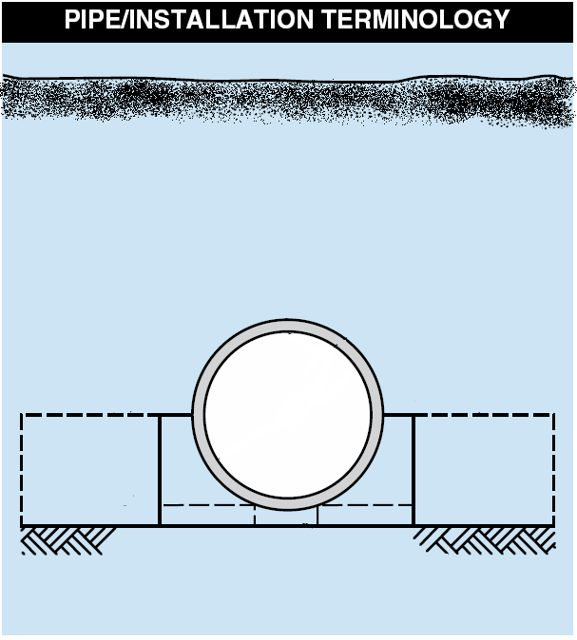
Embedment &Backfill
Backfill
Embedment
Haunch
Springline
Foundation
Bedding
Notes:
And those areas we will be focused on are embedment below the springline and backfill above the springline

Slide 4
The Table has been set…
Notes:
The table has been set…next slide please

Slide 5
We’ve talked about…
Chapter 1 – Fundamentals
Chapter 2 – Bedding & Foundation
Chapter 3 – Handling and Storage
Chapter 4 – Pipe Laying
Chapter 5 – Joints and Joining
Chapter 6 – Structure Connections
Chapter 7 – Embedment & Backfill
Notes:
(Mention first 3 then)…Now, we are moving to Embankment & Backfill

Slide 6
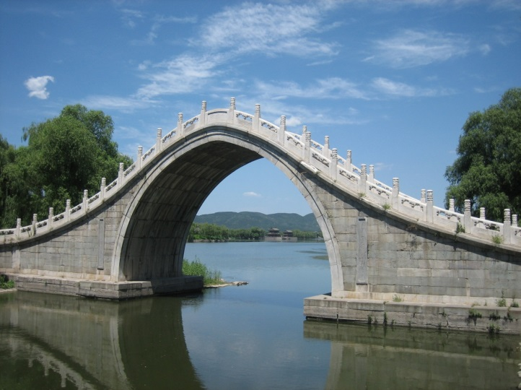
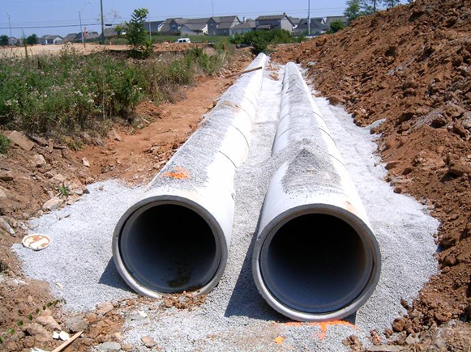
Storm Drain Pipe’s Functions

Conduit
Structure
Notes:
But let’s have a quick review…From our fundamentals earlier we learned that there are two main functions of a storm drain…Anyone remember? I can get Tryg (or another presenter if not Tryg) back up here to go over his presentation again if needed or I can just call on someone…maybe in the back row

Slide 7
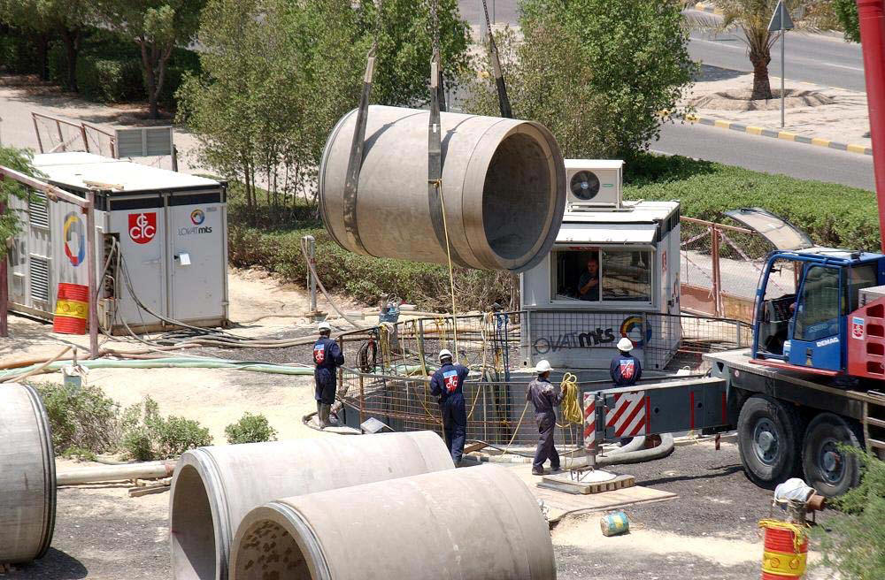
Notes:
Ask the audience if this is proper handling?
Slings are properly in place, so the pipe is balanced. Looks like nylon straps, which keeps the exterior undamaged.

Slide 8
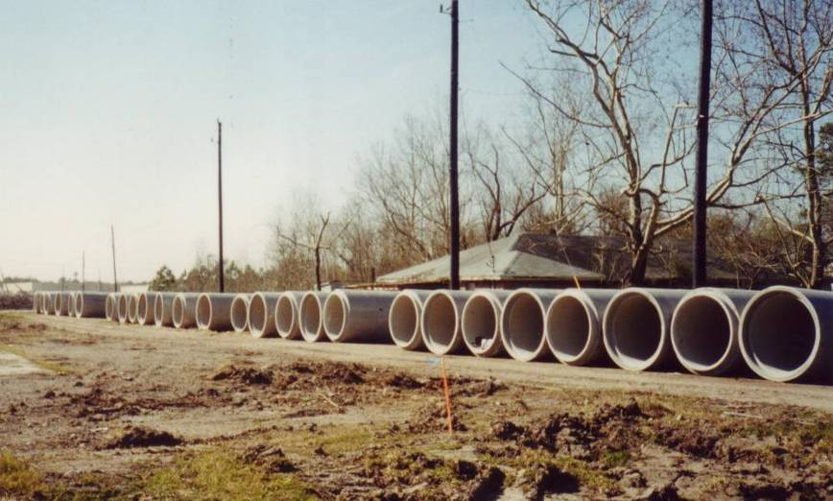
Notes:
Ask the audience what is wrong with this stockpile? Name the number of boo boos
4 from our checklist:
Pipe is not store don flat area
First layer of pipe is not raised off ground
Pipe is not supported so joints are protected
All blocks and wedges are firmly in place.

Slide 9
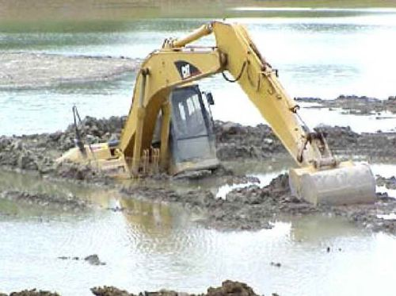
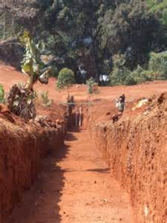
Foundation and Bedding
Notes:
Ok, I am going to toss you a softball here…Would you think that this is a good foundation or not? How about this one?

Slide 10
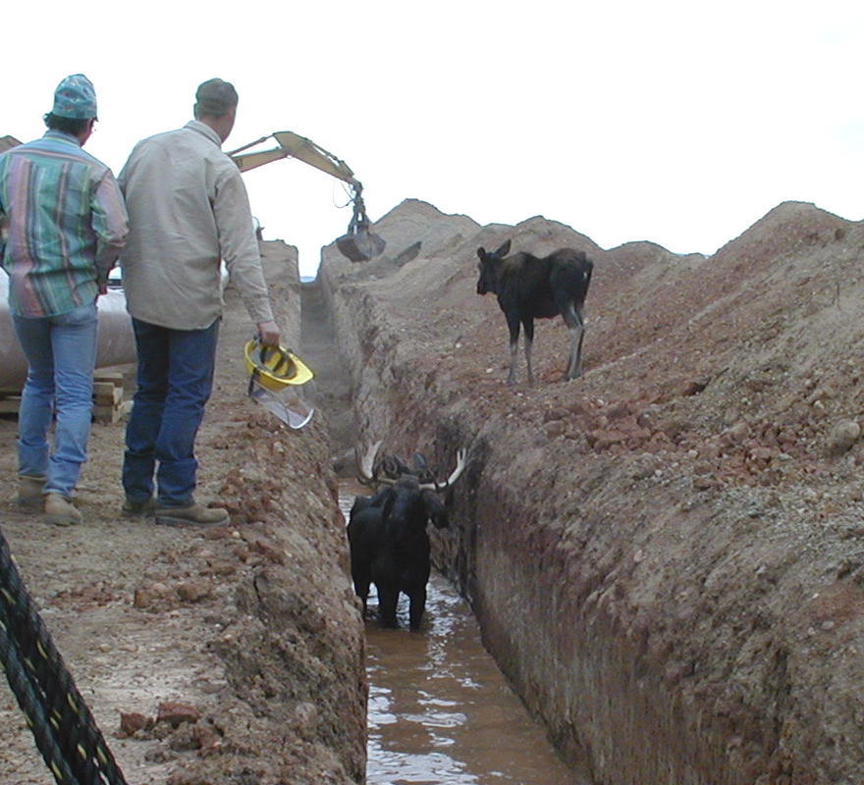
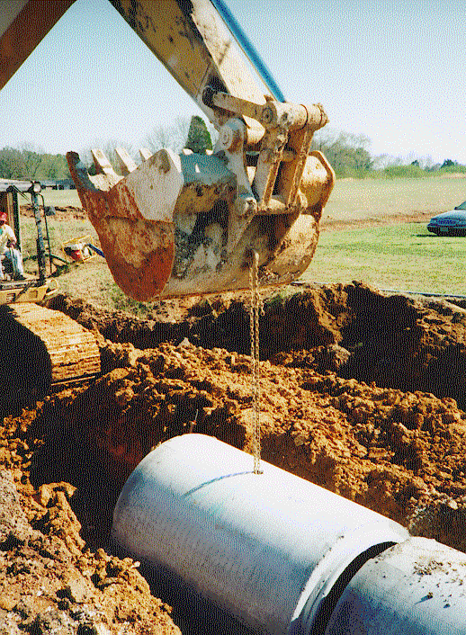
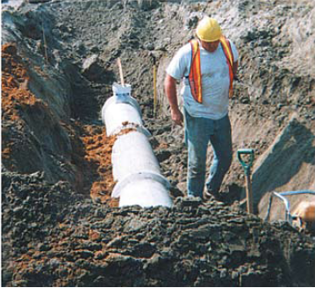
Laying Pipe
Notes:
Laying pipe with bell end in upstream direction…Why? This helps prevent bedding material from being forced into the bell during jointing, restrains joint and enables easier coupling of pipe sections.
“Do not lay or embed pipe in standing or running water…or with animals in the trench” With no pump nearby one has to improvise for that perfect installation. Anyone want to venture a guess what these are?

Slide 11
Types of Joint Systems
Performance Type | Sealant
Soil Tight | Mastic filler External Geotextile Wrap External Sealing Bands Rubber Gasket
Silt Tight | Mastic Filler External Sealing Bands Rubber Gasket
Leak Resistant | Rubber Gasket
Notes:
Soil-tight Definition (AASHTO PP 63-09)
A soil-tight joint does not allow sands similar to sugar or table salt to pass through. Think back to the discussion in the Fundamentals section.
Silt-tight Definition (AASHTO PP 63-09)
As dry as a baby’s bottom…A silt-tight joint would not allow fines as small as talcum/baby powder to pass through
Silt tight joints typically utilize some form of filtering or sealing component, such as a geo-textile fabric.
Silt tight joints should pass a 2 PSIG laboratory test.
Leak Resistance Definition (AASHTO PP 63-09)
Leak resistance refers to a system that is not completely (100%) watertight, but maximum rate of 200 gallons/inch diameter/mile/day. So for two sticks of 24” pipe, 14.5 gallons/24 hour day is allowed to leak out of them in the field. (200gal*24” *16’/5280)
Water-tightness Definition (AASHTO PP 63-09)
Water-tightness refers to a system that has zero leakage or infiltration and typically utilize a resilient rubber seal of some type, and are capable of passing a laboratory hydrostatic pressure and vacuum test of at least (10.8 PSI) without leakage.

Slide 12
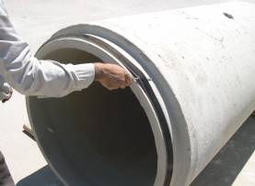
Gasket Installation
Equalize gasket stretch
Notes:
Equalize the rubber gasket stretch by running a smooth, round object (such as a screwdriver shaft), inserted between gasket and spigot, around the entire circumference several times. Unequal stretch could cause bunching of gasket and may cause leaks in the joint or crack the bell. I have a question…When installing a gasket in the field, is it best to install from top down or bottom up? Pause………………Unless you don’t value your face, then bottom up :=}

Slide 13
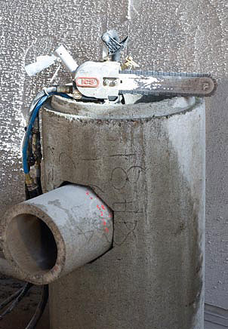
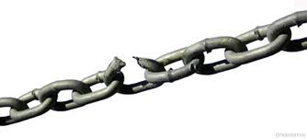
Where is the Weakest Link
Notes:
We are all familiar with the saying “A chain is only as strong as its weakest link”. If one step or phase in a system fails the whole system is at risk of failure. A pipe line system is no different. It is important to review the system from beginning to end. Find the weak link or links and work to strengthen them.

Slide 14
Options to Meet the Challenge
Mortar Connection
Booted/Compression
Pipe Stub
Notes:
As with most things, none of the methods of connecting pipe to structures is perfect. Each has pro’s and con’s and can be dependent on the application and pipe type.

Slide 15
A Buried Pipeline is a Structural System that Incorporates BOTH the Properties of the Pipe and the Properties of the Soil…
Notes:
And that will lead us to a buried Pipeline…(read above) we move forward in our perfect world we begin to see that to get to that perfect long-term installation we have to have a conduit and structure that becomes our buried pipe… Soil and Pipe are mutually dependent on each other to provide a sound structurally buried pipeline. However, there are some fundamental differences between the soil dependency for this rigid pipe here and and a flexible pipe…but I’ll talk about later.

Slide 16
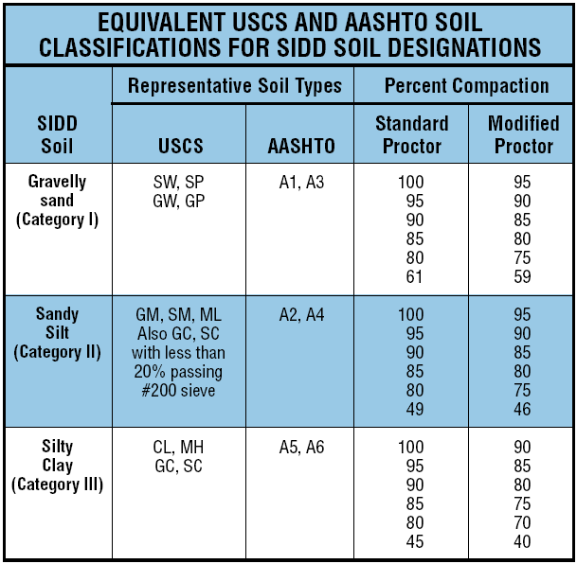
Notes:
The Unified Soil Classification System (USCS) seems to be the most commonly used in the construction industry. But the real point here is regardless of the Standards that are used we have to be able to determine what the various soil properties are for a successful installation. So why do we keep keep droning on about soil? Because pipe and soil are co-dependent to create a buried pipeline structure. This will be on the test. But we typically see conservative designs where the pipe takes more load than having to depend on the unknown soil situations that may be encountered. As Tryg mentioned in Fundamentals we call it a TYPE III Bedding Design. We see an example later

Slide 17
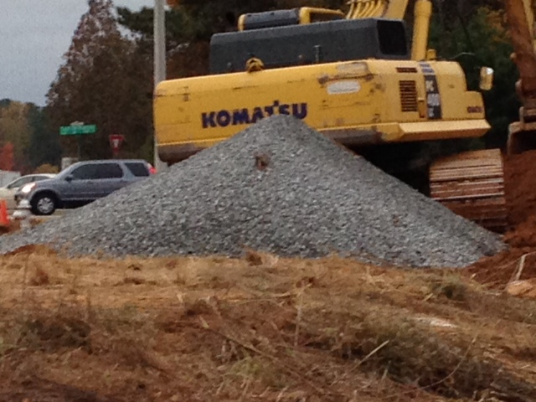
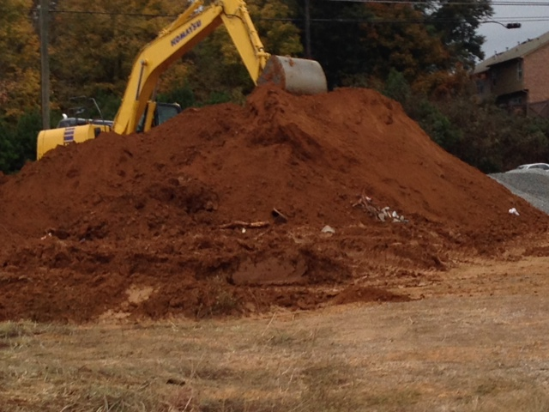
Can you identify the backfill material type
Notes:
So, from these pictures who can tell me the types of backfill materials we are looking at? Maybe it’s clay since it is reddish, maybe it is the garden variety rich in nutrients because it is dark in color? Probably the easiest one to identify is what? Maybe this one (click) Why would you not want large rocks in the backfill?

Slide 18
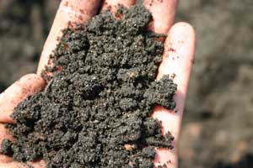
What is it really?
Notes:
Maybe if we held it in our hand we could analyze it better…maybe not. Or, hopefully the backfill material and in situ materials have already been identified for you by a geotechnical expert…Any in the audience? I would add this to my check list to ensure my perfect, long-term installation. Does anyone think this might be organic material or peat? What would you do if it was??? Could be an obstacle for us. The great news about a rigid pipe like RCP in situ soils that are excavated are normally suitable for backfill material. Even better, RCP pipe can be design to address unusual soil conditions by a different design strength or “Class” of pipe

Slide 19
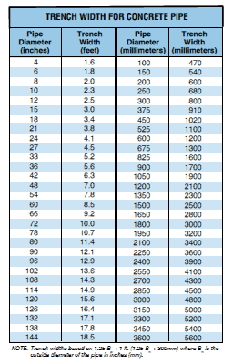
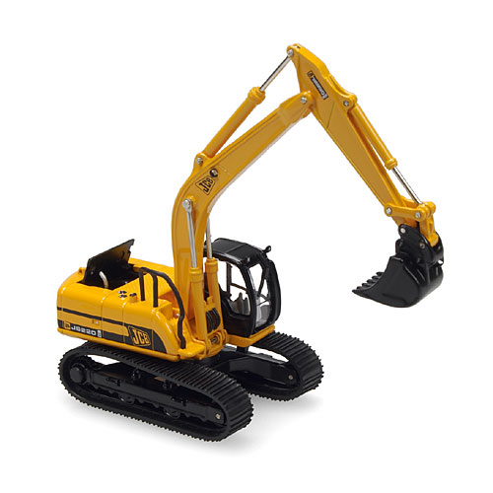
Trench Width
The trench width shall be wide enough for adequate space to attain the specified compaction in haunch and bedding
Notes:
So, we have the soil checked off, foundation and bedding in place and the pipe is in the ditch…But…can I achieve the proper embedment in the haunch area and backfill without considering or knowing what my trench width requirement need to be??? As you know the answer is no. There are charts and math equations to calculate trench widths, but a fairly simply method is….(click). Read slide, then said another way for my check list is “can I get a piece of equipment and a person to operate the equipment into the trench, SAFELY, to achieved the desired compaction. More great news for concrete pipe is once you get the haunch and embedment up to the springline you can start placing backfill material over the pipe. I’ll show you later how that differs significantly flexible pipes as to when you can bring in the backfill material.

Slide 20
Solutions to place embedment?
Notes:
Is there anything in this picture that might prohibit a perfect installation? Bedding? Trench width, compaction which we will talk more about later. Is there a way to get into the trench to properly compact the material? Wonder if the folks in the back of the picture are having a similar discussion. What might be a solution to ensure a proper installation in this situation? Where might you commonly encounter this situation? This looks fairly rural…Maybe the use of flowable fill. Any other thoughts?

Slide 21
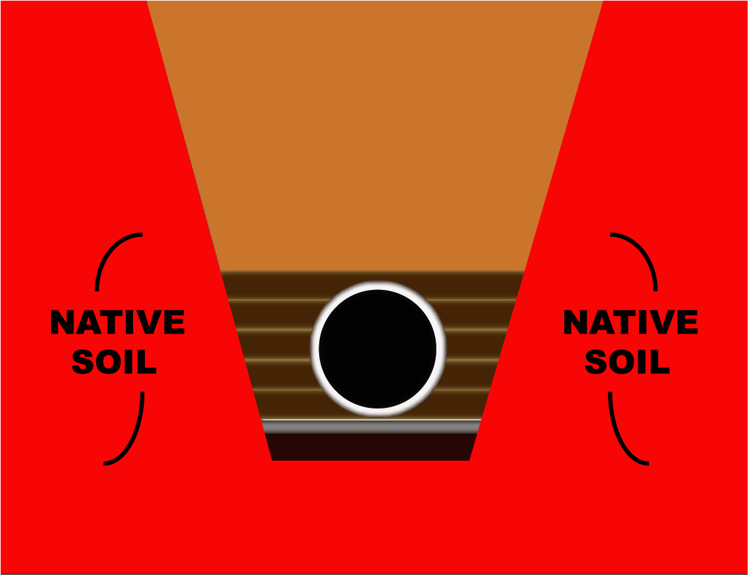
Notes:
Most undisturbed native soils are stable. And with the previous slide the soil tends to have a great deal of stiffness like this picture where the soil is not caving into the ditch. When you do have stable native soil you will typically have more success toward that perfect installation.

Slide 22
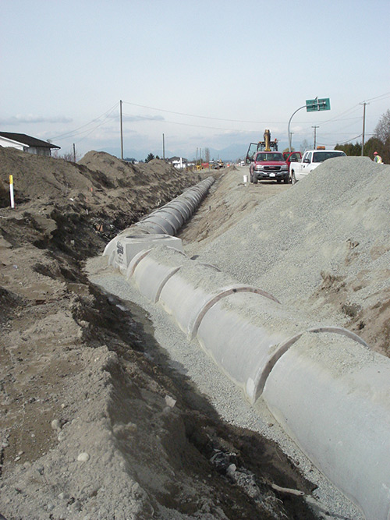
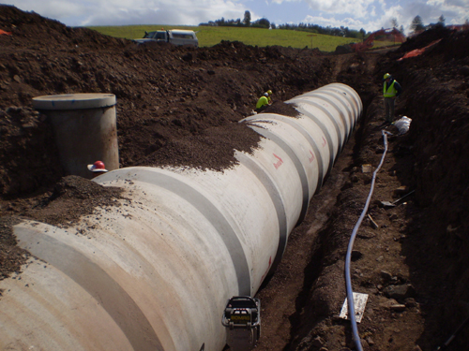
Placing embedment made easy
Notes:
These are examples of what will ensure a perfect successful long-term installation. I would call these ideal and very easy to get soil into the haunch area and compact properly.

Slide 23
Embedment Placement
Notes:
Another ck List item is Embedment material should be placed evenly along the trench and equally on both sides of the pipe in order to maintain alignment and proper compaction. If you dumped a large mass of material only on one side you could cause some movement but typically RCP easily retains it’s alignment during installation. But if you work really hard at it you can move the pipe :=}

Slide 24
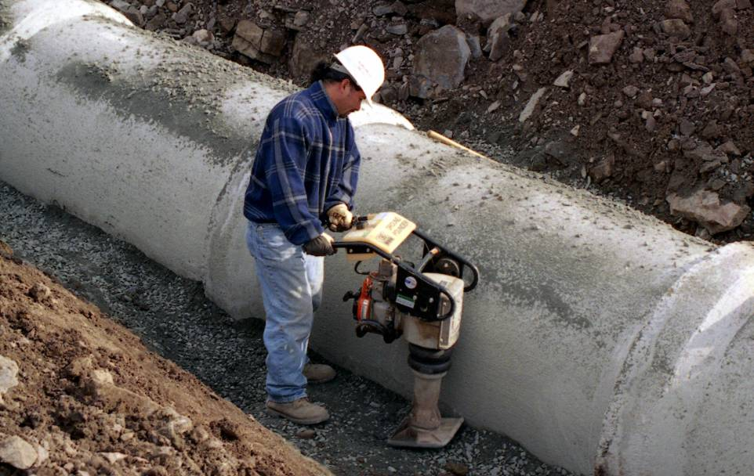
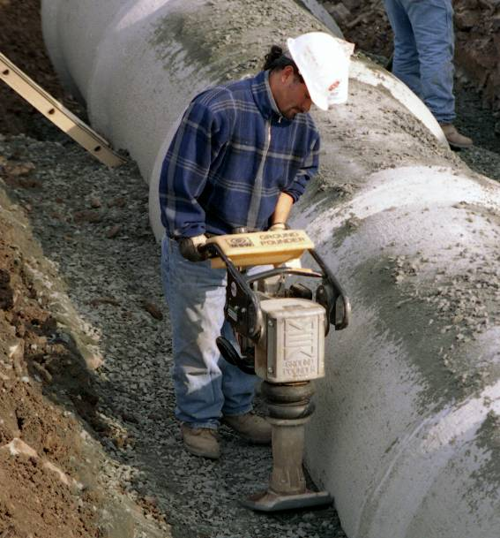
Proper Placement of soils
Soil that supports the pipe
The right trench width
Evenly distribute the load and stress around the pipe outer diameter when compacting and placing soil.
Must be carried to the pipe spring line.
Notes:
This is a very good example of the proper trench width and proper equipment to compact the embedment material. Another good check list item is to determine if the proper installation procedures are being followed to avoid not only improper installation but unnecessary liability. The best rule of thumb is to make sure the plans follow the MANUFACTURER’s and/or NATIONAL STANDARDS.

Slide 25
Backfill
Haunch Compaction
Springline
Bedding
Notes:
I talked earlier about some fundamental differences about rigid pipe and flexible pipe. The key difference is between the embedment material requirements for each…

Slide 26
Thermoplastic Pipes
Source: ASTM 2321 – installation for thermoplastic pipes and manufacture’s standards
Notes:
Typically for flexible pipes the embedment height will end at about 6-inches to 1-foot above the pipe. The above figure is from ASTM D2321 and shows the embedment zone for a plastic pipe to be installed under this specification.

Slide 27
Backfill Requirements
Backfill shall be constructed as specified in the project specifications.
Well graded soils are best
Take care to avoid damaging the pipe
No large debris, organic matter, frozen lumps, or large stones.
Soil shall be compacted to the specified density requirements.
Notes:
With RCP, a good embedment material in the Haunch up to the Spring Line is King!!! Remember that the excavator bucket is not a pipe leveling device used to push the pipe down to grade.

Slide 28
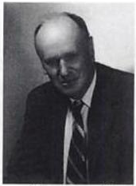
Test Methods for Laboratory Compaction
ASTM D 698 and ASTM D 1557
The Proctor compaction test and the related modified Proctor compaction test, named for engineer Ralph R. Proctor (1933), are tests to determine the maximum practically-achievable density of soils and aggregates
Notes:
Soil compaction technics are not new. And, there are a number of methods to validate compaction. (Soil in place is tested for in-place dry bulk density, and the result is divided by the maximum dry density to obtain a relative compaction for the soil in place.)

Slide 29
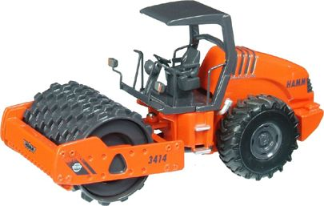
Compaction is the process of increasing the bulk density of a soil or aggregate by driving out air.
Notes:
(read slide) Like this Sheep’s foot roller as I call it, there is a very wide variety of equipment used to achieve compaction. But using compaction equipment can be hazardous to the storm drain’s health. What is one thing you can do to achieve compaction in dry soils? Add water as allowed by local project engineer, inspector, etc.

Slide 30
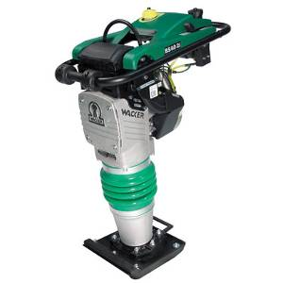
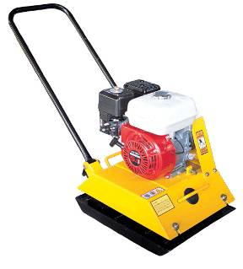
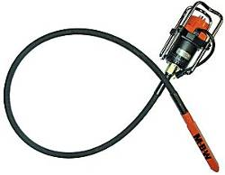
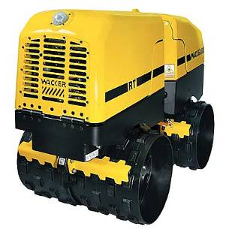
Soil Compaction Methods
Impact
Clays, silts, plastic soils, etc.
Vibration
Granular soils, crushed stone, sands.
Kneading
Natural soils, clays, mixed soil materials
Notes:
Here are some fairly standard tools that all of you have seen…Which ones seem to work best for you and why? Types of soils in your area? Jetting in w water? comfort level? ease of getting in and out of trench? Probably no wrong answers except maybe a sheep's foot on gravel and sands :=} Maybe asked the Q? Why would you not use the bottom machine on gravel or sand? Will make a hole in the material…

Slide 31
Rule of Thumb…
Do not operate large compactor equipment (e.g. a hoe pack) directly on top of any pipe without adequate fill…
Based on your experience, what is considered a safe minimum cover over the buried structure when using heavy compaction equipment???
3 feet
Notes:
Like a hoe pac or that 20 ton dump truck with 40 tons of soil in it…ACPA and University of Texas at Arlington have also done research to validate. However site conditions and types of equipment can vary.

Slide 32
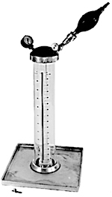
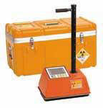
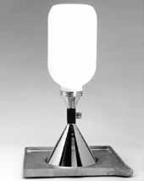
Validate Compaction
ASTM D 2167
ASTM D 2922
ASTM D 1556
Notes:
So, what are acceptable compaction results? “Whatever I can get away with.” “Whatever the inspector feels like.” “Whatever is most difficult for the contractor.” “too wordy to tell on plans.”

Slide 33
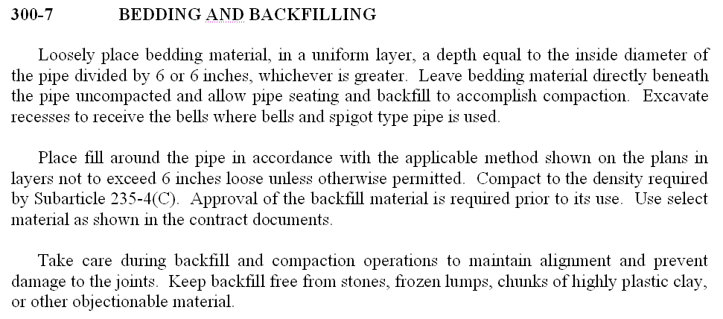
> 95%
Notes:
More details on compaction. As we read through this, no let’s just cut to the chase…greater than 95% is typical for backfill requirements but it may be driven by other factors such as under the road bed…

Slide 34
In situ Silty Clay
Notes:
OK, you are almost finished with the project, you are going on vacation in the morning…actually taking off Friday so you can get out a day early. Per the plans, bedding and backfill material could not be better, 30” pipe, 10 foot deep, everything points to the class III RCP laying near the trench…Great!!! You start excavating and the excavator bucket discovers a 84 inch diameter RCP gravity sewer. You have to finish the job today…So now what

Slide 35
Notes:
But, what if its 30” pipe, same soil type, and 18 feet deep? Call home and suggest you may be a few minutes late?
Maybe talk with the project engineer or inspector, just install the class III pipe because you know it is soooo over designed and just call it a day? Or see what else might work so you get that perfect installation…Another good ck list item.

Slide 36
Installation Video
Notes:
Side by side installation comparison of dissimilar materials that follow the national standards…Hope you find the video interesting

Slide 37
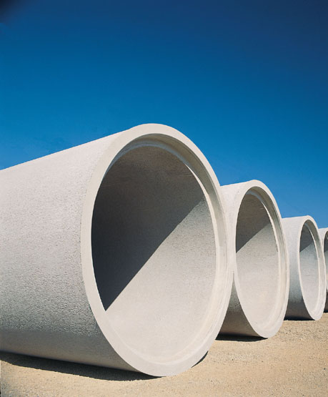
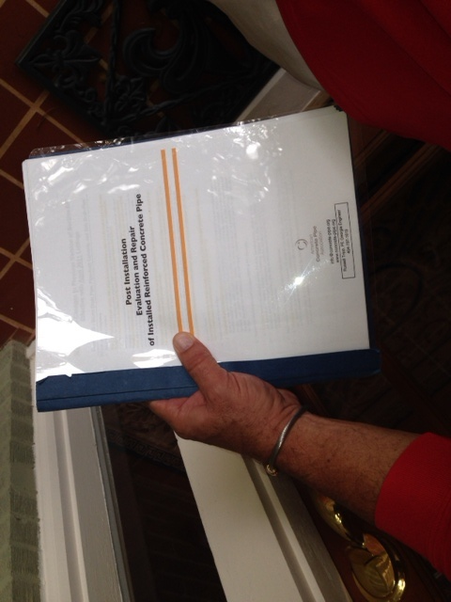
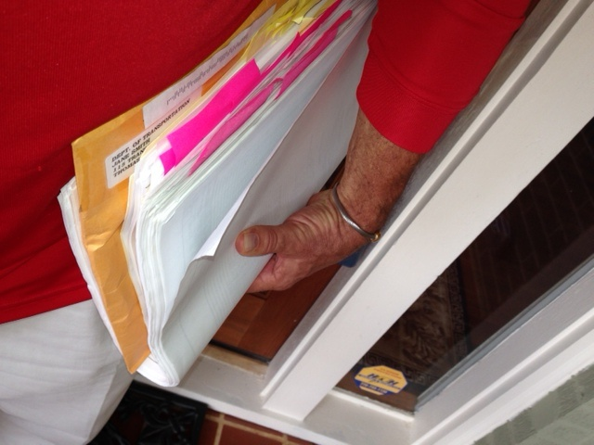
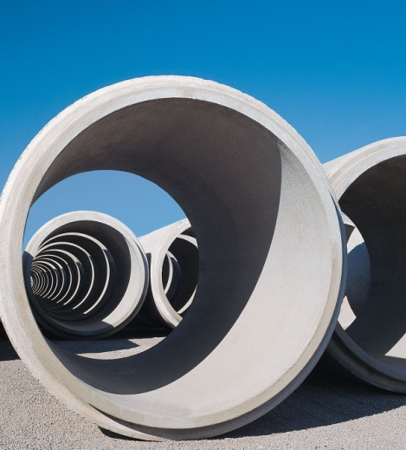
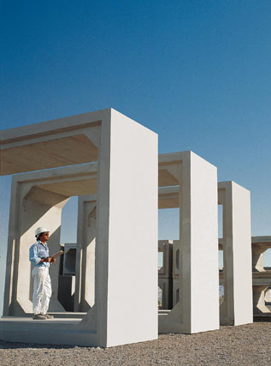
www.concrete-pipe.org
Notes:
Just when you think you have it all in your head and hands, there is usually one more item you could use…Post Installation Evaluation and Repair is the final chapter for the perfect installation.

Slide 38
Here’s the recipe, Just Add…
Correct soil
Required trench width
Proper soil placement
Compaction requirement
Right compaction equipment
ACPA tools/references/staff
Experience

Slide 39
And, you get a perfect installation
Soil
Trench width
Soil placement
Compaction
ACPA tools/references/staff
Experience
Notes:
So if we follow the recipe, then no one can point the finger at us…

