Slide 1
Installation and Inspection of Concrete Pipe Joining / Joints
Types of joints and sealants
Storage and Handling
Proper methods of joining pipe
Testing
How to protect your interest by inspection
Checklist for Contractors / Inspectors
Notes:
Required Reading:
ASTM C924 -Standard Practice for Testing Concrete Pipe Sewer Lines by Low Pressure Air Test Method
ASTM C 969 – Practice for Infiltration and Exfiltration Acceptance Testing of Installed Precast Concrete Pipe Sewer Lines
ASTM C1103 – Practice for Joint Acceptance Testing of Installed Precast Concrete Pipe Sewer Lines
ASTM 1214 - Standard Test Method for Concrete Pipe Sewer lines by Negative Air Pressure (Vacuum) Test Method
Concrete Pipe Installation Manual
http://www.concrete-pipe.org/pages/cpinstall.html
Concrete Pipe Installation Procedures:
http://www.concrete-pipe.org/pdf/CPInstallationProcedures_DosandDonts.pdf
Concrete Pipe Joints, Your Best Choice
http://www.concrete-pipe.org/epipe/ConcretePipeJoints-epipe07-124.pdf
Pipeline Installation by Amster Howard (available from ACPA)
Post Installation Evaluation and Repair , Pages 8, 10, 22-26
http://www.concrete-pipe.org/pdf/Post_Install_Inspect_081011.pdf

Slide 2
Types of Joints and Sealants
Notes:
The function of a pipeline generally determines the performance requirements of the pipe joints. Joints can be designed to provide soiltightness, or watertightness, with the ability to accommodate lateral or longitudinal movement, and strength to handle shear or vertical movement.

Slide 3
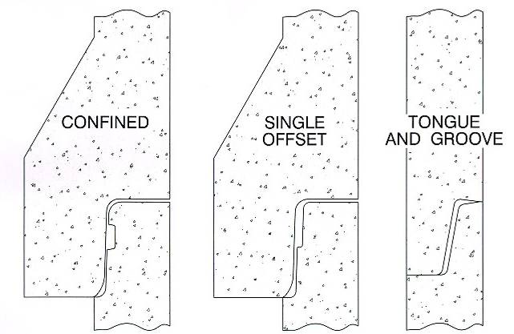
Types of Joint Systems
Notes:
Confined O-ring– This is the first “rubber gasket” joint design established by the industry. Advantages include excellent water tightness and resistance for internal and external pressure. It can however, be a more labor-intensive joint for the manufacturer and the installer compared to a T&G or single offset joint.
Single Offset– This joint design started making its appearance in the early 1990’s. It also tends to be somewhat more forgiving in instances where the contractor fails to equalize the stretch of the gasket during installation (it has fewer tendencies to roll or slide out of place).
Tongue & Groove – There is no defining areas for gasket material placement. It is usually limited to mortar, mastic or butyl sealants. It is typical to stormwater systems where a soil tight joint is required. Advantages include its ease of manufacturing and ease of installation.

Slide 4
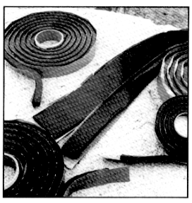
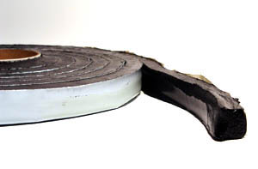
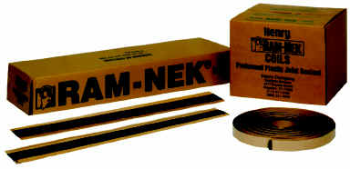
Types of Sealant
Mastic
Ram-Nek
Rubr-Nek
Notes:
Mastic sealants consist of rubber compounds that feel like tar and is a sticky material.
The joint surfaces should be thoroughly cleaned, dried prior to installation of the Mastic.
A sufficient amount of sealant should be used to fill the annular joint space with some squeeze out.
During cold weather, better workability of the mastic sealant can be obtained if the mastic and joint surfaces are warmed.
Joints utilizing flexible mastic sealants typically perform as a soil-tight system.

Slide 5
Types of Joints Systems
External Bands and Filter Fabric
Notes:
External flexible sealing bands and are designed to be wrapped around the exterior of the joint to provide resistance to infiltration and/or exfiltration.
Geotextile Filter Fabrics are usually 1 to 2 feet (.3 to .6 meters) wide may be wrapped around the exterior of the pipe joint and secured with either tape or stitching to prevent soil infiltration into joints of storm and
culvert pipe.
External Bands
Portland cement mortar bands are sometimes specified around the exterior of the pipe joint. A
slight depression is excavated in the bedding material to enable mortar to be placed underneath
the pipe. The entire external joint surface is then cleaned and soaked with water. Special canvas or
cloth diapers can be used to hold the mortar as it is placed. Backfill material should be immediately
placed around the pipe.
Rubber-mastic bands also can be used around the exterior of the pipe joint. The bands are stretched
tightly around the barrel of the pipe and held firmly in place by the weight of the backfill material.

Slide 6
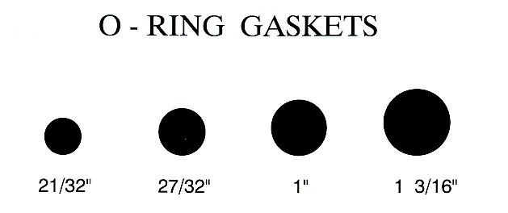
Types of Sealants
www.concretepipe.org
Notes:
O-ring gaskets come in multiple cord diameters, compounds, and durometers to meet multiple applications and soil conditions. Gasket manufacturer certify the volumetric size and high strength of the splice, but these features should be double checked, and the correct size gasket must be installed on the pipe or it will either break the bell of the pipe if too big or not seal the joint if too small.

Slide 7
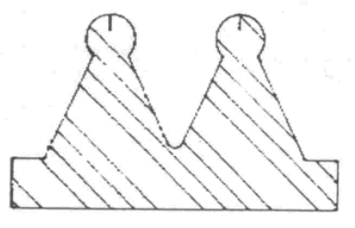
Types of Sealants: Profile Gaskets
Symmetrical
Non-Symmetrical
Pocket Type
www.concretepipe.org
Notes:
Advantages:
Unlimited Shapes and Sizes
Can be used in Confined or Single Offset Joint
Excellent Performance
Less Prone to Displacement during assembly
Disadvantages:
Cost can be higher
Still requires bell and gasket to be lubricated
Can’t be installed backwards if not symmetrical

Slide 8
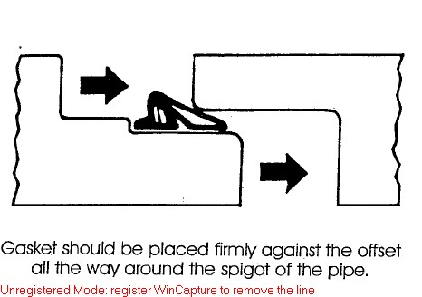
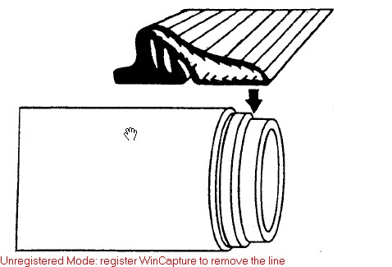
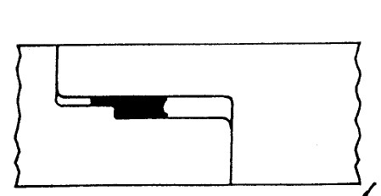
Types of Sealants:
Pre-lubricated Profile Gaskets
Notes:
Profile Gaskets have their Advantages and Disadvantages
Advantages:
Unlimited Shapes and Sizes
Can be used in Confined or Single Offset Joint
Excellent Performance
Less Prone to Displacement during assembly
Disadvantages:
Cost can be higher
Still requires bell and gasket to be lubricated
Can’t be installed backwards if not symmetrical
Shown above is a Pre-Lubricated Gasket should be installed by placing the gasket firmly against the shoulder of the pipe spigot. Not field lubrication is needed as it is self contained inside the gasket tube. Do not hang pre-lubricated gaskets or the lubrication will end up in only the bottom part of the gasket. Pre-lubed gaskets are easier to install in the field, but are more expensive than traditional gaskets. If done correctly, both pre-lubed and gaskets lubed in the field will perform as intended.

Slide 9
Types of Joint Systems
Performance Type | Sealant
Soil Tight | Mastic filler External Geotextile Wrap External Sealing Bands Rubber Gasket
Silt Tight | Mastic Filler External Sealing Bands Rubber Gasket
Leak Resistant | Rubber Gasket
www.concretepipe.org
Notes:
Soil-tight Definition (AASHTO PP 63-09)
A soil-tight joint does not allow sands similar to sugar or table salt to pass through. Think back to the discussion in the Fundamentals section.
Silt-tight Definition (AASHTO PP 63-09)
As dry as a baby’s bottom…A silt-tight joint would not allow fines as small as talcum/baby powder to pass through
Silt tight joints typically utilize some form of filtering or sealing component, such as a geo-textile fabric.
Silt tight joints should pass a 2 PSIG laboratory test.
Leak Resistance Definition (AASHTO PP 63-09)
Leak resistance refers to a system that is not completely (100%) watertight, but maximum rate of 200 gallons/inch diameter/mile/day. So for two sticks of 24” pipe, 14.5 gallons/24 hour day is allowed to leak out of them in the field. (200gal*24” *16’/5280)
Water-tightness Definition (AASHTO PP 63-09)
Water-tightness refers to a system that has zero leakage or infiltration and typically utilize a resilient rubber seal of some type, and are capable of passing a laboratory hydrostatic pressure and vacuum test of at least (10.8 PSI) without leakage.

Slide 10
Joint and Gasket Inspection

Slide 11
Defect Review
You are now the QC Inspector
Do the following products:
Meet specifications?
Can they be repaired?
Or should they be rejected?
www.concretepipe.org

Slide 12
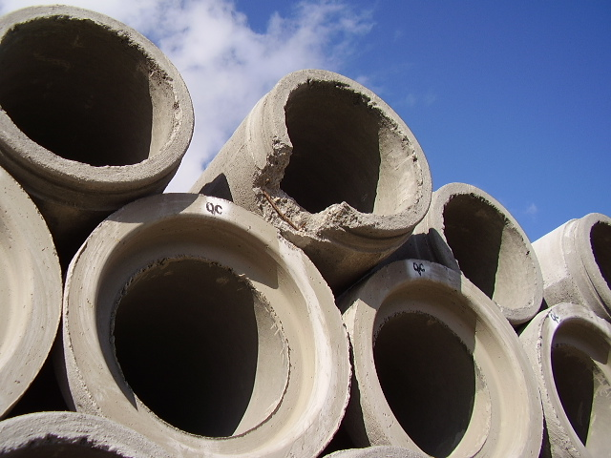
REPAIRS
Notes:
Note: This piece should not be in a pile of good pile as shown. This pipe should be scraped, non-repairable due to the depth of the break and reinforcing steel being shown. A repair would likely compromise the outer sealing surface of the joint. But it could be cut and connected to a structure
According to ASTM C443, Section 14: Spalled areas, imperfections, or damage during handling, of each pipe end, are not prohibited from being repaired and will be acceptable, if the repaired pipe conforms Section 7.1.2(all surfaces of the joint upon or against which the gasket is capable of bearing shall be smooth, free of spalls, crack or fractures that would adversely affect the performance of the joint.)
The length of a single repair should not exceed 1/4th the inside diameter or the combined area of several repairs should not exceed ½ of the diameter.

Slide 13
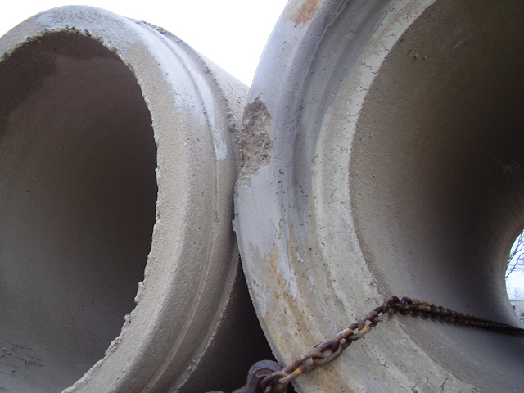
Notes:
Minor defect but, been repaired once. Still could be used—repairable.
This is already loaded on a truck. Chain protectors should be used here. Also note, the broken chain link.

Slide 14
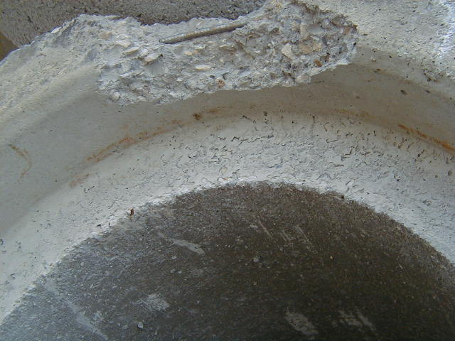
Notes:
Recommend not repairing this due to the integrity of the joint has been compromised. If this pipe is intended for a soil tight application rather than leak resistant, a repair could be made with owner approval

Slide 15
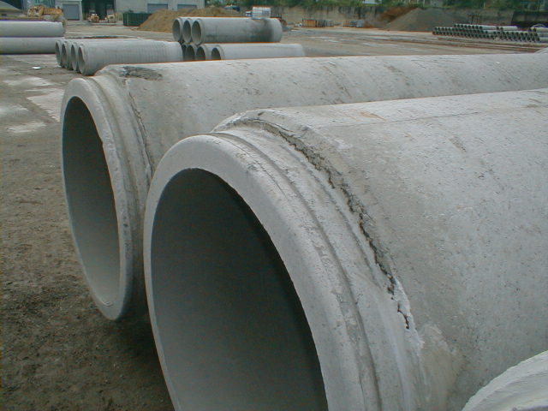
Notes:
Do not repair or use. Significant shoulder crack, and concrete is delaminating.
Quiz: What did we just learn about how much of the joint can need repair for a single joint? ¼ the Diameter of the pipe.

Slide 16
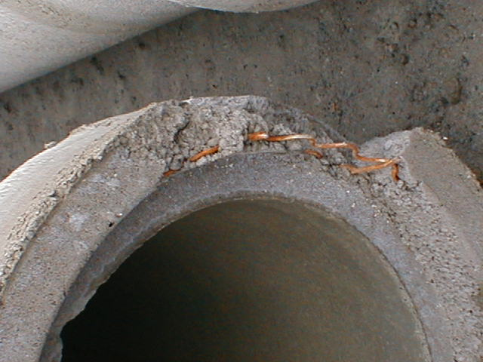
Notes:
Non-repairable due to exposed steel, and the break appears to be as deep as the entire depth of the joint

Slide 17
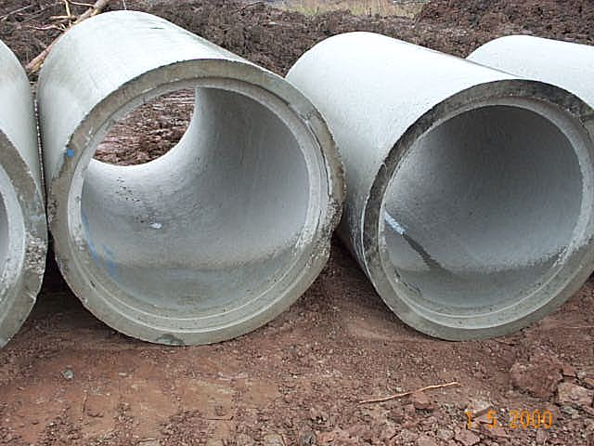
Notes:
The repair is not compromising to the joint, can be repaired.

Slide 18
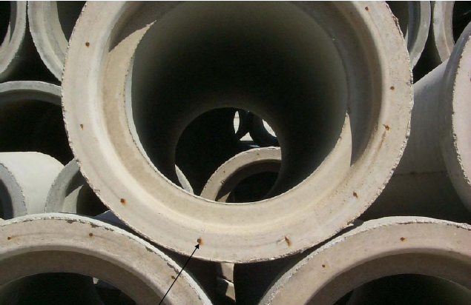
Notes:
End of Longitudinal Reinforcement Exposed that comes from AASHTO
Acceptable

Slide 19
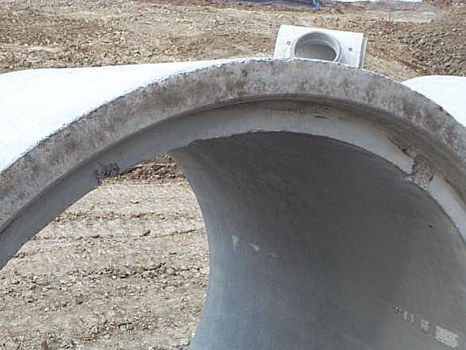
Notes:
Can this pipe be repaired?
The repair is not compromising to the joint, can be repaired. Note, that it looks like there is a crack running around the shoulder of the joint. This is simply discoloration.

Slide 20
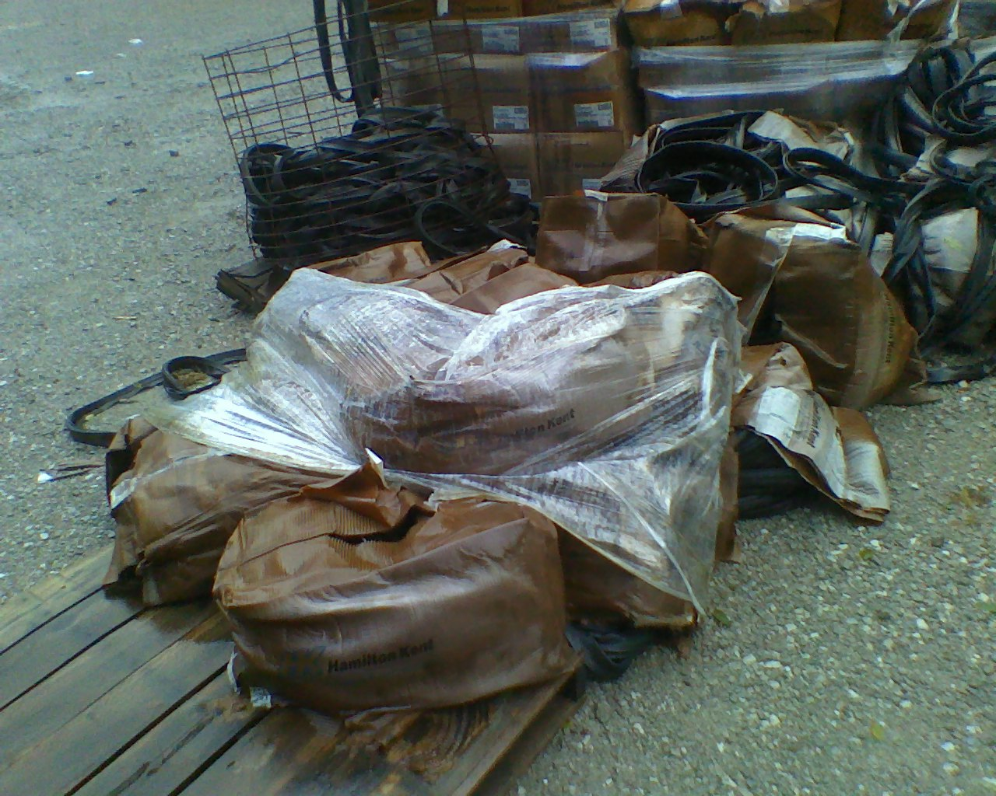
Gasket Storage
Don’t Do This…
Notes:
Proper care of the gaskets prior to installation will ensure maximum ease of installation and maximum sealing properties of the gasket. All rubber gaskets are required to be stored in a sheltered, cool, dry place at the precaster’s facility, as well as on the job site.
Cut length and % of stretch will vary between suppliers
Do not mix gasket suppliers on job
Do not hang pre-lubed gaskets
Storage – FIFO
Gaskets must not be stored near any electrical equipment that produces ozone. They must be protected from prolonged exposure to sunlight, extreme heat in the summer, and extreme cold, snow and ice in the winter. All gaskets must be protected from harmful substance such as dust, grit, solvents and petroleum based greases and oils.

Slide 21
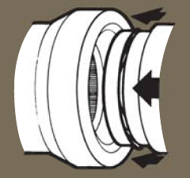
Proper Methods of Joining Pipe
Notes:
We will be discussing the Proper Methods of installing Concrete Pipe Joints. Improperly prepared joining surface of the bell, spigot or gasket recess may prevent homing of the pipe.

Slide 22
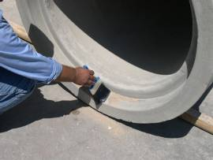
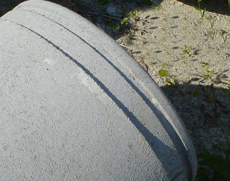
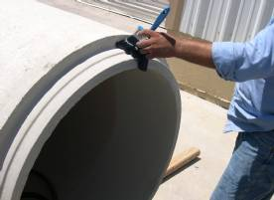
O-Ring Installation – Step 1
Brush or wipe both the bell and spigot clean
www.concretepipe.org
Notes:
Carefully clean all dirt and foreign substances from the jointing surface of the bell or groove end of pipe, and the spigot end including the gasket recess
Improperly prepared joining surface of the bell, spigot or gasket recess may prevent homing of the pipe.

Slide 23
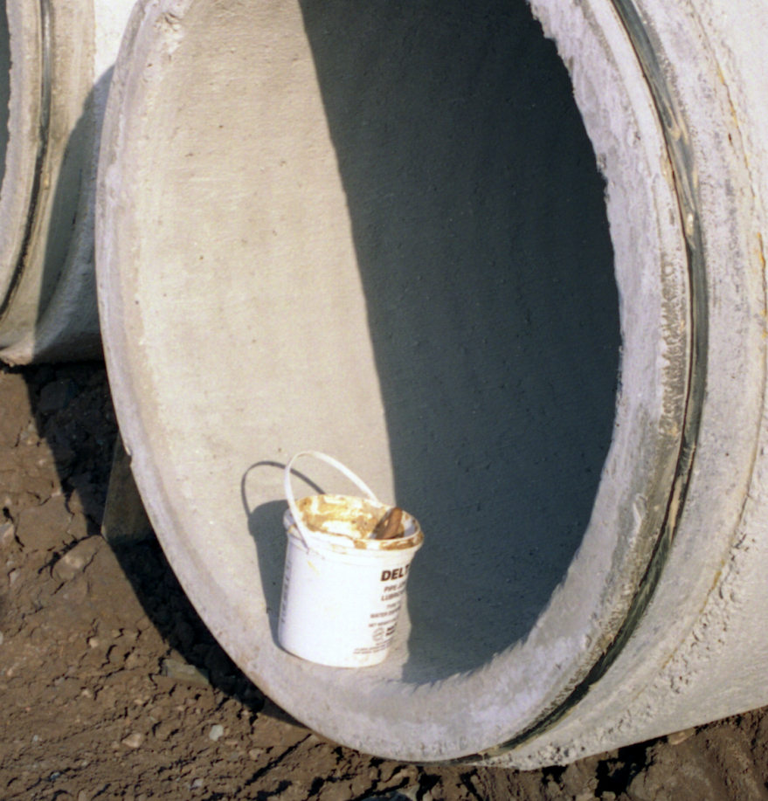
Gasket Installation – Step 2
Lubrication
O
-
R
I
N
G
Stir the Lubricant
Lubricate the recess on the pipe and the gasket.
Snap the gasket into the recess
www.concretepipe.org
Notes:
Lubricate the spigot or tongue end of pipe, especially the gasket recess. Gasket may twist out of recess if lubricant in recess is lacking or insufficient.
Lubricate the gasket thoroughly before it is placed on the spigot or tongue. Excess force will be required to push the pipe to the home position if gasket is not well lubricated.
Lubrication should be stirred 2-3 times per day, and more if its hot if needed. Some lubricants manufactured now do not need stirring.
Lubricate the Groove in order to allow movement of the gasket in the groove during the compression of the gasket as the bell and spigot are connected together

Slide 24
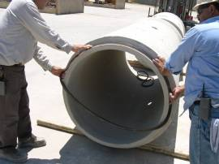
Gasket Installation – Step 3
S
I
N
G
L
E
O
F
F
S
E
T
Lubricate the gasket and mount gasket on Lubricated spigot
www.concretepipe.org
Notes:
Many contractors do not Lubricate the gasket itself or the groove of the spigot. Both should be done in order to reduce friction during installation and avoid breaking joints

Slide 25
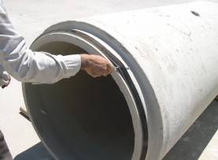
Gasket Installation – Step 4
O
-
R
I
N
G
Equalize gasket stretch
www.concretepipe.org
Notes:
Equalize the rubber gasket stretch by running a smooth, round object (such as a screwdriver shaft), inserted between gasket and spigot, around the entire circumference several times. Unequal stretch could cause bunching of gasket and may cause leaks in the joint or crack the bell.

Slide 26
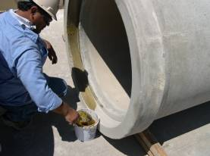
Gasket Installation – Step 5
O
-
R
I
N
G
Lubricate the seated gasket and surface of the bell
Note: Pre-Lubricated Gaskets do not require additional lubrication
www.concretepipe.org
Notes:
Lubricate bell jointing surface liberally. Use a brush, cloth, sponge or gloves to cover entire surface. Only approved lubricant should be used. A bell not lubricated or improperly lubricated may cause gasket to roll and possibly damage the bell.
Lubrication of any part of the pipe including the bell shown here doesn’t take a lot of time, but is critical to making sure the pipe joint perform as intended and do not break upon installation.

Slide 27
Fish Mouth Gasket
O
-
R
I
N
G
Notes:
With an O-ring, if proper lubrication is not applied and a dry spot exists, the gasket may pop out of the spigot groove. This is called fish mouthing.
Only a 1/16 of an inch of space exists between the shoulder of the spigot and the sealing surface of the pipe, so if the gasket rolls out of the groove during installation of the bell end, the bell will break.

Slide 28
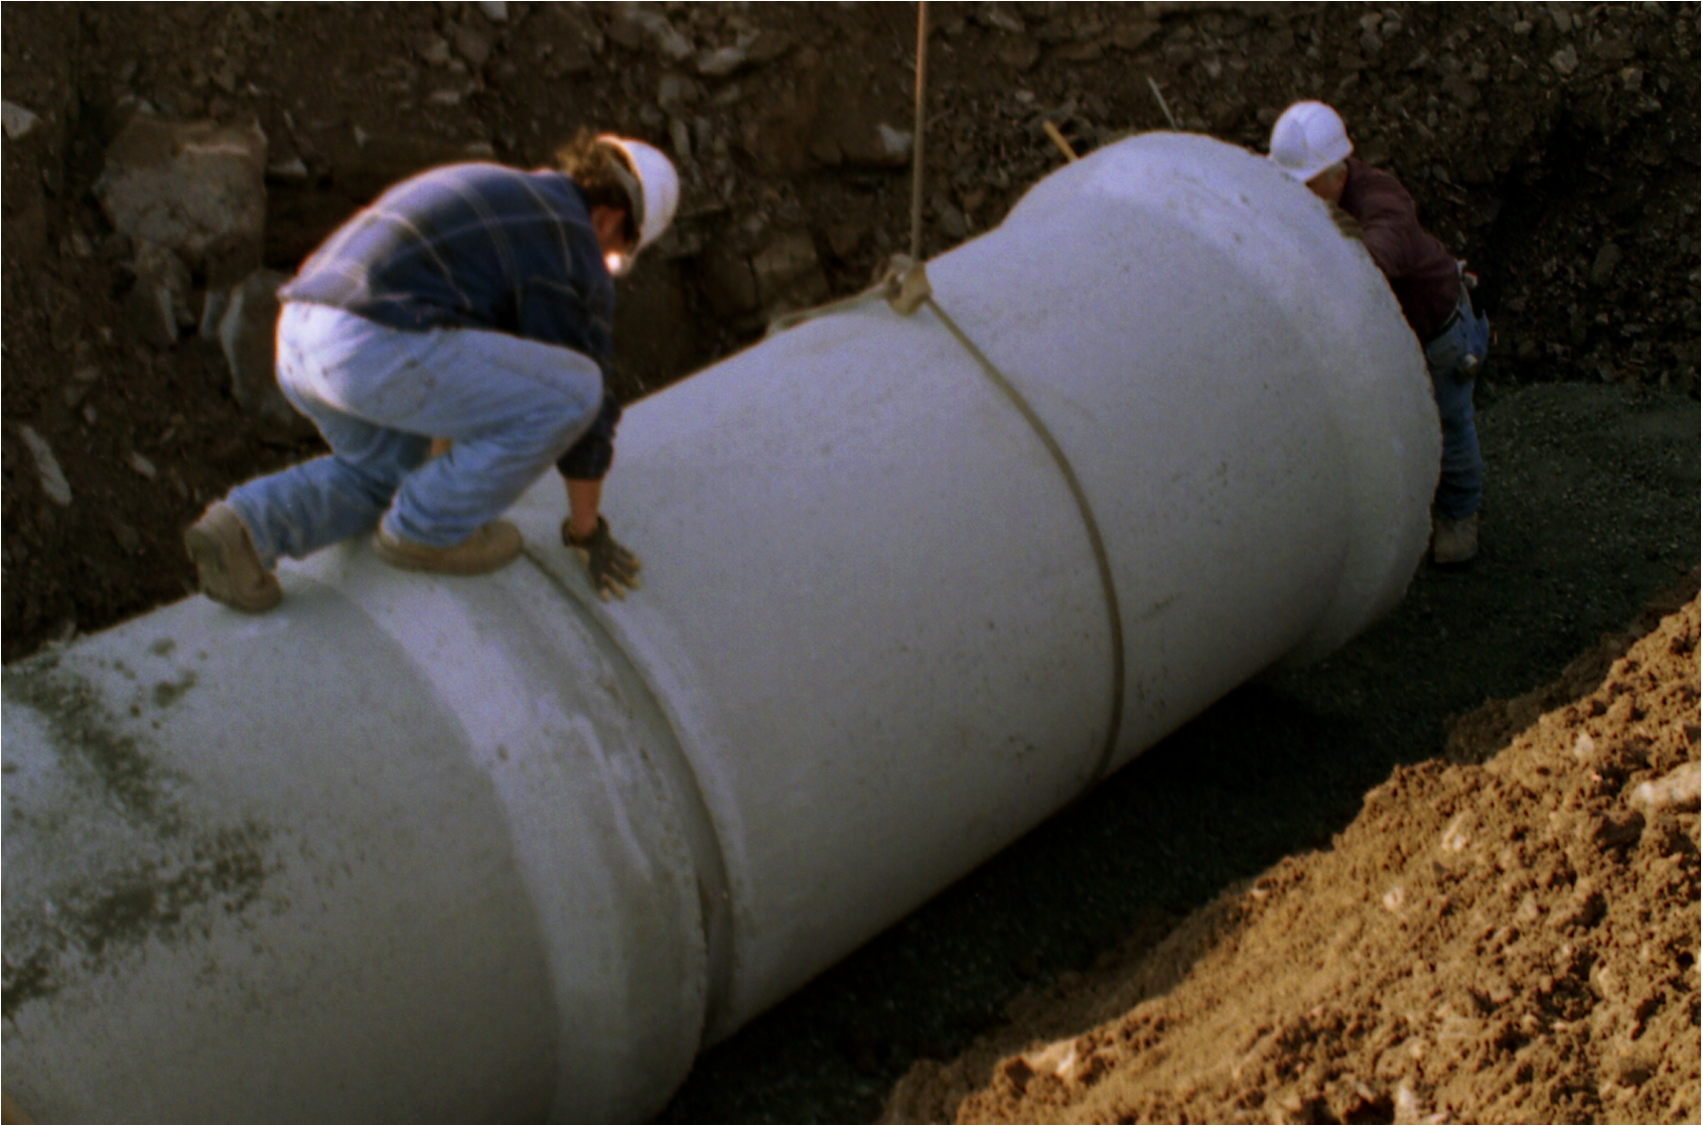
Gasket Installation – Step 6
O
-
R
I
N
G
Carefully align and draw or push spigot into bell
www.concretepipe.org
Notes:
Align bell and spigot of pipes to be jointed. Before homing the joint, check that the gasket is in contact with the entry taper around the entire circumference. Improper alignment can dislodged gasket causing leaks or possibly break the bell.

Slide 29
Gasket Installation – Step 2
S
I
N
G
L
E
O
F
F
S
E
T
Mount gasket on dry spigot
www.concretepipe.org
Notes:
The only step that is different from installing the O-Ring Gasket is that you do not have to Lubricate the gasket or the spigot prior to mounting the gasket. All other steps should be the performed.
A profile gasket is applied to a dry spigot. Be sure the gasket is oriented in the correct direction and the back of the gasket sits against the shoulder of the spigot. The gasket should be pushed all the way against the shoulder.

Slide 30
Gasket Installation – Step 3
P
R
E
-
L
U
B
R
I
C
A
T
E
D
Carefully align and draw or push spigot into bell
www.concretepipe.org
Notes:
When using a pre-lubricated gasket, follow the same steps as you would for a single offset gasket, but you do not need to equalize the gasket or lubricate the seated gasket or bell. Therefore you are down to 3 steps: Clean the bell and spigot, mount gasket, and then home the pipe.

Slide 31
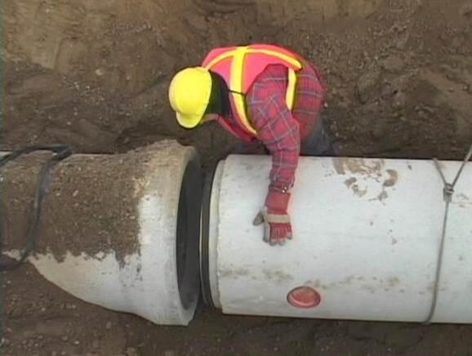
Summary – Joints Made Easy
Inspect Pipe at Delivery
Verify Meets Pipe and Joint Specifications
Visual Inspection Before Backfilling
Is Joint Homed Properly
Complete all Inspections
www.concretepipe.org

Slide 32
Joint Testing

Slide 33
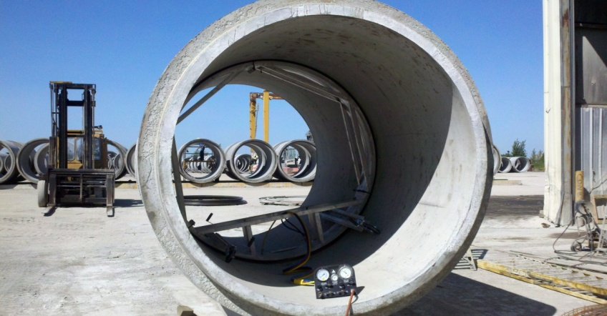
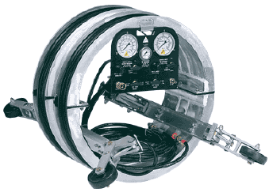
Field Testing: ASTM C 1103
Standard Practice for Joint Acceptance Testing of Installed Precast Concrete Pipe Sewer Lines
www.concretepipe.org
Notes:
Summary: The individual joint tester is used at each joint to verify the integrity of every joint as the product is being installed. It is valid for testing pipe 27” and larger. The apparatus is centered over each joint. The sealing bladders are inflated, and the joint is pressurized to 3.5 psig. Once the test is begun the pressure is required to remain above 2.5 psi for at least 5 seconds.
The intent of this test is to identify installation problems as they are occur so they can be corrected. The equipment works exceptionally well for the intended use. The Equipment does not work especially well for hydrostatic testing each joint as fluid tends to leak past the sealing bladders.
Even though this test does not actually verify the leakage rate on the line it is one of the most valuable field performance tests as it allows for problems to be corrected as they occur, rather than identifying them at the close of the project.
Required test equipment:
Individual joint tester, Stopwatch, Air compressor
Advantages:
Problems are identified while the line is being laid
Problems can be fixed easily
Test is relatively quick and easy
Disadvantages:
Test does not determine actual leakage on line
This test does not check the barrel of the pipe

Slide 34
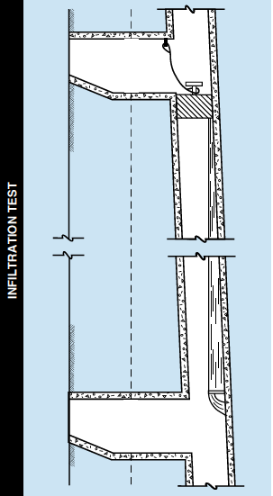
Field Testing: ASTM C 969
Standard Practices for Infiltration and Exfiltration Testing of Installed Precast Concrete Pipe Sewer Lines
Notes:
Summary:
ASTM C969 is one of the most specified standards for determining leakage. This test will usually produce the most accurate and useful data about the line. Typically testing with the C969 is more difficult and time consuming than some of the other tests listed.
Actual leakage of water going into or leaking out of the pipe is measured. Limits are typically set in units of gallons per inch of dia per mile per day. (400gal/in/mi/day is typical) Infiltration testing is done when ground water is present with at least 2’ of head above the line being tested. Exfiltration testing is done when ground water is not present. For exfiltration testing the pipe is filled with water a stand pipe (or manhole) is used to measure leakage and maintain head.
Required test equipment:
Bulkheads/plugs, plumbs, hoses, weir, water, stop watch
Advantages:
This test actually measures leakage into or out of the pipe
Data on actual leakage rate is available
It is often possible to identify individual leaks (Water will be visible coming into the pipe)
Disadvantages:
Setup can be difficult especially for exfiltration testing due to the large volume of water required
Test can only be done on a completed line
This test typically takes a long time to perform

Slide 35
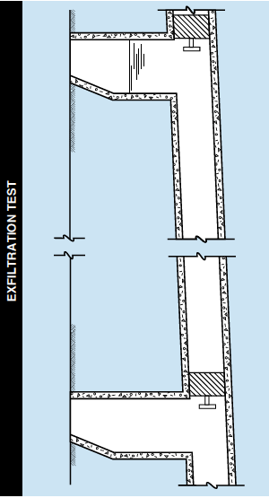
Field Testing: ASTM C 969
Standard Practices for Infiltration and Exfiltration Testing of Installed Precast Concrete Pipe Sewer Lines
Notes:
Exfiltration testing is done when ground water is not present. For exfiltration testing the pipe is filled with water a stand pipe (or manhole) is used to measure leakage and maintain head.

Slide 36
How to Protect your Interest with Inspection

