Slide 1
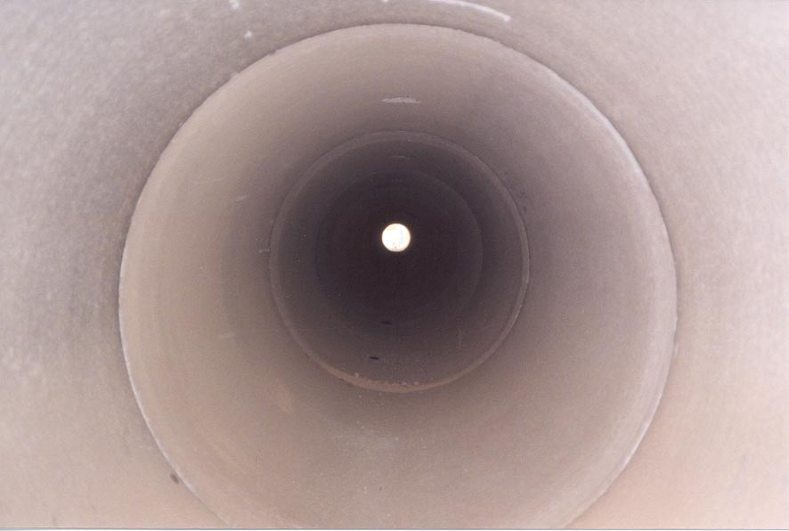
Evaluation Of Installed RCP
Notes:
Our discussions so far have focused on proper installation and important inspection milestones during the installation phase for RCP. My topic as you can see concerns the evaluation of RCP after the installation has been completed. The post installation evaluation phase may be right after installation and before acceptance of the installed pipe into the public system or may be completed many years after the initial installation. When ever the installed pipe is inspected and for what ever reason it is important that the evaluation criteria be correct and consistent to allow for proper decisions and actions to be taken.
I have shared what we feel are important attributes of RCP to DOT and Municipal Engineers, inspectors, contractors, many times over the past 15 years and on many of those occasions I ended my story with a challenge to the audience to simply go stick their head into some pipe. I explained there is no better way understand how the products they were specifying are performing than to see some actual pipe installations in operation. I was confident if they looked into RCP they would witness firsthand the strength, durability, and the toughness of RCP. Once they saw how RCP worked in real life situations they would be confident enough in our product continue to specify and or use RCP. I still believe these true life lessons are powerful and provide much better proof of product performance than some computer generated model or complicated formula to predict performance or service life.
For many years I thought my encouragements to engineers/inspectors to look at how installed pipe is performing was falling on deaf ears, all of a sudden in the past few years I am getting almost weekly request to help engineers or inspectors understand some of the issues they are seeing as they inspect installed pipelines. This give us an excellent opportunity to be a resource to our clients….

Slide 2
Why the Interest in Inspection of Installed Pipe?
= YES
= NO
Notes:
So what is causing my email to light up with request for help in evaluating installed pipe? I think I know but maybe to get you all thinking about this issue we can consider the following questions.…..we need you to participate and it will be reasonably painless… all you have to do is offer an opinion by using the red and green cards in front of you….green means yes…Red means no..here we go…
Q. - Is there or should there be a concern about the age and health of existing pipe systems in our communities and under our highways?
A. - Absolutely…many pipe systems in our nations roadways have been in the ground for well over 50 years, some pipe types were not ever expected to last even 50 years, for RCP we have a proven service life is 100 years but we certainly think periodic inspections should be completed to insure full anticipated service life is met.
Q. - Are more municipalities and DOT’s trying to establish worth/health of all existing assets?
- Yes it is important for municipal owners and DOT’s to understand where all of their infrastructure assets are located, confirm that the particular asset is operating properly, and if some maintenance or replacement is required. Good infrastructure asset management data must provide enough information to allow the owner to make informed asset maintenance decisions or immediately address safety concerns.
Q. - Are municipalities and DOT’s requiring more post installation inspection of newly installed pipe?
A. - Yes as of June of 2012 almost 70% of DOT’s are requiring some type of PII
So lets take a few moments to dig into the reasons for more pipe evaluation in a little more detail….

Slide 3
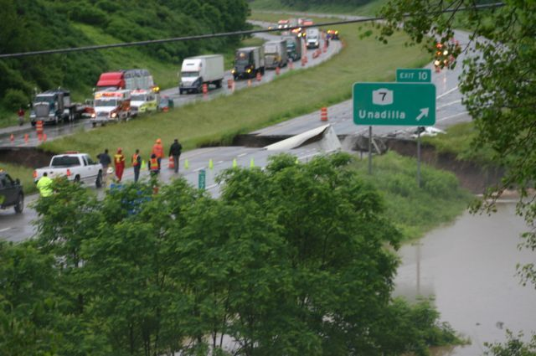
When the American Association of State Highway Transportation Officials (AASHTO) SPEAKS – Everyone Listens!
Notes:
AASHTO The American Association of State Highway Transportation Officials– The rule making & specification writing group of our nations DOT’s is placing more focus on both Asset management and system maintenance of all system infrastructure items.. The AASHTO Sub Committees on Bridge Design, Sub-Committee of Materials and Test, and most recently the Subcommittee on Construction have all have show significant interest in pipe inspection specifications or guidelines to address pipe inspection or maintenance of installed pipe.
Here is an example of how the work of these AASHTO Committees has ramped up the opportunities for more pipe inspection and evaluation….

Slide 4
PII Sweeping Across U.S.!
New Install Acceptance
WA
VT
ME
MT
ND
MN
NY
NH
OR
ID
WI
MA
SD
MI
RI
WY
PA
CT
IA
OH
NJ
NE
IN
IL
WV
DE
MD
NV
UT
CO
VA
CA
KS
MO
KY
TN
NC
OK
AR
SC
AZ
NM
MS
GA
AK
AL
TX
LA
FL
Notes:
In 2006 AASHTO Bridge Design Specifications added requirements for Post Installation Inspection to all three major pipe type specifications… and here is what has happened as a result:
Currently 2 out of 3 State DOT’s now Require some form of PII for acceptance of newly installed pipe(indicated by states that yellow and hashed)
1of 4 allow or require Advanced Inspection Tools for pipe Inspections (indicated by states that are hashed)
If you live and work in a “white” state or a state that is not currently involved with PII, it is still certainly important to be able to properly evaluate the health and condition of existing pipe systems to allow for proper asset maintenance decisions or make the proper decisions when you are simply involved in a road widening system and want to confirm the status of the existing pipe systems that needs to be extended to accommodate the proposed new lanes….We believe Asset management, maintenance of existing systems, and the performance history of installed pipe will become a more important part of FHWA requirements for states across the US as new federal funding programs are developed….it is important that DOT’s be trained in the proper evaluation of installed piping systems….
Our industry is certainly active in many areas with active PII programs. In many of the areas shown above we are asked to evaluate inspection videos and reports on an almost weekly basis. The opportunity to review PII reports and inspection videos has provided us with a unique opportunity to share our knowledge of RCP and our thoughts on reasonable evaluation of issues that commonly present themselves in installed RCP.
Our experience has proven that not only are the inspection process’s and tools important ….but one of the key components of any successful inspection program is the inclusion of good Evaluation Criteria guidelines for all pipe products.

Slide 5
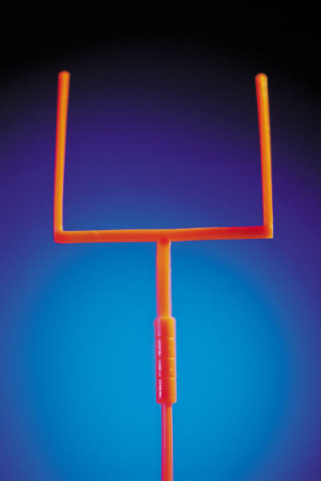
Notes:
It is to everyone's benefit that informed and proper decisions are made when issues of possible concern present themselves in inspection data.
It is imperative that the evaluator has good evaluation guidelines and tools so he or she can quickly differentiate between issues that are minor or simply aesthetic in nature from issues of structural or operational concern.
Our Goal for the rest of our discussion today is to provide you with information and tools to help you make a correct and informed decision for issues that may present themselves in future pipe inspection data or videos from your piping systems.
So lets get to the task at hand so the next time you stick your head inside a RCP you will have the correct expectation and better understand what you are looking at….

Slide 6
Before we start…give me your thoughts…
Notes:
Before we start our discussion on evaluation of RCP…what issues if any would you anticipate seeing in RCP if you were to take a critical look inside an installed pipe?
Anticipated answers… separated joints, cracks, fractures, joint damage, leaky joints
All correct answers and we will touch on many of those items today…

Slide 7
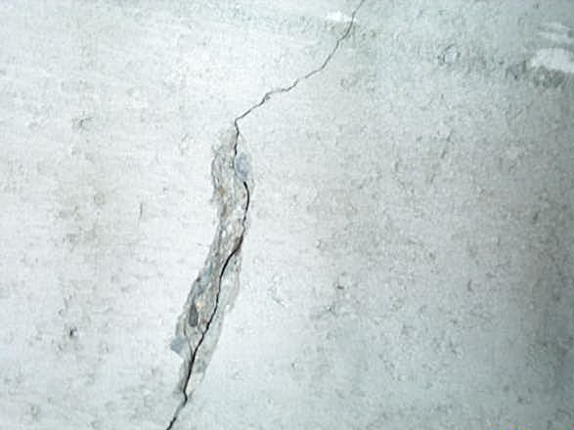
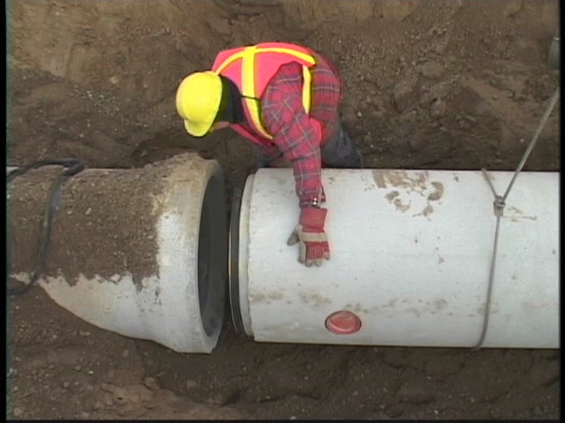
RCP Cracks & Joints:
Addressing The Challenges!!!
Notes:
In an effort to use today's time as efficiently as possible we will focus our thoughts on two popular evaluation topics for RCP:
Proper evaluation of cracks in wall of pipe or cracks near the points
and the evaluation components to confirm joint integrity
Over our century plus history with working with RCP both of these two issues have been thoroughly vetted and researched and we will attempt to share what we have learned about these important issues with you to help you better understand how to evaluate these types of issues when they present themselves.

Slide 8
ACPA - CRACK SCHOOL
“Knowledge is Powerful”
CRACK-A-PHOBIA
Vs
JAMAICA-PHOBIA
Notes:
Every crack is not a problem. For someone inexperienced in pipe evaluation it is easy to simply say all cracks are a problem. We would call this approach CRACKAPHOBIA. Crackaphobia leads to repairs that are not needed, higher future installation cost, unwarranted concern etc….
But to say no crack is a problem is also a costly & incorrect tactic we would call that approach to crack evaluation Jamaicaphobia – No-Problem-Man- aphobia…this approach of no crack is a problem may lead to decisions of not repairing a crack that needs repair and could lead to unanticipated maintenance or costly premature failure and replacements in the future.
Understanding the anatomy of crack formation and patterns are important to insure the severity of these issues are properly determined. The occurrence, function, and significance of cracks in RCP is often misunderstood, leading to unnecessary concern by engineers or inspectors.
The purpose of this portion of the presentation is to discuss why cracks occur and to define the significance of various Known crack patterns to long term durability.
.

Slide 9
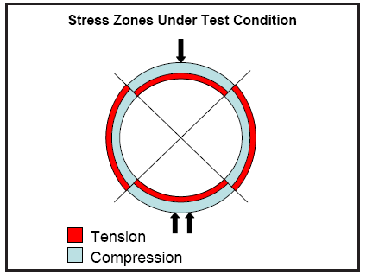
REVIEW OF BASICS! (get your Red and Green Cards)
Obvert
Invert
Notes:
So lets get started by looking at the forces in the pipe wall when a load is placed on the pipe…
When a load is placed on a RCP some portions of the pipe wall are placed in tension (areas in Red) and other portions of the pipe wall are placed into compression.
Few Questions Get your Cards Ready Again…remember Red = No Green = Yes
? - Is concrete easy to compress or crush?
A - No - hardened concrete is not easy to crush it is very strong in compression
? - Can concrete stretch?
A. - No hardened concrete is not flexible and it does not resist being pulled apart very well – concrete is weak in Tension
? - With the facts about how concrete works where would you expect to see a crack form in an RCP?
A. - In the Tension zones absolutely…
?. - Is it common for small cracks to form on the inside of the pipe at the top (obvert) and Invert of Pipe?
A. - Yes - it is very common to see small cracks form in these areas of installed pipe
?. - Last question = Does Steel reinforcement help RCP resist load and control cracks???
A. - Yes …lets look at that fact in more detail….

Slide 10
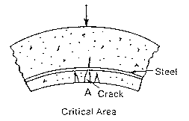
Role of Reinforcement in RCP
Role of Reinforcement?
Where is crack the widest?
Notes:
Reinforcement plays an important role in RCP with respect to cracking:
Our steel is strategically placed in the tension zones o accommodate the tension stresses and in doing so the steel helps the pipe resist the load without allowing the crack to extend through the pipe wall.
We expect to see some cracking in installed pipe and so should you…history has proven that most cracks in RCP will not impact the ability to transport runoff, will not impact the ability of the pipe to carry the soil and traffic loads, nor significantly reduce the anticipated service life of the installed pipe.
However, as stated earlier there are some cracks that can be of concern and we certainly want you to be able to recognize those when they present themselves…
So lets talk about how you can go about determining the severity of a crack found in an installed RCP .

Slide 11
Key Components of Crack Eval.
Pattern + Size= Severity
Notes:
Proper evaluation begins with being able to recognize certain common crack patterns, and then combining your knowledge about the pattern presenting itself with other signs of the extent of distress such as specific location of the crack and the width and length of the crack.
So lets begin with crack patterns….

Slide 12
CRACK PATTERNS,
Random crack
Longitudinal crack
  Radial Tension Sheer
Circumferential crack
“Star” crack
Pattern + Size = Severity
Notes:
Listed before you are common crack Patterns you need to understand when these are noted in the inspection documents or in your inspection notes.
Using the flip chart lets better define or explain how to identify each of the crack patterns….
Speaker use Flip Chart draw pipe and show and explain example of each crack pattern
We will discuss each typical crack pattern and note the general severity of the pattern, locations of concern with the pattern being discussed, and discuss acceptable crack sizes V crack sizes of concern that would lead for the need for remediation or further investigation.

Slide 13
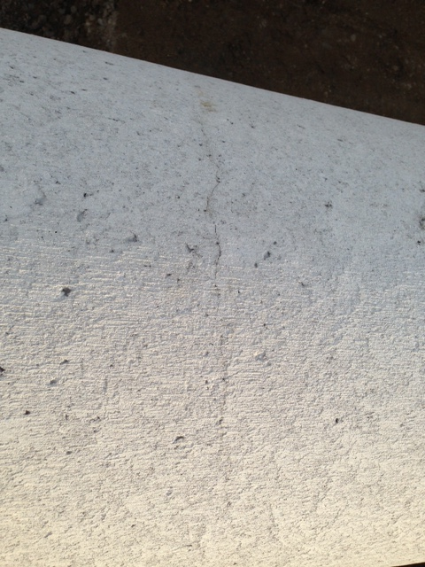
Pattern - RANDOM CRACK
Shattered safety glass or Single short crack:
  shrinkage/curing cracking
  surface cracks w/ no depth.
Significance - NOT A STRUCTURAL or DURABILITY CONCERN
Notes:
Random Crack Pattern of very small surface cracks are indicative of Surface Curing Cracks:
These Curing cracks Originate at the surface of the concrete.
These cracks typically occur during the curing process as moisture is removed from the pipe surface.
Typically these cracks are very small in width and very shallow in depth….so small neither width nor depth can even be measured in many cases…
Random - Curing cracks are of no structural or durability concern!

Slide 14
Pattern – Longitudinal Crack
Longitudinal Cracks:
  result of load on pipe
  Expected Location
    12 o-clock (obvert)
    6 o-clock (invert)
NOT Structural or durability Issue if only found at invert and obvert
Notes:
Longitudinal crack (cracks that run lengthwise in the pipe) are stress/load induced cracks.
Speaker go back to flip chart discuss crack location using clock time and explain invert, obvert, springline…..
Longitudinal cracks that are only in the invert and or top of pipe are typically very small (0.01” – 0.05”) in width and do not present any structural concern or durability or reduced service life concerns.

Slide 15
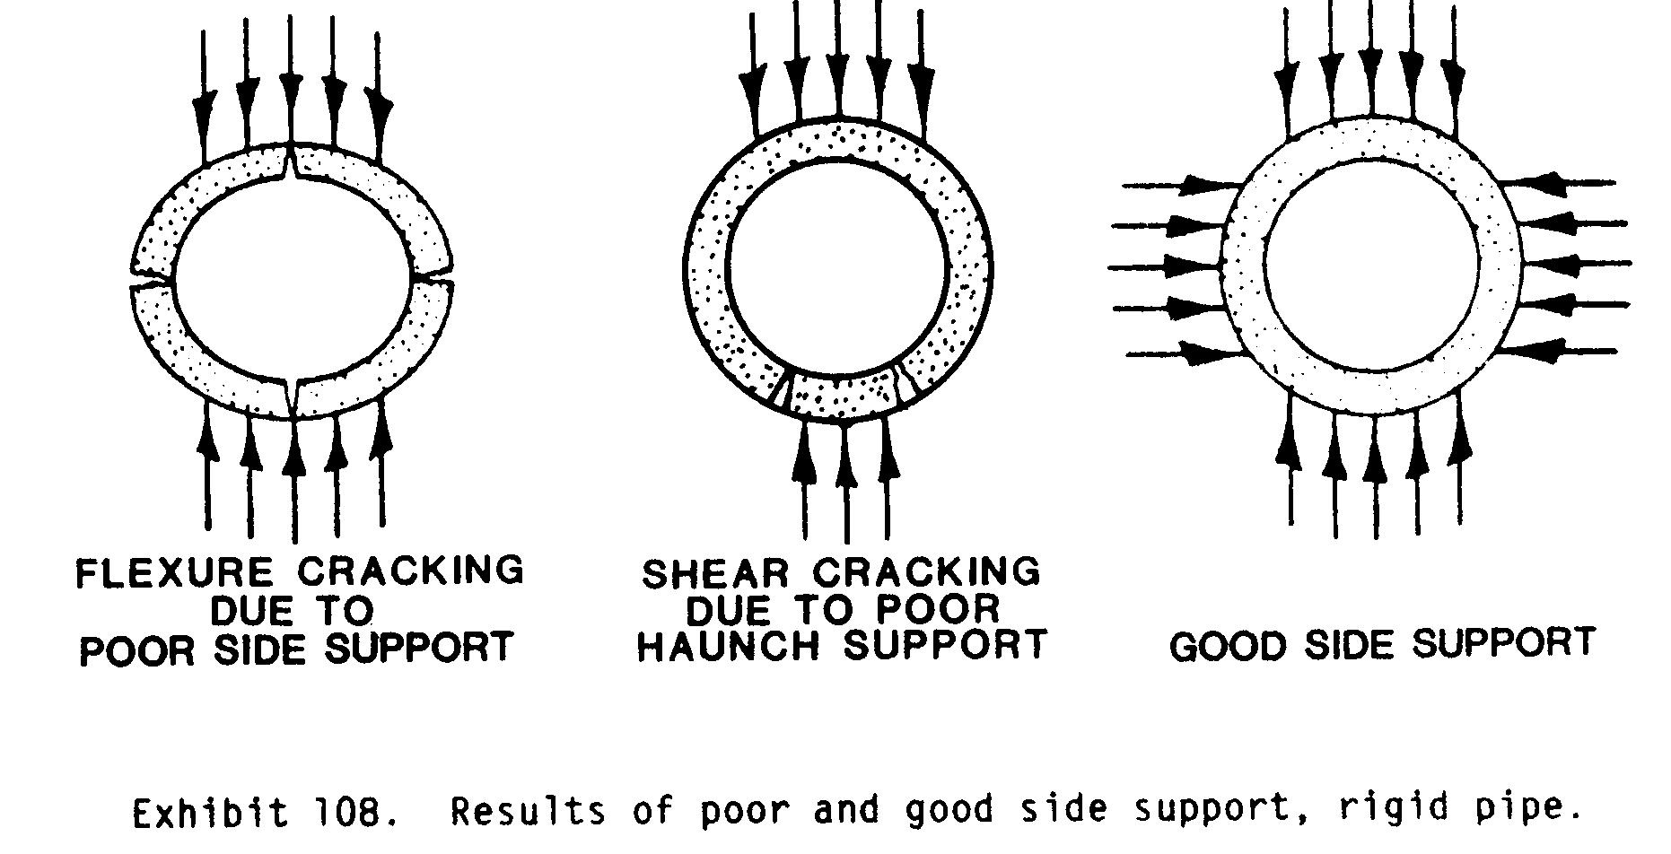
Longitudinal Cracks Locations…
Notes:
There are some longitudinal crack locations that can be cause for further investigation and possible remediation:
Longitudinal cracks present at all quarter points 12, 3, 6, 9 o’clock positions indicate a pipe that has been over - loaded beyond design load anticipated or has poor side support from the installation. Like the diagram shows if a pipe has cracks at all quarter points most likely some of these cracks extend through the wall. Typically new pipe installation with this crack pattern present would require remediation or replacement.
Longitudinal cracks at the 5 o’clock to 7 o’clock location, as shown in the middle diagram, should be thoroughly checked for any displacement across the crack, cracks in these areas may be caused by hard bedding, poor support in the haunch zone.. cracks in these areas with displacement are signs of radial tension shear (steel in so much stress it is trying to straighten out and may spall/slab off large sections of concrete over the steel)

Slide 16
Pattern - Radial Tension Sheer Cracks
  Cracks 30 deg off invert
  Slabs of concrete can become dislodged
  Slabbing is repairable
www.concretepipe.org
Notes:
The picture above is from a real project that experienced radial tension sheer. This particular installation had cover height of 35’, was a Type 1 install, Class IV strength pipe which by design should have worked without experiencing this type of structural distress…so what happened…foundation was solid limestone rock and bedding depth was 5-6” of ¾”-1” crushed stone. No mattress (very hard bedding)….large loads, pipe deformed and caused radial tension sheer….
Result…pipe found to be stable and all loose concrete was removed and steel cleaned and invert repaired and steel protected with polymer based grout and pipe is functioning properly today!
This condition is certainly one that needs repair. Repair is possible only after pipe has reached equilibrium and is no longer experiencing further deformation.

Slide 17
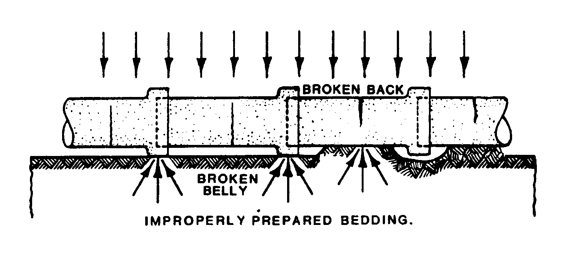
Pattern - Circumferential Crack
Circumferential:
Not of Structural Concern, but may need remediation if backfill can move through crack.
Notes:
Circumferential Cracks run transversely in the pipe.
These types of cracks can exhibit in various widths from less than 0.01” up to well over 0.10” in width.
When widest seen at invert indicates a “broken belly” (Soft area in pipe bedding/foundation). @ top of pipe = “broken back”( Hard area in pipe bedding/foundation)
Circumferential cracks are not of structural concern in most environments for the pipe wall, however, if a circumferential crack is wide enough to accommodate backfill into the pipe it would certainly require remediation.

Slide 18
Why are Circumferential/Transverse Cracks Not a Structural Issue?
Notes:
Our steel reinforcement cages are a combination of longitudinal spacing wires..(blue in diagram above), and the circumferential steel shown in red.
The circumferential steel is our pipes load carrying steel.
When a circumferential crack is present it only crosses longitudinals (non structural steel) or at worst affects or exposes one or two circumferential wires.

Slide 19
Pattern – Star Crack
“Star” Crack
  Severity depends on size of area, size of cracks
Star cracks with vertical offset or greater in width than 0.05” in acidic areas are candidates for remediation
Notes:
Concentric Circles, or a “star” pattern on surface indicates “impact damage”. If you see this pattern the pipe was damaged during handing, storage, or installation
Severity depends on size of area, size of cracks – May be detrimental to structure and durability
Severity depends on width/size of cracks, Concentric cracks with vertical offset or show signs of slabbing or extensive spalling along crack location or the cracks are greater in width than 0.05” in acidic environment are candidates for remediation

Slide 20
Key Components of Crack Eval.
Pattern + Size= Severity
Notes:
Now that we have a basic grasp of crack patterns and locations of concern lets look at crack size severity indicators..

Slide 21
HISTORICAL PERSPECTIVE
“Cracks up to approximately 1/16” (.0625) will not permit corrosion except under the most adverse conditions.”
  Repairing Reinforced Concrete Pipe, M.G. Spangler, Structural Engineering Handbook by Edwin H Gaylord Jr. and Charles N Gaylord, 1968.
Notes:
We have heard the question many times just how wide can a crack be and still not be a problem…in fact we have heard that question for almost a century….
In the late 1960’s one of our countries most well known authorities on RCP design and research, M.G. Spangler spoke on the width of cracks in RCP and concern of possible corrosion of the steel reinforcement… Spangler was confident that cracks in RCP up to 1/16” would not permit corrosion of the reinforcement except under most adverse conditions

Slide 22
Modern Day Crack Width Criteria
Pattern + Size = Severity
AASHTO section 27
  Cracks < 0.01 Noted but No Concern
  Cracks > 0.01
    evaluate to determine if detrimental
  Cracks >0.10
    In non-corrosive environments (ph>5.5) cracks up to 0.10” are considered acceptable
Notes:
A more modern commentary on crack size evaluation is found in Section 27 of the AASHTO LRFD Bridge Construction Specifications
The AASHTO standard for RCP clearly states cracks less than 0.01” are of no concern. Give Audience PERSPECTIVE – USE $1 Bill fold in half – explain that is width of 0.01”
AASHTO states Crack with width greater than 0.01” should be evaluated to determine if it is detrimental to the installation.
We suggest that the evaluation to determine if a crack is detrimental should include crack width, Crack Pattern (number and location of cracks) and other signs of structural distress.
The commentary in AASHTO about crack evaluation goes on to explain that cracks up to 0.10” are generally acceptable if the pipe is in a non-corrosive environment or an area with soil/storm water runoff with Ph exceeding 5.5…non-acidic
More Perspective…..pull out or ask for a dime from audience… explain one dime width = 0.05” therefore stack two dimes = 0.10”…

Slide 23

Crack Size – Eval. Guidelines
Concrete pipe is designed to handle controlled size cracks.
Cracks < 0.05” No Concern
Cracks > 0.05 inch Consider Pattern & Ph
Notes:
As stated a full evaluation of cracks should take into account size, pattern, location.
To make it short and sweet we believe both Mr. Spangler and AASHTO provide reasonable crack criteria guidance we would even suggest a slightly more conservative approach for new installations. We would simply say crack widths of up to 0.05” in width (width of a U.S. Dime) are of no concern and really need no further investigation.
Cracks having crack width greater than 0.05” up to 0.10” in width are candidates to be remediated if the pipe is in a corrosive environment or if certain crack patterns present themselves.

Slide 24
PUT IT ALL TOGETHER
Patterns + Size = Severity
Random crack – no severity
Concentric crack – size or offset
Longitudinal crack – location ,offset, size
Circumferential crack – soil migration
Notes:
Random Curing Cracks are shallow Surface Cracks , are cosmetic, are no problem, and no remediation required
Concentric Cracks Pattern is rare, not any issue of concern unless they exceed 0.05” in width or have displacement evident across the crack plane. Repair if > 0.05” and in a corrosive environment or cracks exhibit displacement or spalling
Long. Cracks
Not structural concern @ Invert & obvert and crack sizes < 0.05”
Cracks in all four quarter Points = remediate new pipe – requires evaluation of older pipe
Seal cracks larger than 0.05 and Ph less than 5.5
Remediation needed for cracks larger than .10”
Circumferential Crack
Not structural concern
Repair If greater than .10’ or allows transport of backfill

Slide 25
Examples and Application
Stick our Head into some Pipe!
Make Application of Crack and Joint Evaluation
Discussion and Questions
Notes:
Speaker should pass out Joint and Crack Matrix sheets to all attendees and walk them through the following examples….
Please take out the Crack Evaluation Matrix and Red and Green Cards again and lets work through some real life evaluation situations…

Slide 26
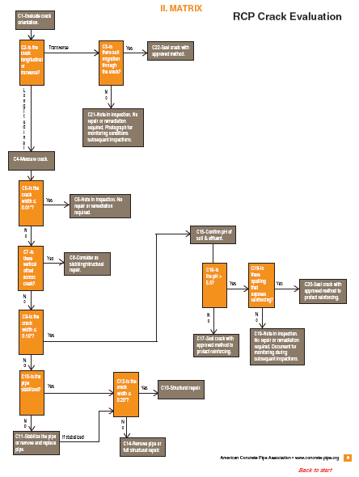
Notes:
The Crack Matrix generally follows the thought process we went through in the earlier part of our discussion today…and is taken from our “Post Installation Evaluation and Repair Guidelines of Installed RCP”…

Slide 27
“Post Installation Evaluation and Repair Guidelines of Installed RCP”
Text Book
Notes:
Our “Post Installation Evaluation and Repair Guidelines of Installed RCP” (nicknamed RCP Eval. Guideline) is a great tool for evaluation of installed pipe…we will discuss this tool in detail later in the presentation but the main resource in this document is the decision matrix for Cracks, Joint Evaluation, and the slabbing and spalling decision matrix….as the user moves through any one of the decision trees the user will end up with an answer of whether repair is needed or not for the given situation under consideration….

Slide 28
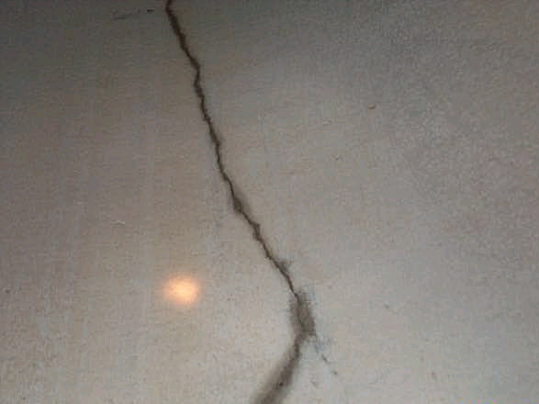
1st Example = Longitudinal Crack

Slide 29
Practice Makes Perfect…..
Using Crack Matrix…
  Longitudinal crack (C2)
  Crack at Invert 6 o-clock and 12 o-clock
  Crack width = 0.08” (C9)
  Soil Maps indicate Ph = 4+/- (C16)
Any Action to be taken?
Notes:
(Speaker should walk attendee through use of Crack Matrix;
Crack Type, Crack Location, Crack width, Soil condition, ……etc to help them learn how to utilize Crack Matrix.)
Is the pattern or location a concern? No it is an anticipated pattern for long. crack
Is the size an issue…Yes and No it depends…..on environment – acidity…
Is the Ph an issue of concern? Yes – Ph less than 5.5 is acidic
Should the crack be remediated? Yes…due to crack size greater than 0.05 and acidic condition the crack should be sealed to protect the steel.

Slide 30
Answer…
  Yes - Seal Crack to protect steel and insure anticipated service life….(C17)
  See Crack Repair Procedures..
Cautions about wet v dry cracks
ZOOM issues
ACTUAL Accuracy
Notes:
Just as a side note….few things to be cautious about when reviewing CCTV Video’s…things are not always as they appear…the photo is question is a good example that shows a small crack can look rather large when they are wet….the actual width of crack will be signifigantly less than what is indicated by the wet area in the vicinity of the crack edge.
Also the CCTV cameras can zoom in for a very close view of the crack or any other anomaly found in the pipe. It is very easy for the untrained eye to loose perspective…in other words if you do not know the amount of zoom and there is no measurement provided it is almost impossible to determine width of a crack, I find it mush easier to evaluate with no zoom in video, be able to see the crack pattern, and when possible the reported crack to be accompanied by a measurement in the report document. If I see measurements smaller than 0.05” I certainly get very interested in what equipment they are using…and how they determined crack width..
I mention 0.05” in width for couple of reasons…in our experience, cracks less than 0.05” pose very little issue of concern as previously discussed, and we have found it is next to impossible with the current video micrometers to provide repeatable accurate crack width measurements less than 0.05”. It is very difficult to obtain accurate data for cracks less than 0.05” in width for a multitude of reasons but mostly simply because of hand eye coordination of operator.

Slide 31
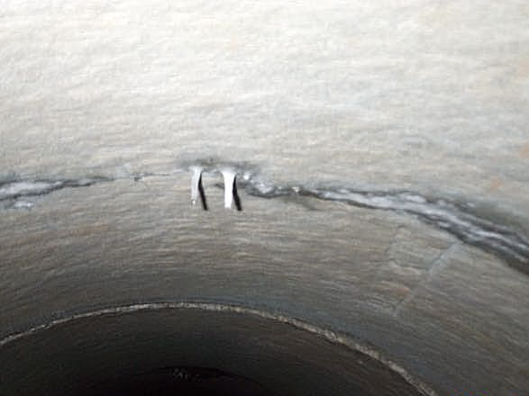
2nd Example = Transverse/Circumferential Crack

Slide 32
Practice Makes Perfect…..
Take out Crack Matrix…
  Transverse - Circumferential crack (C2)
  Mid pipe from 3 o-clock to 9 0-clock
  Crack width = 0.04”
  No sign of soil migration (C3)
Any Action to be taken?
Notes:
Lets use our crack matrix to see what action if any is needed…
Is Pattern a concern? No - typically Circumferential crack pattern in itself is not of structural concern.
Is width of crack any concern? No – 0.04” very small crack, probably not through the wall…
Any Migration of backfill? No –
Is there any Action to take for this issue? No

Slide 33
Components of Joint Evaluation
= YES
= NO
Notes:
Before we discuss the subject of joint evaluation lets see what you already know….
Get your Red and Green cards in hand
Q. - Is it important to know what is required in the specifications about the pipe joints and jointing procedures?
– Specifications will/should specify joint performance requirements, may even specify max internal joint gap allowed….so yes you must have knowledge of joint specs to properly evaluate installed pipe joints.
Q. – Is soil tight joint performance criteria a popular choice for storm pipe systems…
– Yes soil tight and silt tight are the two most common performance criteria for storm pipe
Q. – does soil tight or silt tight joint performance criteria require a proof of design test at the plant?
– Soil Tight = No Plant Proof of Design, Silt Tight Requires 2.5 psi plant proof of design test.
Q. – would silt tight joint seal material normally be some type of rubber gasket?
- Yes most silt tight designs utilize a rubber gasket however it is possible to provide silt tight joint with butyl mastic sealant and an exterior joint wrap if proof of design provided….
Q. – would it be unusual to see a requirement for leak resistant joint performance in coastal areas?
– No, it would be expected to see leak resistant joint performance required for installations in sandy soils and high water table conditions…don’t forget Leak resistant performance requires plant proof of design tests and proof of installation field tests to confirm allowable leakage is not exceeded in any line segment.
Q. – Do you need manufacturers allowable joint gap criteria to evaluate joints…
– Yes each manufacturer should be able to provide allowable joint gap for each performance criteria and joint design the provide…
Some owners work with local producers to agree upon a joint gap criteria to place in the specifications and if this is done there would be no need to obtain allowable joint gap criteria from each manufacturer…joint gap should be based upon performance criteria….leak resistant gap v soil tight gap criteria should not be the same

Slide 34
Joint Evaluation Made Simple
Notes:
Any joint evaluation would utilize you expertise or knowledge of
Required/Specified Joint Performance? Each of the different Performance requirements require different evaluation criteria
Acceptable Joint Gap present at joint based upon Allowable Gap Criteria established by owner based upon specification requirements matched to the required performance or proof of design allowable gap information provided by manufacturer/supplier
Infiltration of water and or soil backfill
The Severity of damage in the area of the joint sealing surface such as Cracks/Chips/spalls

Slide 35
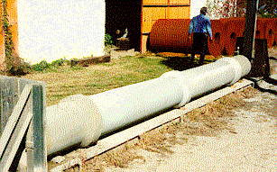
Manufactures Allowable Joint Gap?
Notes:
Every Producer should be able to supply their proof of design test For each of the joint performance criteria's when proof of design is required.
There are many RCP joint designs so every manufacturer may have different joint gap criteria for each type of joint configuration he has available and the gap requirements will vary based upon Joint performance requirements, pipe size, type of joint materials used…these joint gap criteria should be a job by job type submittal …as an engineer or inspector you should have these for every project. The manufacturers gap criteria will be established through a combination of joint design and plant proof testing….
Best way to get a grasp on Joint evaluation is to work through a couple of examples……

Slide 36
Joint Evaluation Matrix
Notes:
To get your input and help in working through our examples please get your Joint Evaluation Matrix and your red and green cards ready….and lets review a couple of

Slide 37
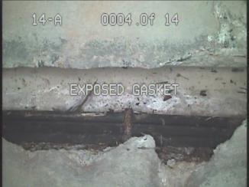
Given Information:
Joint Performance = Soil Tight
Condition - chipped area at joint
Joint Gap less than manuf. Allowances except for the area of chip
Vertical Offset = no
Primary steel Exposed – yes ( J2 )
Action Required?
Notes:
We can use our Soil Tight Joint Matrix to review the extent of the severity for this given situation and determine what action should be taken.
Speaker - Walk Students Through Joint Matrix
J2 is there spalling or chips that expose primary steel – Yes
J3 – Repair and Seal joint is action to be taken…
Lets think a little deeper and review what we have learned about joints and joint performance
Answer the following questions by holding up your red and green cards….
Manufacturers joint gap tolerance for soil tight storm drain pipe could be 1” or more. Yes…would not be uncommon for larger diameter pipe with longer robust joints could be published and perform well at a gap of over 1”…
Is the exposure of primary steel a concern? Yes…exposed circumferential load carrying steel if compromised could allow further damage and allow backfill
To migrate into pipe and cause loss of support for road structure above pipe or interup flow through the pipe an cause up stream flooding.

Slide 38
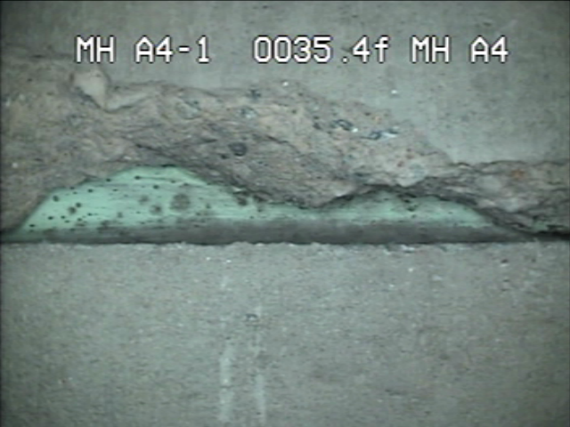
Is Steel Exposed (J2)? = No
Silt Tight (J5) Application? = Yes
Infiltration carrying soil (J9)? = No
Is Joint Gap less than Manufacturers recommendation? Yes = (J11)
Vertical offset (J13)? = No
Cracks Greater than 0.10 (J15)? = No
Action Required?
No - No Action Required (J17)
Notes:
Walk students through the joint matrix…J2 – J5 – J9 – J11 – J13 – J15 – J17 No Action or repair needed….

Slide 39
Evaluation Tools are Available!
Notes:
We have covered a lot of ground during this presentation and we know proper and confident evaluation of installed pipe takes product knowledge, and some level of experience and training.
Over the past several years ACPA has tried to make several evaluation resources available to the engineering and pipe inspection communities to allow users to be able to borrow from our experience and history to be able to confidently evaluate situations they may find and need to evaluate in installed RCP.

Slide 40


Evaluation Tools
Notes:
We have evaluation guidelines developed for field engineers to allow for quick adjudication of common issues that may be dioscovered during a pipe inspection. Located on Home Page of ACPA Website
We have cliff notes versions, Readers Digest, and text book versions of evaluation tools available for your use.
All of the information about cracks and joint integrity evaluation as well as other important topics are covered in these documents.
“Evaluation Guidelines for New Drainage Pipe” is the cliff notes version of Evaluation and can be used a guideline document to evaluate the most common storm drain pipes available and in common use today.
“Sample Specifications for Evaluation of Newly Installed Culvert and Storm Drain Pipe” is our Readers Digest length document on pipe evaluation. It was written to allow it to be used in technical specifications or as a fairly detailed field guidance document to evaluate installed storm pipe.
Our Text book version of pipe Evaluation of RCP is titles “Post Installation Evaluation and Repair Guidelines of Installed RCP” (nicknamed RCP Eval. Guideline)

Slide 41
“Post Installation Evaluation and Repair Guidelines of Installed RCP”
Text Book
Notes:
Our Test book version of pipe Evaluation of RCP is titles “Post Installation Evaluation and Repair Guidelines of Installed RCP” (nicknamed RCP Eval. Guideline)

Slide 42
Contents
Background on RCP Loads, Design, Structural Confirmation, & Joint Performance
www.concretepipe.org
Notes:
The Eval Guideline contains background discussion of RCP Load, RCP design concepts, Structural confitmation testing, and full discussion of joint integrity.

Slide 43
Contents
Background on RCP Loads, Design, Structural Confirmation, & Joint Performance
Decision Matrix
  Crack Evaluation & Repair
  Joint Evaluation & Repair
  Spalling and Slabbing Evaluation & Repair
www.concretepipe.org
Notes:
The key portion of the eval. guideline are the Three Evaluation Decision Matrices for Crack Evaluation, Joint Evaluation, and Slabbing and Spalling …you all have a good feel now for the contents of two of these matrix…the crack eval and joint eval matrix which we used in our example problems earlier today….

Slide 44
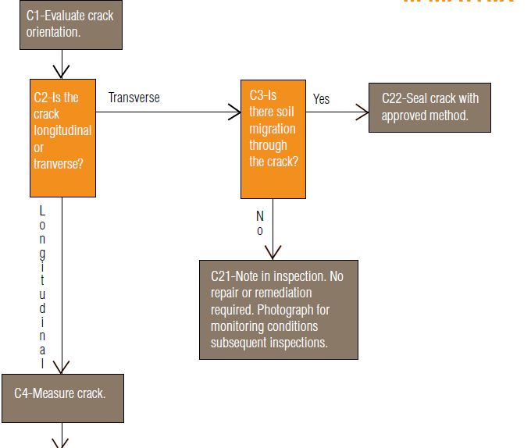
INTERACTIVE
Notes:
The Eval Manual is an interactive electronic document….in other words if you are working on a crack evaluation and utilizing our crack eval matrix you can click on any question or answer on the matrix and you will be taken to that part of the document that discusses that very specific topic in question.
As example if you click on C-3 Is there soil migration through the crack…..

Slide 45
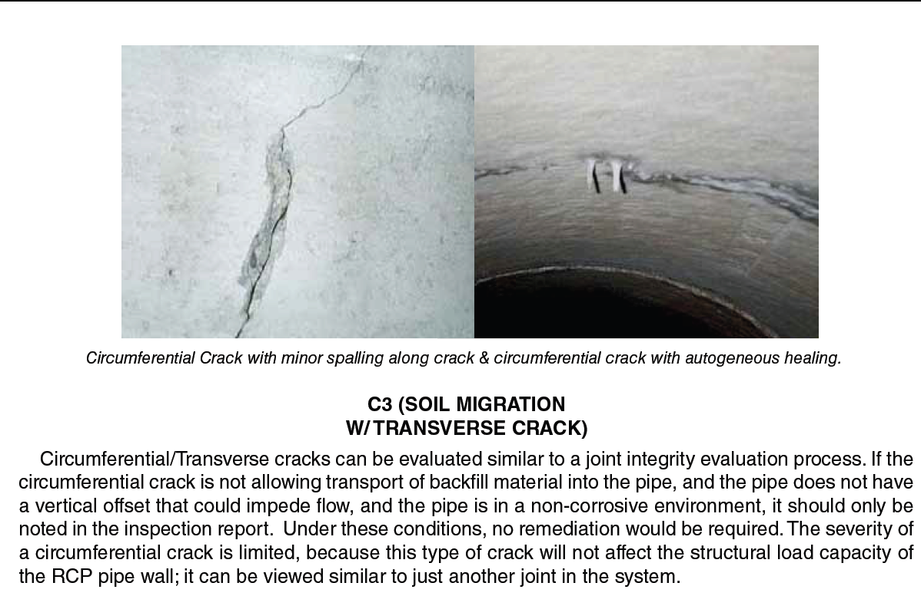
Notes:
You are immediately taken to the portion of the manual that discusses soil migration through cracks….when finished reading this information you can toggle back to the matrix….

Slide 46
Notes:
The Crack Matrix follows the thought process we went through in the earlier part of our discussion today…

Slide 47
New National Guidelines Available….AASHTO Const.
Pipe Inspection and Evaluation Guidelines are available from AASHTO Subcommittee of Construction
Notes:
An excellent guideline has been developed for Pipe Inspections and Pipe Evaluation by the AASHTO Subcommittee of Construction.
Covers the criteria for inspection requirements for installed pipe, inspection methods and tools, report requirements, and evaluation and acceptance criteria for all pipe types! This is a great read and a good model for the development of inspection and evaluation specifications.

Slide 48
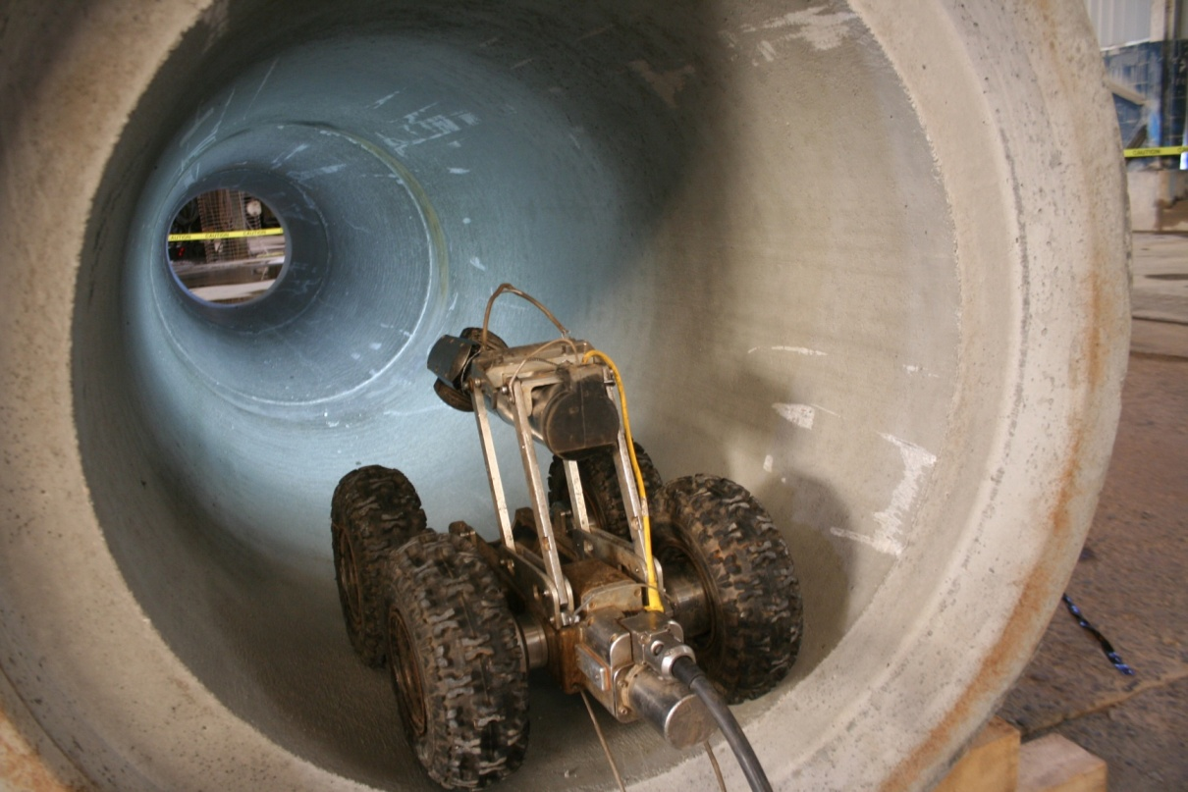
DON’T TAKE THIS THE WRONG WAY, BUT…
GO STICK YOUR HEAD IN SOME PIPE!!!!!
GO STICK YOUR HEAD IN SOME PIPE!!!!!
Notes:
We hope our discussion of RCP has been helpful and the tools we have presented and made available will assist you on occasion when you need to evaluate an installed RCP….
We are happy to answer questions at this time. And we stand ready by phone or email to answer any evaluation or inspection question you might have…let us be a resource for you…
As we close out our thoughts on the evaluation of RCP …It is important to note that the design, installation, inspection techniques, and evaluation criteria are unique for each of the different pipe types available for use in today's storm drain market. Time would not permit us today to cover all the differences between flexible and rigid pipe or even discuss the evaluation techniques for the other pipe types, but if you are interested we certainly can discuss these at a later date if you would like.
Now – I end this presentation like I have many times before with a request for you to Go Stick your head in some pipe!

